Slide 1
Supporting Grieving Students
Presenters:

Slide 3
Objectives
Distinguish: Loss, Grief, Mourning and bereavement
Examine how children deal with loss
Life Without (New Normal)

Slide 4
Vocabulary Quiz
Loss
Grief
Mourning
Bereavement
Sorrow
Notes:
Loss = Any separation from a person, place, thing, or activity to which we have become attached and with which we find an important part of our identity and sense of self.
Grief = The normal and natural emotional reaction to loss or change of any kind.
the feeling of reaching out for someone who’s always been there, only to discover when I need her [or him] one more time, she’s no longer there.”
Bereave/Bereaved = To deprive someone of something/ the state or fact of being bereaved or deprived of something or someone
Bereavement = A period of mourning after a loss
Mourning = Mourning is a feeling and period of sadness after a loss. (noun)
Mourn = Express grief or sorrow
Sorrow = a feeling of great sadness or grief, often caused by loss or disappointment.

Slide 5
Loss
Any separation from a person, place, thing, or activity to which we have become attached and with which we find an important part of our identity and sense of self.
List examples of loss
Notes:
Loss = Any separation from a person, place, thing, or activity to which we have become attached and with which we find an important part of our identity and sense of self.
Grief =

Slide 6
Activity: Losing something important” How Do You Feel?
Like you couldn't believe it?
Were you angry with yourself or someone else?
Did you feel sad that you had lost something?
Were you sorry that you didn't look after it more?
Were you afraid that someone might blame you?
Did you blame yourself for losing it?
Like you couldn't think about anything else?
Like nothing would ever be the same again.?

Slide 7
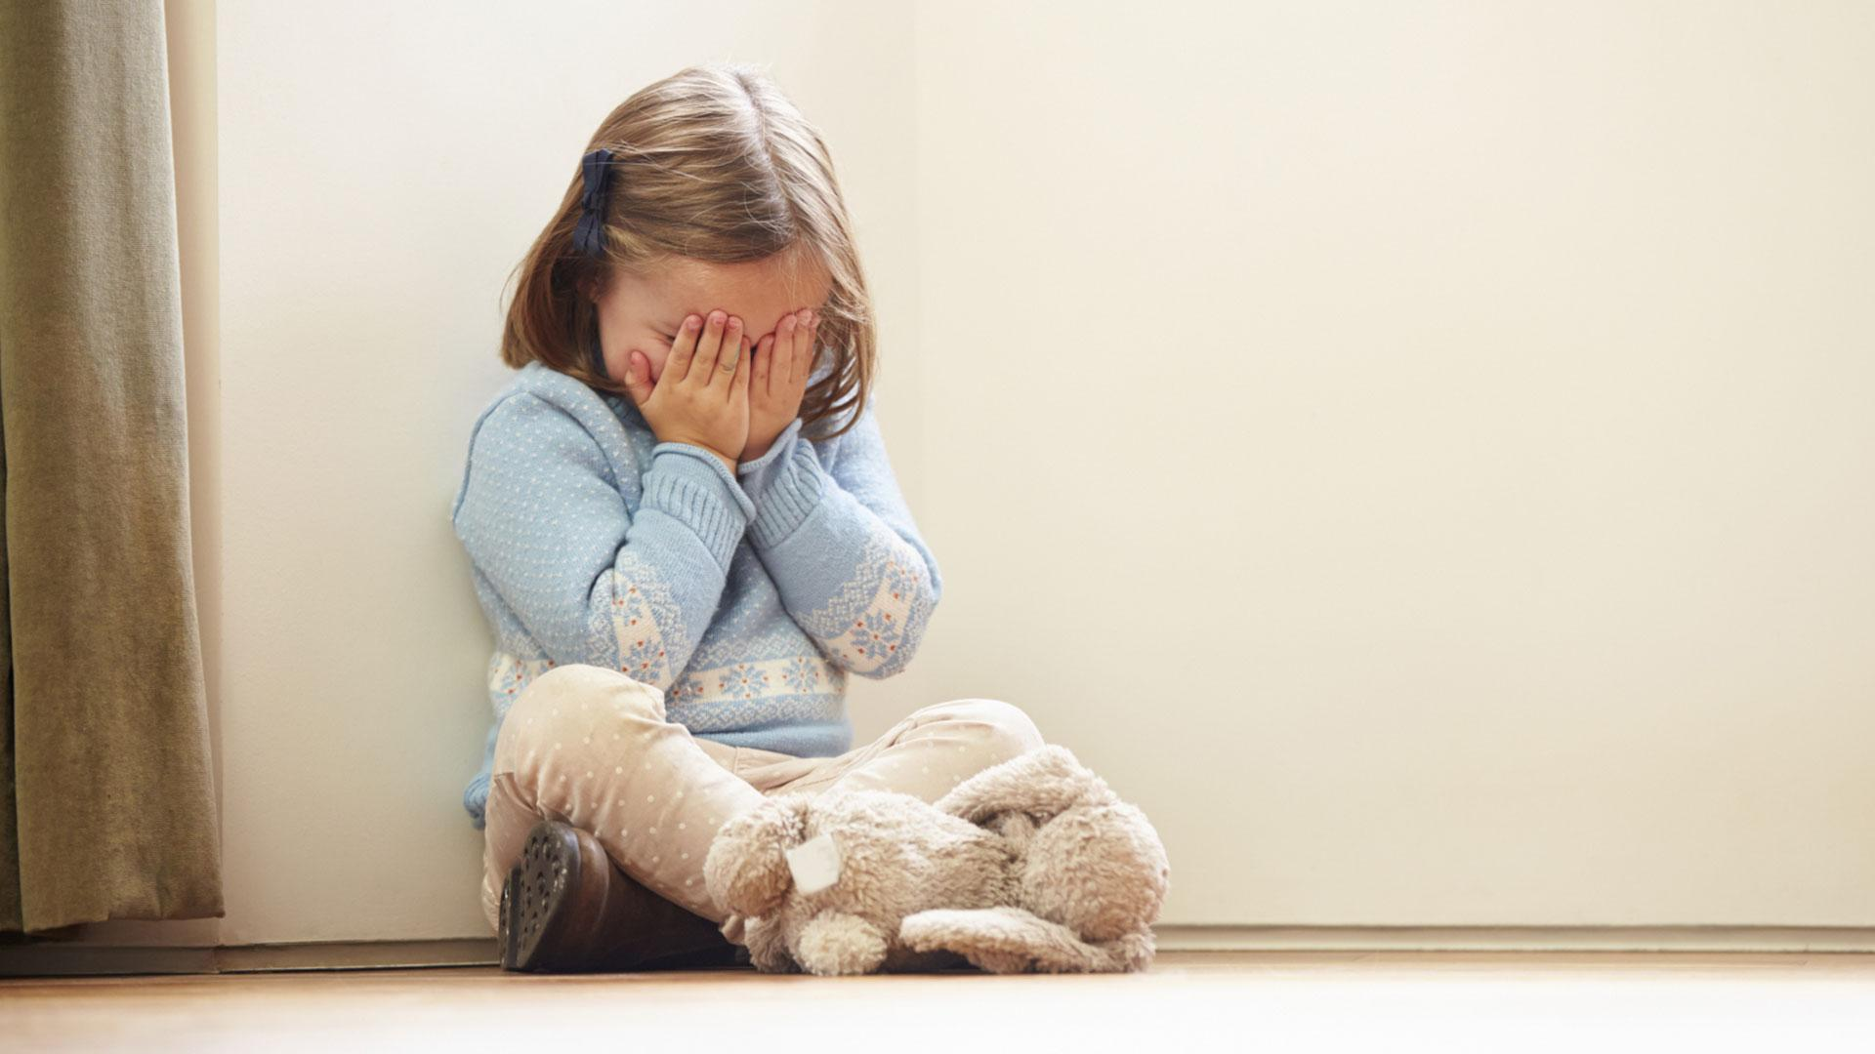
Grief

Slide 8
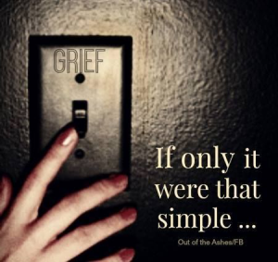
Grief
Grief = The normal and natural emotional reaction to loss or change of any kind.

Slide 9
The Unavoidability of Grief
By good rights I ought not to have so much
Put on me, but there seems no other way.
Len says one steady pull more ought to do it.
He says the best way out is always through.
And I agree to that, or in so far
As that I can see no way out but through—
Robert Frost/ Poem ~ A Servant to Servants
Grief: The only way out is through.
Facing the grief is better than running. Don’t hide from the pain. If you do, it will fester and grow and consume you.
Notes:
Facing the grief is better than running. Don’t hide from the pain. If you do, it will fester and grow and consume you

Slide 11
Types of Grief
Anticipatory grief
Normal grief
Delayed grief
Complicated grief (traumatic or prolonged)
Disenfranchised grief (ambiguous)
Collective grief
Chronic grief
Cumulative grief
Masked grief
Distorted grief
Exaggerated grief
Inhibited grief
Secondary losses in grief
Abbreviated grief
Notes:
Everyone has an idea of what they expect grief to look or feel like. But, did you know that there are many different types of grief?

Slide 12
The 5 Stages of Grief and Loss
Denial and isolation;
Anger;
Bargaining;
Depression; and
Acceptance.
People who are grieving do not necessarily go through the stages in the same order or experience all of them.

Slide 13
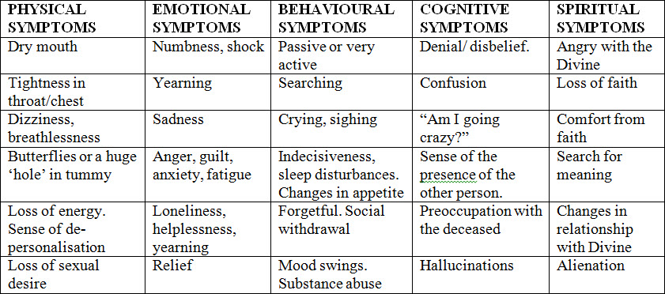
Manifestations of Normal Grief

Slide 14
Grief and Cultural sensitivity
What emotions and behaviors are normal grief responses within the person’s own culture?
What are the bereaved family's beliefs surrounding death?
Who should attend mourning ceremonies, and how are attendees expected to dress and act?
Are gifts, flowers, or other offerings expected?
What special days or dates will be significant for the bereaved family?
What types of verbal or written condolence are expressed?

Slide 15
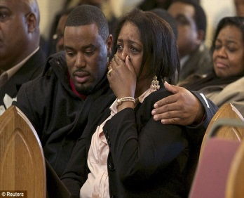
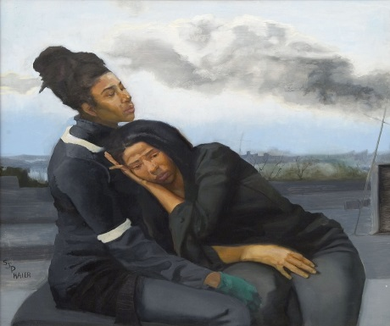
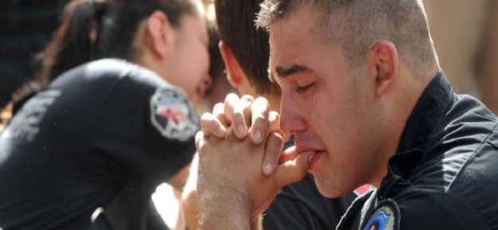
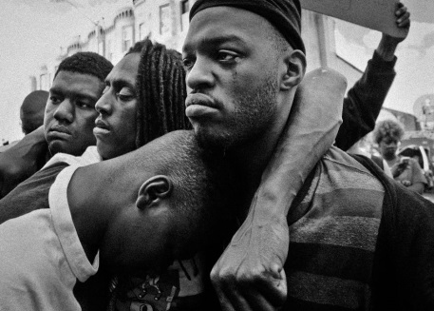
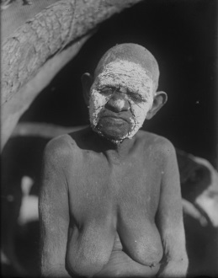
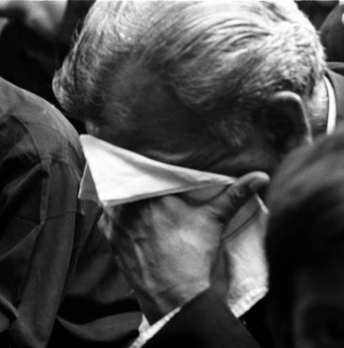
Mourning
The outward expression of grief due to loss
Mourning = remembering with care
Notes:
Mourning is grieving gone public.

Slide 18
Bereavement
The period after a loss during which grief is experienced and mourning occurs.
Originates from the word “reave,” meaning "to be dispossessed" or “to be robbed.”
It also means “to be torn apart” and “to have special needs.”
Bereavement initiates grief, and grief tries to instinctively convert to mourning.
Notes:
Bereavement: originates from the word "reave," meaning "to be dispossessed" or "to be robbed." It also means "to be torn apart" and "to have special needs." When you experience the death of someone loved, you are dispossessed of something very precious to you. Bereavement initiates grief, and grief tries to instinctively convert to mourning. The experiences of grief and mourning alert compassionate people around you that you have special needs that call for support and comfort.

Slide 19
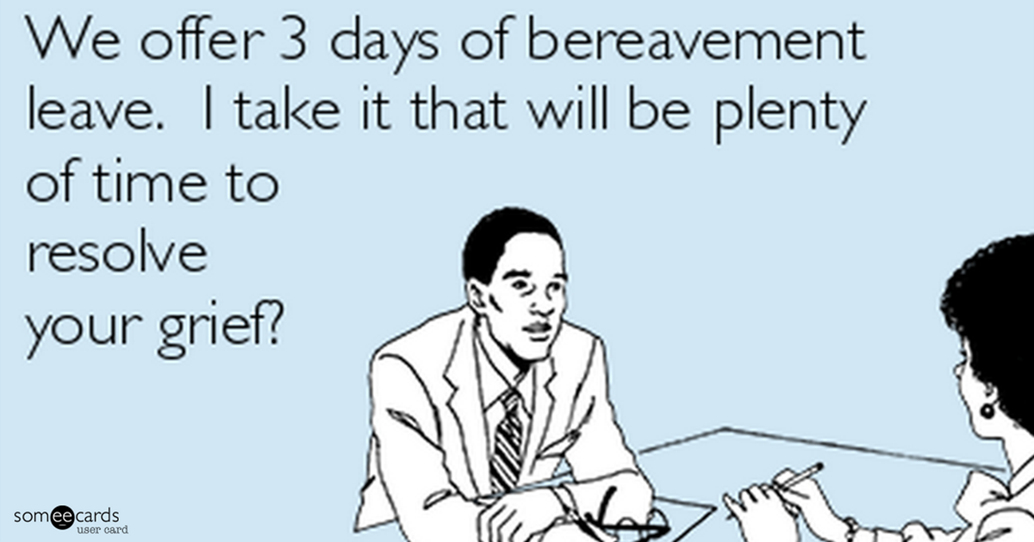

Slide 20
Children and Loss
Loss
Grief
Mourning
Bereavement

Slide 21
Children and Loss
Death of a pet
Death of a grandparent
A major move
Divorce of the child’s parents
Death of a parent(s)
Death of a playmate, friend, or relative
Debilitating injury to the child or someone important in the child’s life
Notes:
Though the majority of children don’t experience severe losses while young, loss in childhood is common and includes the following (in order, starting with the most likely to occur):

Slide 22
Sometimes you lose
Confidence
Health
Pets
People
Friends

Slide 23
Divorce
Physical Loss: Broken Family
Loss of a sense of safety
Notes:
After a loss, a family or individual tries to return to life as they knew it before the death of a loved one, but they find, of course, that it's impossible. This life after loss, the survivorship itself and how the survivor lives that life, is "New Normal."

Slide 24
Secondary Loss
Changed Relationships
Change in Lifestyle
Change in Peer Group
Change in plans for the future
Decreased sense of security and safety

Slide 25
Hidden Loss
Loss of Trust,
Loss of Safety
Loss of Control
Notes:
After a loss, a family or individual tries to return to life as they knew it before the death of a loved one, but they find, of course, that it's impossible. This life after loss, the survivorship itself and how the survivor lives that life, is "New Normal."

Slide 26
Three Questions
1. Did I cause this to happen?
2. Will it happen to me?
3. Who will take care of me now? (or if something happens to my surviving caretaker)?
Notes:
As with adults, ⁸⁸ a number of common themes emerge in bereaved children, typically associated with or underlying feelings of sadness, rage, fear, shame, and guilt.
There are at least three questions, whether directly articulated or not, that will occur to most children following a loss:
Did I cause this to happen?
Will it happen to me?
Who will take care of me now (or if something happens to my surviving caretaker)? It is important to provide answers to these questions and to hear how the child understands those answers, because misunderstandings may give rise to feelings of anger or fear.

Slide 27
Four concepts of Death
Death is irreversible.
2. All life functions end completely at the time of death
3. Everything that is alive eventually dies
4. There are physical reasons why someone dies.
Notes:
Children must understand these concepts about death.

Slide 28
Special Times Loss
Holidays
Birthdays
Moves to a new grade or school
Celebrations
Awards, graduations, recognition
Rites of passage: a. first bicycle, b. first job, c. first date

Slide 29
Children and Grief
Loss
Grief
Mourning
Bereavement

Slide 30
Children and Grief
1) Children of all ages experience grief.
2) Children tend to grieve differently than adults.
3) Children “grow up” with grief, revisiting it at each developmental stage, understanding it in new ways the older they become.
4) Children can be forgotten in their grief, especially when surviving parents, siblings or grandparents are grieving too.
Notes:
1) Children of all ages experience grief.
Though in the past it might have been argued that a child needs to be able comprehend death and loss in order to experience grief, we now know that’s just not true. In fact, now we know that even very young children will experience grief when they lose someone very near and dear to them, especially a caregiver. Infants may become inconsolable or colicky, toddlers may have trouble sleeping or behavioral distress, and preschoolers may talk incessantly about the deceased, fully believing their loved one will return. Young children will especially be affected if their caregiver is grieving, picking up on their parent's distress and feeling it themselves. Yes, no matter how young the child, if she is old enough to love, she is old enough to experience grief.
2) Children Grieve Differently Than Adults
There are over 100 acknowledged grief symptoms, and most people (children and adults) experience their own unique symptoms of grief. However, the pattern of grief in adults tends to be more of a sustained emotional experience than is for kids. Children’s grief symptoms can include intense feelings, but they tend to “come and go,” with periods of intense grief symptoms followed by periods of apparent happiness and well-being, often all within the same day.
3) Children tend to “grow up” with grief, revisiting it as the brain develops.
As the brain develops and matures, comprehension of death and loss increases. This is why grief can feel like it randomly “comes and goes” with kids. Their younger brains can be “protective” in times of loss, helping them move on easier than adults who fully comprehend the finality of death. However, “mourning for a childhood loss can be revived at many points in life, especially when important life events reactivate the loss.” [2] Times of stress (school, friends, or family stress) can bring out grief symptoms and reactions. The teenage years are another vulnerable time for experiencing grief, as abstract thinking develops and hormones hit. And some may experience only minor grief symptoms in childhood, but won’t experience major grief symptoms until they are adults and they can fully comprehend the loss. The important thing is to recognize that, no matter how or when it happens, grief will eventually hit and will need to be experienced in order to heal.
4) Children can be forgotten in their grief, especially when surviving parents, siblings or grandparents are grieving too.
Grieving parents may not be able to help their children through grief. Often, when a child dies, the surviving siblings are left to cope on their own, feeling lonely and afraid. Parents don’t intend to forget their children’s grief, but it does happen often. Also, well-meaning, attentive adults might see a grieving child playing or laughing and make the mistake of thinking they are “fine” or “over” their grief. This can have an impact on the type and amount of help and support a grieving child receives. It is therefore important to involve as many adults with the child as is helpful and necessary to get his or her needs met. School teachers, church leaders, friends, and extended family members can all play the role of watching the child for grief symptoms, providing support and encouragement, and loving the child through this difficult time.

Slide 31
Video : Backdraft

Slide 32
Myths About Child Grieving
1: Grief and mourning are the same experience.
2: A child’s grief and mourning is short in duration
3: There is a predictable and orderly stage-like progression to the child’s experience of grief and mourning.
4: Infants and toddlers are too young to grieve and mourn.
5: The grief and mourning of adults surrounding bereaved children doesn’t have any impact on them
6: The trauma of childhood bereavement always leads to a maladjusted adult life
7: Children are better off if they don’t attend funerals
8: Children who express tears are being “weak” and harming themselves in the long run
9: Adults should be able to instantly teach children about religion and death.
10: The goal in helping bereaved children is to “get them over” grief and mourning
Notes:
http://www.copefoundation.org/myth-1-2/

Slide 33
Emotional
oceans of tears
crying at unexpected times
having strong feelings about seemingly small things
over-reacting to a situation
inability to concentrate or focus
noncompliance with adults
needing to be near an adult all the time
being angry at everyone and everything
seeing someone and believing it is the person who died
forgetfulness
lowered self esteem
irritability
clowning

Slide 34
Physical
eating a lot
not eating much
sleeping a lot
not sleeping
urine and bowel accidents
pains in the stomach and other areas unexplained by physician
non-serious, recurrent illnesses such as colds, sore throats, and headaches.
older children regressing: clinging,wanting to do babyish things such as suck a bottle, play with dolls
aggressive behavior such as hitting, pinching
needing to touch people frequently
weariness and fatigue, even with enough sleep
wanting to rip and destroy things

Slide 35
Grieving: High Risk
Drop in grades
Angry Outbursts
Hyperactivity
Depression and/or Anxiety
Discussions about wanting to die
Changes in Physical Symptoms:
Feelings of Guilt:
Lack of communication:
Identity Change:
Isolation or Withdrawal:
Watch for the student who becomes isolated, drops out of clubs or sports, or cancels events with friends.
Use of drugs or alcohol, self injurious behaviors, or other risky behaviors.
Notes:
In a grieving student, the following changes in behavior and/or occurrence of symptoms constitute a high risk student for whom a referral for professional evaluation may be appropriate.
Drop in grades: It is not uncommon for students to have a lapse in their grade point average for a short time after a loss. Although some students struggle with school work more than others. Grief takes top priority so studying, concentrating and retaining information are difficult. However if there is no improvement after some time, consider seeking further support for the student. Try to understand when a student is avoiding homework because of associated depression or inability to focus. Often teachers can work with such students and break down assignments or have them get support from a homework buddy.
Angry Outbursts
Hyperactivity
Depression and/or Anxiety
Discussions about wanting to die: Watch for the student expressing a wish to die through writing, speaking or drawing. In young children be attentive to their play, however remember that it is also normal for children to re-enact their experiences through play.
Changes in Physical Symptoms: Watch for symptoms like lack of appetite, nightmares, restlessness, inability to concentrate, clinging to parents or physical complaints.
Feelings of Guilt: Watch for students who express a responsibility for the death of a loved one or friend. He or she may blame themselves for something they said, did, or didn't say or didn't do.
Lack of communication: Watch for students who don't want to talk about the loss or exhibit prolonged inability to acknowledge a loss.
Identity Change: Watch for students who seem to be assuming the identity of the person who died.
Isolation or Withdrawal: Watch for the student who becomes isolated, drops out of clubs or sports, or cancels events with friends. Early on this is normal but this should not continue.
Use of drugs or alcohol, self injurious behaviors, or other risky behaviors.

Slide 36
Worrisome Behaviors
dangerous risk taking
self destructive behaviors
threatening to hurt self or others
violent play
total withdrawal from people and environment
a dramatic change in personality or functioning over a long period of time
any of the "normal" behaviors happening over a very long time or to an extreme.

Slide 37
Normal Verbal Behaviors:
Talking about the deceased or loss a lot
Not talking about the deceased or loss at all.
(Some children initially act like everything is fine)
Asking numerous questions
Not asking any questions
Wanting to hear the story of the loss over and over
Not wanting to hear anything about the loss
Wishing to be with the deceased
Engaging attention by talking a lot
Saying silly things, being the class clown
Mentioning nighttime dreams about the person who died
Talking about having "seen" or "felt" the person who died
Voicing fears of almost everything and anything
Voicing worries about safety, other people getting sick or dying

Slide 38
Normalizing Grief Response In Children
•Imitate behavior of the deceased
•Want to “appear normal”
•Need to tell the story over and over again
•Enjoy wearing or holding something of their loved one
•Speak of their loved one in the present tense
•Tend to worry about the health of their surviving loved ones

Slide 39
Childhood Traumatic Grief
A condition in which children develop significant trauma symptoms related to the death of an attachment figure (e.g., parent or sibling) or another important person.
1. Being overly preoccupied with how the loved one died
2. Reliving or re-enacting the traumatic death through play, activities, and/or artwork
3. Showing signs of emotional and/or behavioral distress when reminded of the loss
4. Attempting to avoid physical reminders of the traumatic death, such as activities, places, or people related to the death
5. Withdrawing from important aspects of their environment
6. Showing signs of emotional constriction or “numbing”
7. Being excessively jumpy or being easily startled
8. Showing signs of a lack of purpose and meaning to one’s life
Notes:
http://virginiaservice.virginia.gov/wp-content/uploads/2017/04/Childhood-Traumatic-Grief-Educational-Materials.pdf
A child may have a traumatic reaction after a death that was sudden and unexpected (e.g., through violence or an accident) or a death that was anticipated (e.g., due to illness). If the child’s responses are severe or prolonged and interfere with his or her functioning, the child maybe experiencing Childhood Traumatic Grief.

Slide 40
Childhood Traumatic Events
Traumatic events may include:
Neglect and psychological, physical, or sexual abuse
Natural disasters, terrorism, and community and school violence
Witnessing or experiencing intimate partner violence
Commercial sexual exploitation
Serious accidents, life-threatening illness, or sudden or violent loss of a loved one
Refugee and war experiences
Military family-related stressors, such as parental deployment, loss, or injury

Slide 41
Childhood Traumatic Symptoms
Preschool Children
Fearing separation from parents or caregivers
Crying and/or screaming a lot
Eating poorly and losing weight
Having nightmares
Elementary School Children
Becoming anxious or fearful
Feeling guilt or shame
Having a hard time concentrating
Having difficulty sleeping
Middle and High School Children
Feeling depressed or alone
Developing eating disorders and self-harming behaviors
Beginning to abuse alcohol or drugs
Becoming sexually active

Slide 42
Supporting Grieving Children
Loss
Grief
Mourning
Bereavement
Notes:
The word grief comes from the Latin word gravare, which means to make heavy. Gravare itself comes from the Latin word gravis, which means weighty. So think of grief as a heavy, oppressive sadness. We associate it most often with mourning a loved one's death, but it can follow any kind of loss.
Grief means “heavy.”

Slide 43
A Common Story
An adolescent experiences the death of his mother after a lengthy illness. When I ask what services he would like to receive from the school, he initially says he didn’t expect special treatment, would be embarrassed by counseling from the school mental health staff and wouldn’t feel comfortable if many of his teachers asked to talk to him about his grief. At the same time, the student felt as though the school should somehow take his situation into account.
“I don’t know what the school should do,” the student told me. “But I just lost the person I love most in my life and they act as if nothing happened.”
Notes:
In my many years as a developmental-behavioral pediatrician who specializes in school crisis and child bereavement, I believe this dilemma – that is, the need to do enough but not to overwhelm the grieving student or the adults who are trying to help – represents a major challenge for America’s schools.
The need for recognition by trusted adults of their loss, a genuine expression of sympathy and an offer of assistance is often what students seek after a major loss – but too often don’t receive.

Slide 44
Silence
Silence may say to children:
• I don’t care. • This isn’t important. • I’m not willing to give you support. • This is too overwhelming for me to deal with. • I don’t think you’re able to cope, even with my help.
Notes:
Silence may say to children: • I don’t care. • This isn’t important. • I’m not willing to give you support. • This is too overwhelming for me to deal with. • I don’t think you’re able to cope, even with my help.

Slide 45
Common responses of Grief in Children By Age
Notes:
The word grief comes from the Latin word gravare, which means to make heavy. Gravare itself comes from the Latin word gravis, which means weighty. So think of grief as a heavy, oppressive sadness. We associate it most often with mourning a loved one's death, but it can follow any kind of loss.
Grief means “heavy.”

Slide 46
Preschool (2-4 years)
Common responses to grief
• General anxiety
• Crying
• Irregular sleep
• Clinginess/need to be held
• Irritability
• Temper tantrums
• Telling the story to anyone, including strangers •Repetitive questions
• Behavior regression – may need help with tasks they’ve already learned
Notes:
Developmental stage
Children this age don’t fully understand that death is permanent and universal. They are most likely to express themselves through their behavior and play. Concept of death
Young children see death as reversible and are starting to wonder if death happens to everyone. You might hear questions like: “My mom died? When will she be home?” and “Will you die too? What about me?”

Slide 47
Preschool (2-4 years)
Video: The Land Before Time

Slide 48
Ways To Help
• Create a consistent routine to re-establish safety and predictability, especially around starting and ending the day.
• Provide short, honest explanation of the death. “Mommy died. Her body stopped working.” Use the words dead and died. Avoid euphemisms such as gone, passed on, lost.
• Answer questions honestly.
• Set limits but be flexible when needed.
• Provide opportunities for play.
• Give choices whenever possible. “Do you want hot or cold cereal?”
• Offer lots of physical and emotional nurturance

Slide 49
Elementary School (5-8 years)
Common responses to grief:
• Disrupted sleep, changes in eating habits
• Repetitive questions – How? Why? Who else?
• Concerns about safety and abandonment
• Short periods of strong reaction, mixed with acting as though nothing happened
• Nightmares
• Regressive behaviors – may need help with tasks they’ve already learned (can’t tie shoes, bedwetting)
• Behavior changes: high/low energy, kicking/hitting
• Physical complaints: stomachaches, headaches, body pain
Notes:
Developmental stage
Children this age are exploring their independence and trying tasks on their own. They are very concrete thinkers, with a tendency towards magical/fantasy thoughts.
Concept of death
In this age range, children often still see death as reversible. They can also feel responsible and worry that their wishes or thoughts caused the person to die. They may say things like: “It’s my fault. I was mad and wished she’d die.

Slide 50
Preschool (5-8 years)
Video: Lion King

Slide 51
Preschool (2-4 years)
Video: The Land Before Time

Slide 52
Ways To Help
Explain the death honestly using concrete language. “Daddy’s heart stopped working.”
Use the words dead and died. Avoid euphemisms such as gone, passed on, lost.
Be prepared for repetitive questions.
Provide opportunities for big energy and creative play.
Allow children to talk about the experience and ask questions.
Offer lots of physical and emotional nurturance.
Give choices whenever possible. “Your room needs to be cleaned. Would you like to do it tonight or tomorrow morning?”

Slide 53
Preschool (8-12 years)
Video: My Girl

Slide 54
Middle School (8-12 years)
Common responses to grief:
• Express big energy through behavior sometimes seen as acting out
• Anxiety and concern for safety of self and others - “The world is no longer safe”
• Worries about something bad happening again
• Difficulty concentrating and focusing
• Nightmares and intrusive thoughts
• Physical complaints: headaches, stomach aches, body pain
• Using play and talk to recreate the event
• Detailed questions about death and dying
• Wide range of emotions: rage, revenge, guilt, sadness, relief, and worry
• Hypervigilance/increased sensitivity to noise, light, movement, and change
• Withdrawal from social situations
Notes:
Developmental stage Elementary school age children may still be concrete thinkers, but are beginning to understand abstract ideas like death and grief. They often start making closer connections with friends and activities outside their home and family.
Concept of death Children this age begin to understand that death is permanent and start thinking about how the loss will affect them over the long-term. Some children will focus on the details of what happened to the body of the person who died. Feelings of guilt and regret can lead to concern that their thoughts and actions made the death happen. They may say or think things like: “If I had done my homework, my teacher wouldn’t have died.” or “I think it was my fault because I was mean to my brother.”

Slide 55
Ways To Help
Inform yourself about what happened. Answer questions clearly and accurately. • Provide a variety of activities for expression: talk, art, physical activity, play, writing.
• Help children identify people and activities that help them feel safe and supported. Maintain routines and limits, but be flexible when needed.
• Give children choices whenever possible, “Would you rather set the table or put away the dishes after we eat?”
• Work to re-establish safety and predictability in daily life.
• Model expressing emotions and taking care of yourself.
• Be a good listener. Avoid giving advice (unless they ask for it), analyzing, or dismissing their experiences.
• Talk with teachers about providing extra support and flexibility with assignments.
• Seek professional help for any concerns around self-harm or suicidal thoughts.

Slide 56
High School (13-18 years)
Common responses to grief
• Withdrawal from family or other support networks/focused on connections with peers
• Increased risk taking: drugs/alcohol, unsafe behaviors, reckless driving
• Inability to concentrate (school difficulties)/pushing themselves to succeed and be perfect
• Difficulty sleeping, exhaustion
• Lack of appetite/eating too much
• Unpredictable and at times intense emotional reactions: anger, sadness, guilt, relief, anxiety
• Uncomfortable discussing the death or their experiences with parents and caregivers
• Worry about safety of self and others
• Fear about death or violence happening again
• Confusion over role identity in the family
• Attempts to take on caregiving/parent role with younger siblings and other adults
• May have thoughts of suicide and self-harm
• Hypervigilance/increased sensitivity to noise, movement, light
Notes:
Developmental stage Teens are cognitively able to understand and process abstract concepts about life and death. They begin to see themselves as unique individuals, separate from their role in the family and may wrestle with identity and who they want to be in the world. There can be significant changes in their priorities, spirituality/faith, sexuality, and physical appearance. Teens often rely on peers and others outside the family for support.
Concept of death While teens understand death is permanent, they may have unspoken magical thoughts of the person being on a long trip, etc. They may also delve into questions about the meaning of life, death, and other traumatic events.

Slide 57
Ways To Help
• Reinforce assurances of safety and security, even if teens don’t express concerns.
• Maintain routines and set clear expectations, but be flexible when needed.
• Allow for expression of feelings without trying to change, fix, or take them away.
• Answer questions honestly.
• Provide choices whenever possible. “I’d like to do something to honor your dad’s birthday, would you like to be part of that? What ideas do you have?”
Adjust expectations for concentration and task completion when necessary.
• Assist teens to connect with support systems, including other adults (family, family friends, teachers, coaches).
• Model appropriate expressions of grief and ways to take care of yourself.
• Ask open ended questions (“What is it like for you?”) and listen without judging, interpreting, advising, or placating.
• Have patience with teens’ wide range of reactions and questions.
• Seek professional help for any concerns around self-harm or suicidal thoughts.

Slide 58
Triggers
Holidays
Birthdays
Song
Celebrations
food
Activity

Slide 59
Grief and Cultural sensitivity
What emotions and behaviors are normal grief responses within the person’s own culture?
What are the bereaved family's beliefs surrounding death?
Who should attend mourning ceremonies, and how are attendees expected to dress and act?
Are gifts, flowers, or other offerings expected?
What special days or dates will be significant for the bereaved family?
What types of verbal or written condolence are expressed?

Slide 60
Guidelines for Helping Grieving Children
Be a good observer. A bereaved child's behavior can be very telling about her emotions.
Listen. Let each child teach you what grief is like for him. And don't rush in with explanations. Usually it's more helpful to ask exploring questions than to supply cookie-cutter answers.
Be patient. Children's grief isn't typically obvious and immediate.
Be honest. Don't lie to children about death. They need to know that it's permanent and irreversible. Don't use euphemisms that cloud these facts. Use simple and direct language.
Be available. Bereaved children need to know that they can count on the adults in their lives to listen to them, support them and love them

Slide 61
Preparing the Class for Grieving Student’s Return
Discuss grief with the class
Discuss the difficulties the returning student may have at school
Discuss ways for the class to reach out to the grieving classmate
Anticipate some changes in the returning student’s behavior
Be alert to other children reacting to a friend’s loss
Provide guidance for the students
Notes:
After a class member has experienced a death, how can a teacher help the class through its own anxiety and uneasiness? And how can the teacher prepare the class to help the returning student? Discuss grief with the class After the school has contacted the family and received permission to share about the death with the class, teachers can talk to their students about how grief affects people. The students can be encouraged to share how they feel themselves, perhaps by discussing what other types of losses or deaths the students have experienced, and what helped them cope. Discuss the difficulties the returning student may have at school The class might discuss how difficult it may be for their classmate to return to school, and how the student may feel. The class can be asked for ideas about how they would like others to treat them if they were returning to school after a death. Some students might like to be left alone, while others would want the circumstances discussed freely. Most grieving students say that they want everyone to treat them the same way that they treated them before. In general, they don’t like people being “extra nice.” While students usually say they don’t want to be in the spotlight, they also don’t want people to act like nothing happened. Discuss ways for the class to reach out to the grieving classmate Students can reach out by sending cards or pictures to the child and his or her family to let them know the class is thinking of them. If students in the class knew the person who died, they might share memories of that person in the cards.
Other options for providing support include helping the returning classmate with chores or homework. Older teens might offer to help the family with shopping, cleaning or errands, or with babysitting for younger children. Anticipate some changes in the returning student’s behavior It’s important for children to understand that their grieving friend may act differently—they may withdraw from their friends for a while, they might seem angry or very sad, etc.—and that these feelings and behaviors are normal. Be alert to other children reacting to a friend’s loss Some children in the class may need extra support as well, to help them deal with the sense of frustration and helplessness that they may be feeling, or to help them with their own feelings of loss that might surface if they too have had someone close to them die. Provide guidance for the students Many children need help in communicating condolence or comfort messages. Providing the students with age appropriate guidance for supporting their classmate will help them decide what to say.

Slide 62
When a grieving student returns
Discuss grief with the class
Discuss the difficulties the returning student may have at school
Discuss ways for the class to reach out to the grieving classmate
Anticipate some changes in the returning student’s behavior
Be alert to other children reacting to a friend’s loss
Provide guidance for the students

Slide 63
Create a Classroom Safe Haven
•Allow the child to leave the room if needed
•Allow the child to call home if needed
•Create a visit to the school nurse and guidance counselor periodically
•Change some work assignments
•Assign a class helper
•Create some private time in the day
• Designate a support person
• Key chain/photos

Slide 64
T.E.A.R.S.
Talking
Exercise & Physical Activity
Artistic Expression & Recording Emotions
Sobbing
Notes:
4) Help children process their losses.
Most adults are uncertain about how to grieve, and children are no different.
TEARS[i] is a method for helping people process the emotions of grief; below are a few suggestions specific for children:
Talking–Some children want to talk, and many do not. Open ended statements like “Tell me how you feel about that,” can be helpful. Getting them involved in an activity (like playing a sport or game together) can also help them open up and start talking, especially for boys. However, don't force it; over time they should feel more able talk about what they've been through. If they know you're open and ready, they will come to you when the time is right.
Exercise & Physical Activity–This can be very helpful for kids who don't have the verbal capacity or desire to express emotions. Sports and other physical activity can help them work out the emotions in a healthy way.
Artistic Expression & Recording Emotions–This is especially great for younger children. Make a collage, photo album, or scrapbook of the deceased. Have the child draw pictures of favorite memories. Older children can write a letter to the deceased, expressing what they need to say. Give the child a journal where s/he can write or draw out feelings and experiences. Music can also help–playing an instrument, singing, or creating music in honor of the deceased both helps remember them and helps process emotions physically and emotionally too. Most of my children use the piano, guitar, or drums to “play out” their emotions when they get too high, and it is highly effective.
Sobbing–Children might not cry as often as you think they should, but when they do, take it seriously. Encourage them to stick with it and let it out. It's a very powerful way to release the emotions of grief.

Slide 65
Activity
See Handout
Notes:
4) Help children process their losses.
Most adults are uncertain about how to grieve, and children are no different.
TEARS[i] is a method for helping people process the emotions of grief; below are a few suggestions specific for children:
Talking–Some children want to talk, and many do not. Open ended statements like “Tell me how you feel about that,” can be helpful. Getting them involved in an activity (like playing a sport or game together) can also help them open up and start talking, especially for boys. However, don't force it; over time they should feel more able talk about what they've been through. If they know you're open and ready, they will come to you when the time is right.
Exercise & Physical Activity–This can be very helpful for kids who don't have the verbal capacity or desire to express emotions. Sports and other physical activity can help them work out the emotions in a healthy way.
Artistic Expression & Recording Emotions–This is especially great for younger children. Make a collage, photo album, or scrapbook of the deceased. Have the child draw pictures of favorite memories. Older children can write a letter to the deceased, expressing what they need to say. Give the child a journal where s/he can write or draw out feelings and experiences. Music can also help–playing an instrument, singing, or creating music in honor of the deceased both helps remember them and helps process emotions physically and emotionally too. Most of my children use the piano, guitar, or drums to “play out” their emotions when they get too high, and it is highly effective.
Sobbing–Children might not cry as often as you think they should, but when they do, take it seriously. Encourage them to stick with it and let it out. It's a very powerful way to release the emotions of grief.

Slide 66
Teachable Moment
To create a spontaneous lesson calling upon a life experience that is happening in “The Now.” Example: The death of Mrs. Arnold’s class’s goldfish
Goldie, was a huge loss to the kindergartners. Goldie’s death during school provided a “teachable moment” whereby the children could express their feelings about death and commemorate their loss with a burial ritual and memorial service.

Slide 67
In Memoriam: Death In School
•Creating a ceremony, releasing a balloon with a special note or lighting a candle
•Creating a memorial wall with stories and pictures of shared events
• Having an assembly about the student
•Planting a memory garden
•Initiating a scholarship fund
•Establishing an ongoing fundraiser such as a car wash or bake sale, with proceeds going toward the family’s designated charity
•Placing a memorial page and picture in the school yearbook or school newspaper
•Sending flowers to the grieving family

