Slide 1
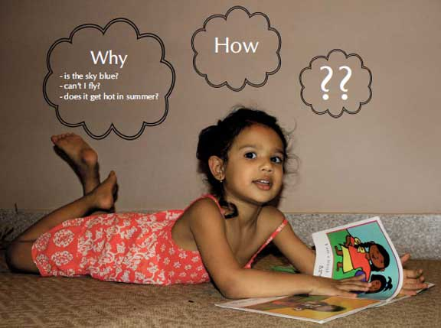
Demystifying Higher Order Thinking
Catherine Mastronardi
President
Springfield Federation of Paraprofessionals

Slide 2
Higher-order thinking, also called higher order thinking skills (HOTS), is a concept based on the idea that some types of learning require more cognitive processing than others
Cognitive skills are the core skills your brain uses to think, read, learn, remember, reason and pay attention. Working together, they take incoming information and move it into the bank of knowledge you use every day at school, at work, and in life..

Slide 3
8 Core Cognitive Capacities
Sustained Attention
Response Inhibition
Speed of Information Processing
Cognitive Flexibility and Control
Multiple Simultaneous Attention
Working Memory
Category Formation
Pattern Recognition

Slide 4
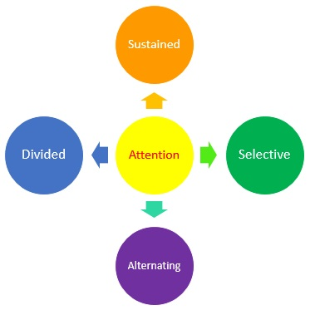
Sustained Attention is the basic ability to look at, listen to and think about classroom tasks over a period of time. All teaching and learning depends on it. Without attention, new learning simply does not happen, and issues of understanding and memory are of no relevance.

Slide 5
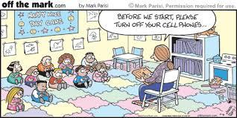
Response Inhibition is the ability to inhibit one’s own response to distractions. Imagine two children paying close attention to a lesson, when there is a sudden noise in the hallway. The child who maintains attention has better response inhibition.

Slide 6

Speed of Information Processing refers to how quickly a learner can process incoming information. Some scientists consider speed of information processing a central aspect of IQ. Many children with attention problems often are unable to keep up with the lesson plan presented by the teacher.

Slide 7
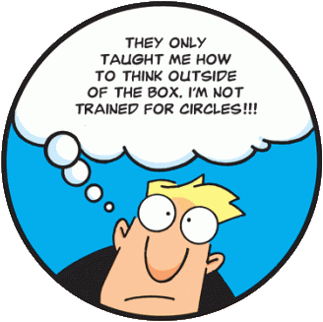
Cognitive Flexibility is the ability to change what you are thinking about, how you are thinking about it and even what you think about it – in other words, the ability to change your mind. Cognitive flexibility is required in multiple ways throughout the school day.

Slide 8
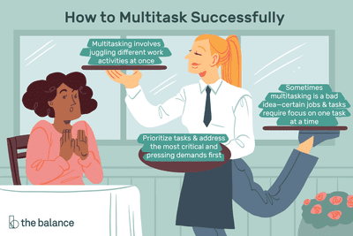
Multiple Simultaneous Attention is the ability to multitask with success. It is the ability to move attention and effort back and forth between two or more activities when engaged in them at the same time. It makes demands on sustained attention, response inhibition and speed of information processing, and also requires planning and strategy.

Slide 9
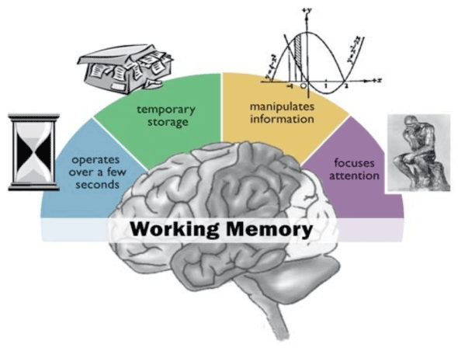
Working Memory refers to the ability to remember instructions or keep information in the mind long enough to perform tasks. We use simple working memory when we look at a phone number and keep it in mind while we dial it. Working memory is the sketch pad of the mind where we put things to think about and manipulate.

Slide 10
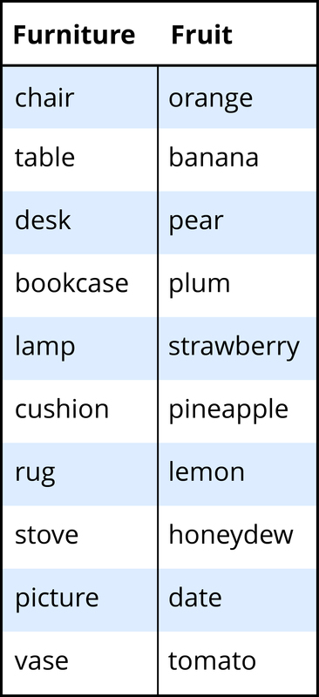
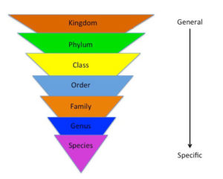
Category Formation is the ability to organize information, concepts and skills into categories, and forms the cognitive basis for higher-level abilities like applying, analyzing, and evaluating those concepts and skills. Categories are the basis of language and organization of the world.

Slide 11
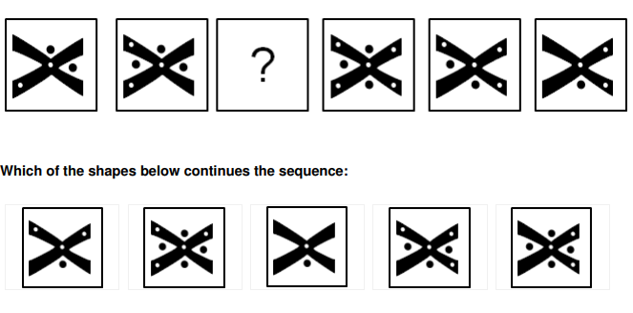
Pattern Recognition and Inductive Thinking is a special ability of the human brain to not only find patterns, but figure out in a logical way what those patterns suggest about what will happen next. In a broad sense, pattern recognition and inductive thinking form the basis for all scientific inquiry.

Slide 12
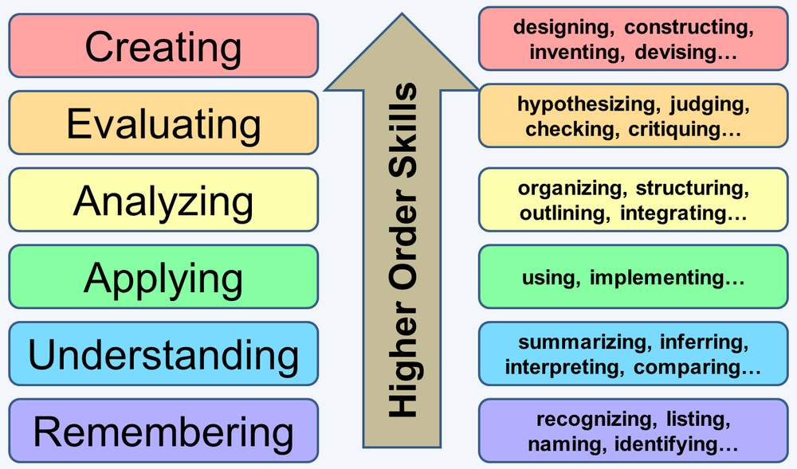
Higher-order thinking skills go beyond basic observation of facts and memorization. They are what we are talking about when we want our students to be evaluative, creative and innovative.

Slide 13
A murder was committed last night at the hotel. As
Chief Detective Officer, you have to solve the crime.
So far you have collected the names and details of all
32 suspects. The murderer is one of them.
There were five witnesses to the murder. Each has
left you one clue to the identity of the murderer.
Each clue was left in a different code so that only you,
with your amazing code‐breaking skills, will be able
to solve them all.
You can tackle the clues in any order. Once you have
solved each clue you will be able to eliminate some of
the suspects from your enquiries.
Each clue will remove half of the suspects from the
list, until you are left with just one…
Who is the murderer?

Slide 14
CLUE 1
A5 = ONE
B10 = HOTEL
C6 = OF
E3 = MURDERER
F9 = THE
G7 = EAR
A8 = RINGS
B2 = THE
D8 = AT
E6 = THEIR
G3 = LEFT
When these cells are highlighted on the grid, the sentence can be read in the correct order The murderer left one of their ear rings at the hotel.

Slide 15
CLUE 2
------
To unravel Clue 2 you must REVERSE the direction of the original coding. All the As were replaced by M’s" it says. So to go back, you must replace all the M’s by A’s. (That is, replace A by 0, replace B by P, and so on)
Strands of dark hair were found on the victims clothing.

Slide 16
CLUE 3
------
I SAW MY REFLECTION IN THE MURDERERS GLASSES

Slide 17
CLUE 4
------
Just start at the bottom left corner and read RIGHT and UP:
I saw a very tall person running away from the hotel

Slide 18
CLUE 5
------
THE MURDERERS BEARD COVERED MOST OF HIS FACE

Slide 19
CONCLUSIONS
-----------
Clue 1 - The murderer wears ear rings
Clue 2 - The murderer has dark hair
Clue 3 - The murderer wears glasses
Clue 4 - The murderer is very tall
Clue 5 - The murderer is a man
SO THE MURDERER IS ..... ?

Slide 21
Why Use Collaborative Learning?
Research shows that educational experiences that are active, social, contextual, engaging, and student-owned lead to deeper learning. The benefits of collaborative learning include:
Development of higher-level thinking, oral communication, self-management, and leadership skills.
Promotion of student-faculty interaction.
Increase in student retention, self-esteem, and responsibility.
Exposure to and an increase in understanding of diverse perspectives.
Preparation for real life social and employment situations.

Slide 22

We are going to play a game. Each of the pieces of paper I am holding contains one clue that will help you solve a mystery. If you put all the facts together, you will be able to solve the mystery. Any time you think you know the answers and the group agrees on the guess, you may tell me. I will only tell you whether everything is correct or not. If parts of your answers are incorrect, I will not tell you which answers are wrong.
You may organize yourselves in any way you like. You may not, however, pass your clues around or show them to anyone else, and you may not leave your seats to walk around the group. All sharing of clues and ideas must be done verbally.

Slide 23
Mr. Kelley was murdered. You must use clues you were given to work collaboratively in your group to find answers to these five questions:
who was the murderer?
2. the weapon?
3. the time of the murder?
4. the place of the murder?
5. the motive?
The First National Bank of Minnetonka, Minnesota, was robbed of $1,000,000. You must use clues you were given to work collaboratively in your group to find answers to these questions:
Who robbed the bank?
Where was everyone else?
Who lied?

Slide 24
Discussion Guide
How were decisions made in your group?
Was a leader needed?
Was time lost getting organized?
Was it ineffective for everyone to talk at once?
Did problems arise because some people didn’t present their clues?
Did any members ignore the clues of others?
Were attempts made to encourage the participation of all members?
Did anyone monopolize the discussion? Was this productive for the group?
How did you organize the information to solve the mystery – time, person, location, etc?
Could you have organized the information more efficiently?

Slide 25

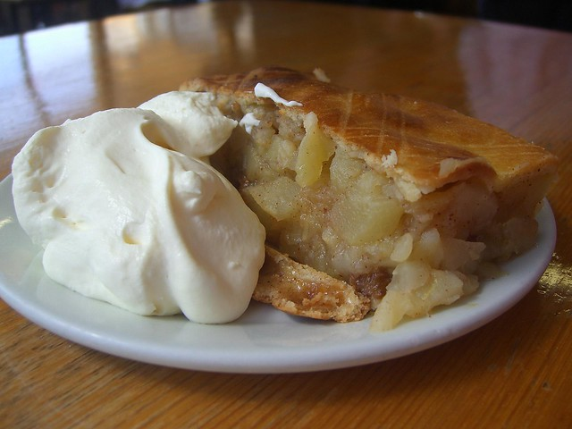
Easy as apple pie..

Slide 26
Bloom’s taxonomy is a powerful tool to help develop learning objectives because it explains the process of learning:
Before you can understand a concept, you must remember it.
To apply a concept you must first understand it.
In order to evaluate a process, you must have analyzed it.
To create an accurate conclusion, you must have completed a thorough evaluation.

Slide 27
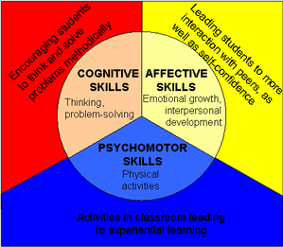
Affective: growth in feelings or emotional areas (attitude)
Cognitive: mental skills (knowledge)
Psychomotor: manual or physical skills (skills)
K.S.A.: Knowledge [cognitive], Skills [psychomotor], and Attitudes [affective])

Slide 28
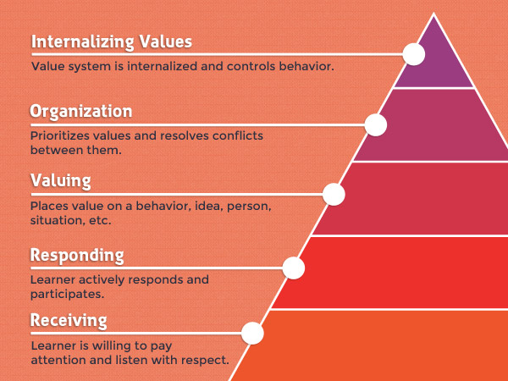
The affective domain (Emotion-based-”ATTITUDE”)
Receiving
Responding
Valuing
Organizing
Internalizing

Slide 29
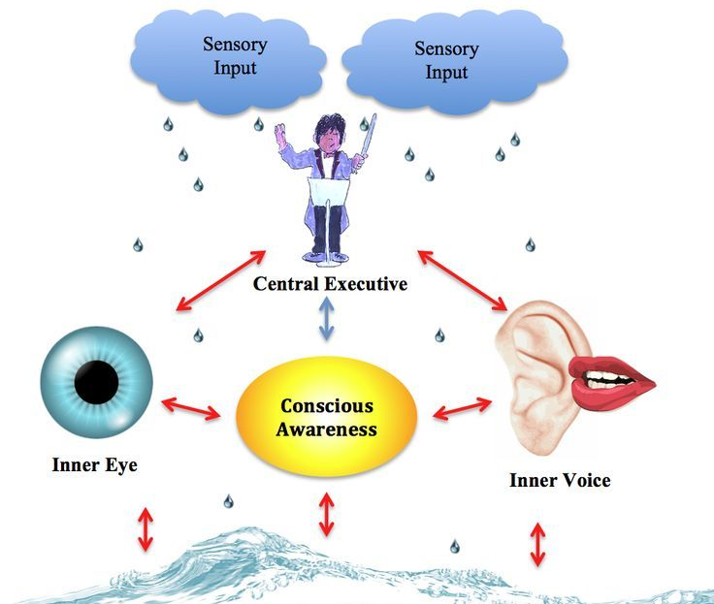
Affective education is concerned with the beliefs, feelings and attitudes of students. Proponents of affective education believe that academic teaching should go hand in hand with personal and social education. For a student to perform well, he has to have a sound mind and sound environment.

Slide 30
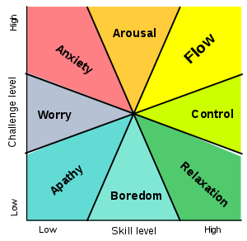
 | Negative Affect | Positive Affect
Constructive Learning | Disappointment Puzzlement Confusion | Awe Satisfaction Curiosity
Un-learning | Frustration Discard Misconceptions | Hopefulness Fresh research

Slide 31
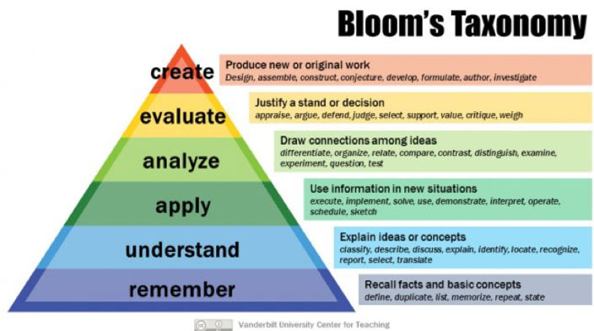
The cognitive domain (“KNOWLEDGE”-based)

Slide 32
Corresponding Verb Examples
Remembering: arrange, define, duplicate, label, list, memorize, name, order, recognize, relate, recall, repeat, reproduce, state
Understanding: classify, describe, discuss, explain, express, identify, indicate, locate, recognize, report, restate, review, select, translate
Applying: apply, choose, demonstrate, dramatize, employ, illustrate, interpret, operate, practice, schedule, sketch, solve, use, write
Analyzing: analyze, appraise, calculate, categorize, compare, contrast, criticize, differentiate, discriminate, distinguish, examine, experiment, question, test
Evaluating: appraise, argue, assess, attach, choose, compare, defend estimate, judge, predict, rate, core, select, support, value, evaluate
Creating: arrange, assemble, collect, compose, construct, create, design, develop, formulate, manage, organize, plan, prepare, propose, set up, write

Slide 33
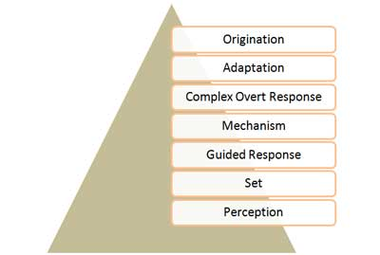
The psychomotor domain (action-based-”SKILLS”)
Behavioral examples include driving a car, throwing a ball, playing a musical instrument and cooking a meal. In psychomotor learning research, attention is given to the learning of coordinated activity involving the arms, hands, fingers, and feet, while verbal processes are not emphasized.

Slide 34
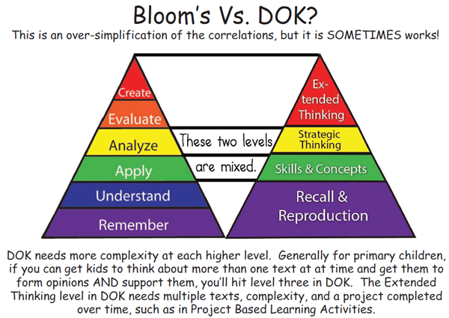
Depth of Knowledge—also referred to as DOK— refers to the depth of understanding required to answer or explain an assessment-related item or a classroom activity. The concept of depth of knowledge was developed in the 1990s through research by Norman L. Webb, a scientist at the Wisconsin Center for Education Research.

Slide 35
Bloom’s provides the instructional framework, while DoK analyzes the specifics of the assignments.
Bloom’s Taxonomy requires that students master the lower levels of cognition before moving onto the next. So, if the objective is to use a mathematical formula (Application), they first must be able to identify that formula and its basic purpose (Remember and Understand). This might mean that the objectives are given in incremental steps to show the progression of learning.
In DoK, when measuring the assessments, students are moving fluidly through all the levels. For example, while using a mathematical formula to solve a problem, students are recalling the information or formula (DoK 1) in order to solve the problem (DoK 2 & DoK 3). Depending on the complexity of the problem to be solved, the learning might transition into DoK 4.

Slide 36
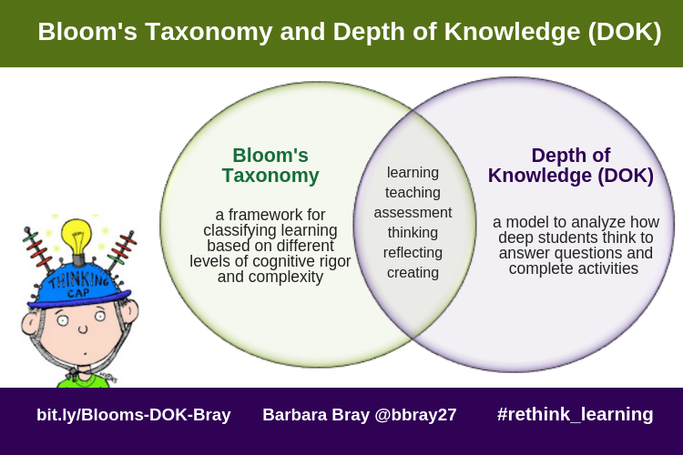
DOK is about…
what FOLLOWS the verb. What comes after the verb is more important than the verb itself.
the complexity of mental processing that must occur to complete a task.
DOK is NOT about…
verbs. The verbs are a valuable guide, but they can sometimes be used at more than one level.
the difficulty of what they are learning. All levels of DOK have a place in a rigorous curriculum.

Slide 37
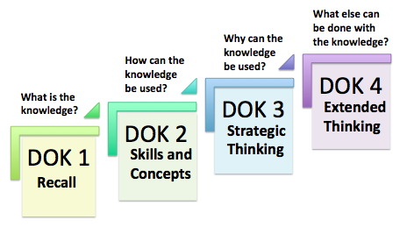
Level 1 (Acquired knowledge) involves recall and reproduction. Remembering facts or defining a procedure.
Level 2 (Knowledge Application) are skills and concepts. Students use learned concepts to answer questions.
Level 3 (Analysis) involves strategic thinking. Complexity increases here and involves planning, justification, and complex reasoning. Explains how concepts and procedures can be used to provide results.
Level 4 (Augmentation) is extended thinking. This requires going beyond the standard learning and asking, how else can the learning be used in real world contexts.

Slide 38
Let’s go back to our apple activity…
Which portion of the activity is DOK Level 1 (Acquired knowledge)
Which portion of the activity is DOK Level 2 (Knowledge Application)
Which portion of the activity is DOK Level 3 (Analysis)
Which portion of the activity is DOK Level 4 (Augmentation)

Slide 39
Discussion
Mystery 1------Mystery 2----Apples
What were the similarities in the activities?
What were the differences in the activities?
What levels of learning did each activity achieve? (Blooms and DOK)
Did collaborative learning enhance the level of learning?
How will you use the knowledge you obtained today about learning levels to support your students in the classroom?

Slide 40


