Slide 1

The World of Social and Emotional Learning
Leonard Edmonds, Associate Director
AFT Paraprofessional and School-Related Personnel Department

Slide 2
Objectives
Examine:
  I. Social and emotional learning
  II. Emotional Learning
  III. Social Learning
  IV. Family
  V. Trauma
  VI. Behavior
  VII. School culture and climate Research (SEL)
  VIII. The importance of Relationships

Slide 3
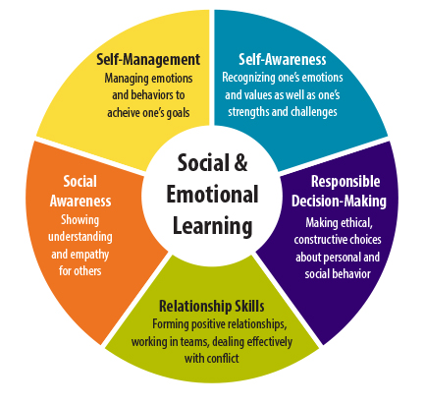
What Is Social and
Emotional Learning?
Social and emotional learning (SEL) is a process which helps children cultivate essential life skills including:
awareness of one’s own emotions
fostering respect and care for others
establishing strong relationships
making ethical and responsible decisions
handling adversity constructively
Notes:
Social and emotional learning is one of the most important strategies available to promote student success and effective school reform. Extensive evaluations have found that social and emotional learning enhances academic achievement, helps students develop self-management and self-control, improves relationships at all levels of the school-community, reduces conflict among students, improves teachers’ classroom management, and helps young people to be healthier and more successful in school and life.” ~The Collaborative for Academic, Social and Emotional Learning

Slide 4
Social Learning

Slide 5

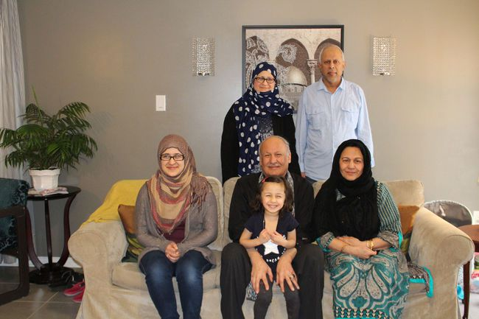







It all starts here!
Notes:
Social and emotional learning begins at home

Slide 6








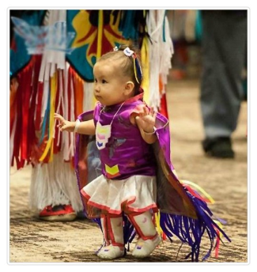

I don’t yet understand things like love, compassion, integrity, tolerance, human decency and truth. For the first, most important years of my life, all I will know is WHAT YOU TEACH ME socially, emotionally and intellectually!
Teach me well!

Slide 7
What Influences
Child Development?
Intrauterine environment
Endowments at birth
Attachment and quality of parenting
Physical and cultural environment

Slide 8
Optimal Child Development
Provision of a safe environment
+
Attuned, reliable and consistent care
+
Patterned, repetitive responses
=
The best approach to optimizing children’s development.

Slide 9





Attachment
The bond felt between two people.
It is the child's primary bond to her first caregiver, which becomes the template for all future relationships.
It is also a critical internal system for dealing with stress.
Notes:
Some kids have experienced ruptures in the attachment process or never had the opportunity to form secure attachments or, by extension, an effective stress regulation system.

Slide 10
Four Types of Attachment
Secure—upset when parent leaves, easily soothed upon return
Insecure Anxious—upset when parent leaves, difficult to soothe when they return
Insecure Avoidant—does not register outward distress when parent leaves, ignores them when they return
Insecure Disorganized—displays anxious and avoidance characteristics in an unpredictable way
Notes:
John Bowlby Attachment Theory

Slide 11
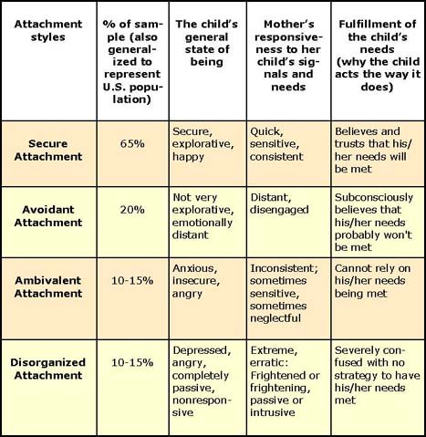
The Four Attachment Styles

Slide 12
What’s the attachment?
When Baby Leonard cries because he is wet, or hungry or in some discomfort, his mom always responds in a timely fashion.
When Baby Mary cries because she is wet, hungry or in some discomfort, her mother responds sometimes and sometimes she doesn’t.
When Baby Janet cries because she is wet, hungry or in some discomfort, her mother response is erratic.
When Baby James cries because he is wet, hungry or in some discomfort, his mother response is that he just wants attention.
1. Disorganized 2. Secure 3. Avoidant 4. Ambivalent .

Slide 13
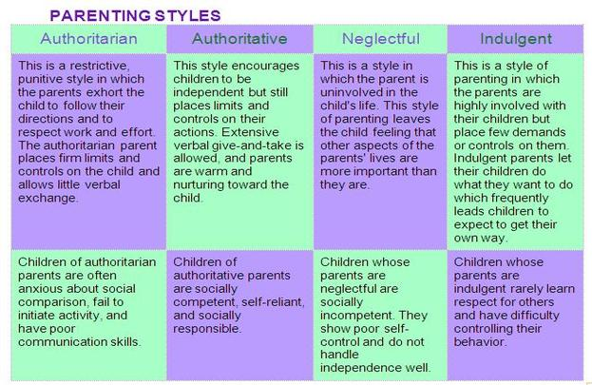

Slide 14
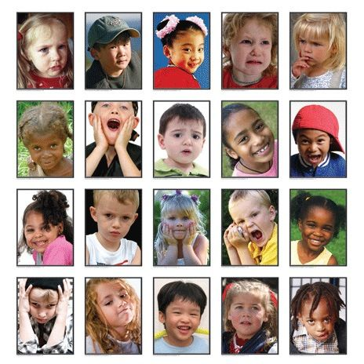
Emotions

Slide 15

Question
How many emotions can a person experience?
2
14
597
1496
E. 34, 000

Slide 16
Types of Emotions
Primary/Basic: Your reactions to external events.
Example: You may feel sad that someone hurts you or anxious about an upcoming test.
Secondary: When you feel something about the feeling itself.
Example: You may feel anger about being hurt or shame about your anxiety.
Notes:
Primary And Secondary
Imagine something has happened, anything, and suddenly you're feeling an emotion. It's strong; it's the first reaction to what has happened. That is a primary emotion. Primary emotions are the body's first response, and they're usually very easy to identify because they're so strong. The most common primary emotions are fear, happiness, sadness, and anger.
These may also be secondary emotions given different situations, but when we first react, it's usually with one of these. If the phone rung and someone started yelling at you for no reason you'd get angry; if the phone rung and someone told you that your dog had died you'd feel sad - it doesn't have to be a huge stimulus to elicit a primary emotion. Primary emotions are considered to be adaptive because they make us react a certain way without being contaminated or examined. They are very much an instinctual survival response.
Primary Emotions
Primary emotions are more transient than secondary emotions which is why they're less complicated and easier to understand. The first thing we feel is directly connected to the event or stimulus but as time passes we struggle to connect the same emotion with the event because our emotions have changed. There are eight primary emotions that we are born with. They are:
Anger
Sadness
Fear
Joy
Interest
Surprise
Disgust
Shame
All emotions have a connection to one of these 8 or are derived from them. As babies, our psyche is primarily controlled by the id, and it is wholly interested in our survival at a selfish level. As our psyche develops and we grow to understand the reality around us, we can then process more complex secondary emotions.
Secondary Emotions
Secondary emotions are much more complex because they often refer to the feelings you have about the primary emotion. These are learned emotions which we start understanding by coping parents or others as we grow up. For example, when you feel angry you may feel ashamed afterward, when you feel the joy, you may feel relief or pride. In Star Wars, Master Yoda explained secondary emotions perfectly - "fear leads to anger, anger leads to hate, hate leads to suffering.“
A secondary emotion is one that isn't a reaction but a response to understanding the initial reaction. Secondary emotions are not connected to any part of the psyche like primary emotions are connected to the id which is why they are not hardwired and are often cultural. Since they're much more complicated, it is often the secondary emotional response that is compromised when dealing with patients who have emotional detachment or other emotional disorders.
Secondary emotions can also be divided into instrumental emotions. These are unconscious and habitual. We learn instrumental emotions as children as a form of conditioning. When we cry a parent comes to soothe us, so we learn to use the facial expressions and response associated with crying when we need that soothing or sense of security.
Many toddlers are very adept at using instrumental emotions to get their way with anger. A toddler throws a tantrum, and parents give in to make them quiet, but as we grow, we learn that this behavior isn't appropriate or we become spoiled and manipulative. By not learning the correct secondary emotional response it leaves the person distant and emotionally detached from those around them.
How To Tell The Difference?
Asides from the secondary emotions being harder to name there are several ways to determine whether you're feeling a primary emotion or a secondary one. Firstly, ask yourself if the emotion is directly a reaction or not. If it is a direct connection, then it is a primary emotion. If the emotion came on strongly, but that feeling has begun to fade then it is also likely a primary emotion if the opposite is true it's more likely to be a secondary emotional reaction.
If the emotion continues to affect you long after the event has happened, even to affecting new but similar or connected events, then it is likely to be secondary. If the emotion is complex, it's almost always secondary. There is such a thing as tertiary emotions, but as elusive as secondary emotions are tertiary emotions are even harder to pin down.
For children, and even some adults, who struggle to identify their emotions one of the easiest ways to differentiate between primary and secondary emotions is to use flashcards. A flashcard can have several feelings on one side (e.g., rage, envy, irritation) and whether they are primary or secondary responses on the back. The patient must guess, or make an informed decision, about whether the feelings and emotions are primary or secondary, or identify which primary emotion they belong to.
What Use Are Primary And Secondary Emotions?
Primary and secondary emotions to a person say a lot about their emotional stability and integrity, but to a healthcare professional they can make diagnosis much easier. Rather than blindly accepting an emotion, being able to understand where it comes from and the actions that led up to that emotion can act as a path to trace back prior abuse, or traumatic events that have left emotional scars.
Finding the real cause behind a person's reaction means examining the primary emotion, while the secondary emotion will help them understand how the patient processes information. By slowing down the thought process, and consciously working through the internal reasons why someone feels a certain way they are also likely to understand more about themselves through a process that would have been entirely subconscious until now.
Another reason why identifying emotions is important is to be able to react to them properly and for someone who struggles to handle emotions or react appropriately being unable to express themselves can be frustrating. This, in turn, leads to anger and other secondary issues.

Slide 17
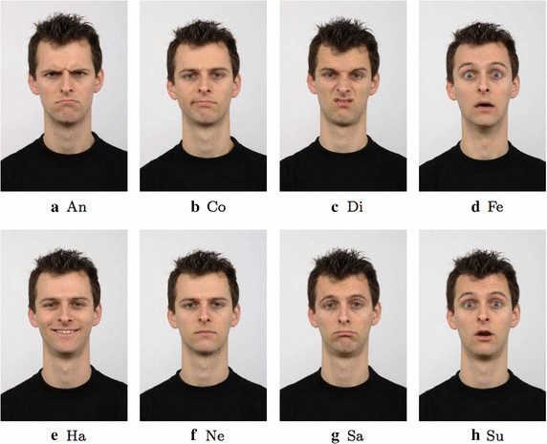
What are the 8 Basic Emotions?
Anger
Anticipation
Joy
Trust
Fear
Surprise
Sadness
Disgust

Slide 18
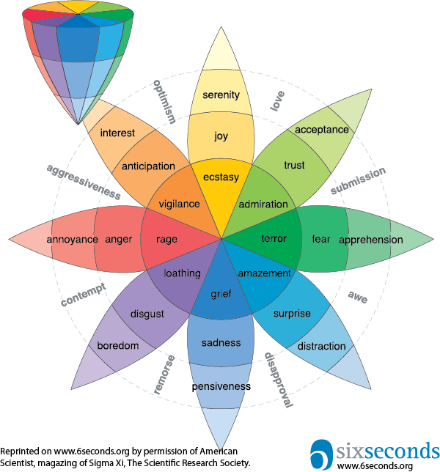
Robert Plutchik’s
Wheel of Emotions
Joy is the opposite of sadness.
Fear is the opposite of anger.
Anticipation is the opposite of surprise.
Disgust is the opposite of trust.
Notes:
Primary: The eight sectors are designed to indicate that there are eight primary emotion dimensions. They are anger, anticipation, joy, trust, fear, surprise, sadness and disgust.
Intensity: The cone’s vertical dimension represents intensity – emotions intensify as they move from the outside to the center of the wheel. For example, a feeling of boredom can intensify to loathing if left unchecked. This is an important rule about emotions to be aware of in relationships: If left unchecked, emotions can intensify. Herein lies the wisdom of enhancing your emotional vocabulary: it’s the bedrock of effectively navigating emotions.
What Does It Mean to Be Emotionally Literate?
Plutchik’s emotion wheel helps us look at literacy through a broader lens. Literacy means “a person’s knowledgeof a particular subject or field.” So enhancing emotional literacy means not only having words for emotions, but understanding how different emotions are related to one another and how the tend to change over time
The intensity of emotion decreases as you move outward and increases as you move toward the wheel's center. The intensity of the emotion is indicated by the color. The darker the shade, the more intense the emotion. For example, anger at its least level of intensity is annoyance. At its highest level of intensity, anger becomes rage.

Slide 19
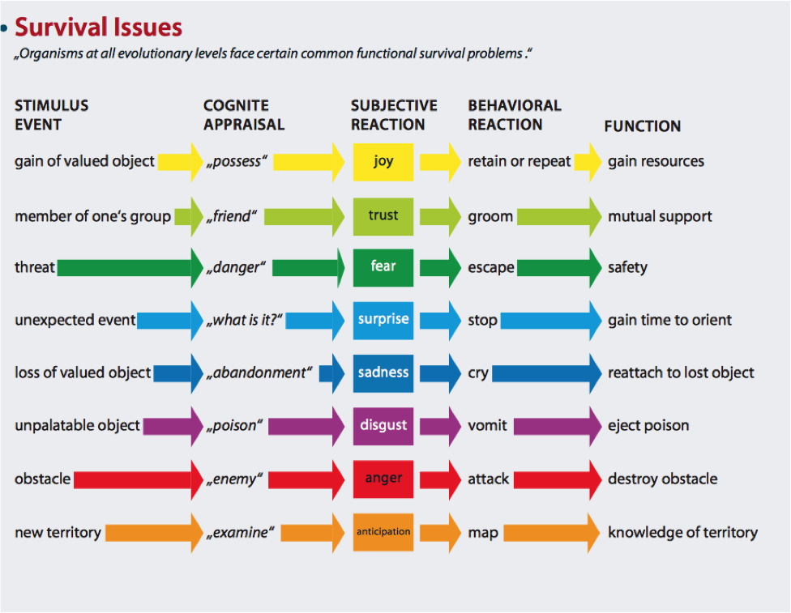
Illustrations

Slide 20
The combination of these attributes distinguish the emotions from sensations, feelings and moods.
Kind of emotion | Positive emotions | Negative emotions
Related to object properties | Interest, curiosity, enthusiasm | Indifference, habituation, boredom
 | Attraction, desire, admiration | Aversion, disgust, revulsion
 | Surprise, amusement | Alarm, panic
Future appraisal | Hope, excitement | Fear, anxiety, dread
Event-related | Gratitude, thankfulness | Anger, rage
 | Joy, elation, triumph, jubilation | Sorrow, grief
 | Patience | Frustration, disappointment
 | Contentment | Discontentment, restlessness
Self-appraisal | Humility, modesty | Pride, thinking or acting in a way above others
Social | Charity | Avarice, greed, miserliness, envy, jealousy
 | Sympathy | Cruelty
Cathected | Love | Hate
Notes:
Humans experience emotion, with evidence used that they influence action, thoughts and behavior. Emotions are categorized into various affects, which correspond to the current situation.^{[1]} An affect is a term used to describe the range of feeling experienced.^{[2]}
Many different theories of emotion have been researched^{[3]}, which have contrasting views on emotion.^{[4]}

Slide 21
Differentiating Between Primary and Secondary Emotions
Is this emotion a direct reaction to an external event?
Is the emotion becoming more intense over time?
Do you experience the emotion more frequently than the events that prompted the emotion?
When the initiating event receded, did the emotions recede?
Does the emotion continue long after the event, interfere with your abilities in the present, and affect new and different experiences?
Is the emotion complex, ambiguous, and difficult to understand?
Notes:
Primary
Secondary
Secondary
Primary
Secondary
Secondary

Slide 22
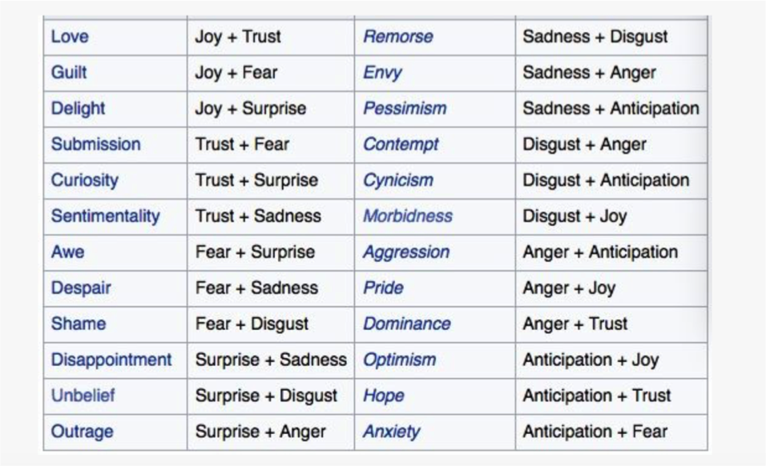
Activity: The Complex
Emotions Quiz
What combinations of these basic emotions make more complex emotions?
(Anger Anticipation Joy Trust Fear Surprise Sadness Disgust)

Slide 23
What’s The Difference Between An Emotion, A Feeling and A Mood?
Emotions are chemicals released in response to our interpretation of a specific trigger. It takes our brains about 1/4 second to identify the trigger and about another 1/4 second to produce the chemicals. By the way, emotion chemicals are released throughout our bodies, not just in our brains, and they form a kind of feedback loop between our brains & bodies. They last for about six seconds—hence the name of our organization.
Feelings happen as we begin to integrate the emotion, to think about it, to “let it soak in.” In English, we use “feel” for both physical and emotional sensation—we can say we physically feel cold, but we can also emotionally feel cold. This is a clue to the meaning of “feeling,” it’s something we sense. Feelings are more “cognitively saturated” as the emotion chemicals are processed in our brains & bodies. Feelings are often fueled by a mix of emotions and last for longer than emotions.
Moods are more generalized. They’re not tied to a specific incident, but a collection of inputs. Mood is heavily influenced by several factors: the environment (weather, lighting, people around us), physiology (what we’ve been eating, how we’ve been exercising, how healthy we are), and finally our mental state (where we’re focusing attention and our current emotions). Moods can last minutes, hours, probably even days.
Notes:
Emotions are chemicals released in response to our interpretation of a specific trigger. It takes our brains about 1/4 second to identify the trigger, and about another 1/4 second to produce the chemicals. By the way, emotion chemicals are released throughout our bodies, not just in our brains, and they form a kind of feedback loop between our brains & bodies. They last for about six seconds – hence the name of our organization.
Feelings happen as we begin to integrate the emotion, to think about it, to “let it soak in.” In English, we use “feel” for both physical and emotional sensation — we can say we physically feel cold, but we can also emotionally feel cold. This is a clue to the meaning of “feeling,” it’s something we sense. Feelings are more “cognitively saturated” as the emotion chemicals are processed in our brains & bodies. Feelings are often fueled by a mix of emotions, and last for longer than emotions.
Moods are more generalized. They’re not tied to a specific incident, but a collection of inputs. Mood is heavily influenced by several factors: the environment (weather, lighting, people around us), physiology (what we’ve been eating, how we’ve been exercising, how healthy we are), and finally our mental state (where we’re focusing attention and our current emotions). Moods can last minutes, hours, probably even days.

Slide 24
Emotions and the Brain:
Why relationships matter
                How learners feel is very important to their learning process. When a learner is enthusiastic and doesn't feel stress, learning will take place. If the conditions are negative and the learner doesn't feel safe, learning will not take place.
                (Deutsch ND)
Notes:
5 minutes
Page 9
Facilitator Notes:
Ask participants to continue note-taking. Explain that this finding is a more recent discovery coming out of studies of how the brain works. (The amygdala is a seat of emotions. The frontal cortex is a seat of conscious thought. When the amygdala is over-active because of too much stress for any reasons, the frontal cortex can’t function effectively. )
Debrief:
What are some of the things that stress students? (List on Chartpak and post.)
Select one of the examples listed and ask for one or two volunteers to explain one thing s/he does to try to alleviate the stress for students.
Move to Slide 23 - Activity Six: Give One, Take One

Slide 25
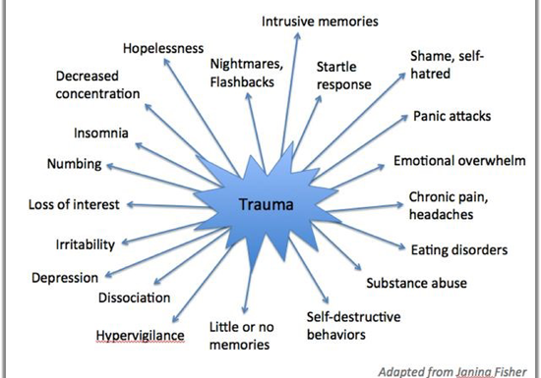
Trauma

Slide 26

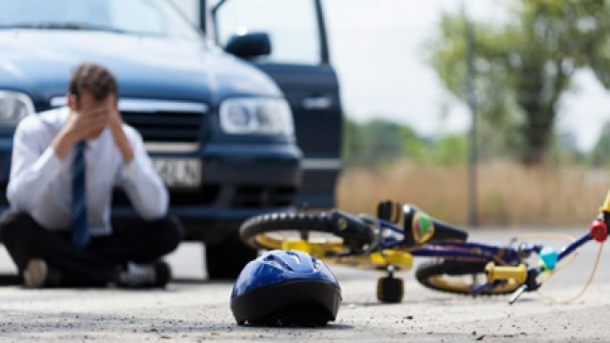
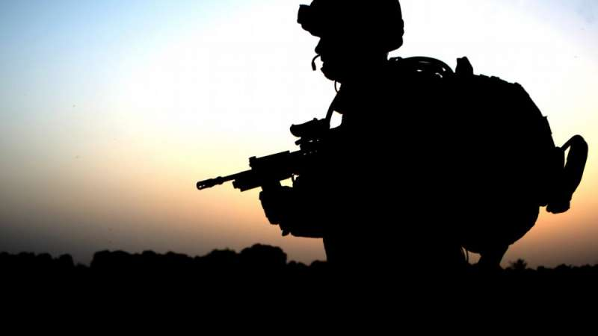
What Makes an Experience Traumatic?
Overwhelming, very painful, very scary
• Fight or Flight
• Threat to physical or psychological safety
• Loss of control
• Unable to regulate emotions

Slide 27

What Are Different Types of Trauma
Trauma
Single Blow
Repeated
Naturally Caused
Man Made
Psychological
The unique individual experience of an event or enduring conditions, in which:
  The individual’s ability to integrate his/her emotional experience is overwhelmed, or
  The individual experiences (subjectively) a threat to life, bodily integrity, or sanity. (Pearlman & Saakvitne, 1995, p. 60)
Notes:
Nobody is immune to the effects of psychological trauma. Whether you were involved in an abusive romantic relationship, an acrimonious divorce, witnessed a horrific event, experienced workplace bullying or spent time as a prisoner of war, the effects of experiencing psychological trauma can last for a few moments or for a lifetime. It can lead to the development of depression, PTSD, anxiety, addictions, phobias, or social problems. Trauma can negatively impact all areas of your life.
Psychological trauma is defined as “damage to the psyche that occurs as a result of a severely distressing event.” Trauma happens when we perceive the situation to be life threatening with no means of escape. We then get “stuck” in the memory of this event. Time does not heal emotional trauma on its own. Psychological trauma becomes part of who we are but it is possible to come to peace and heal from its devastating effects. Let’s take a closer look at emotional trauma…

Slide 28



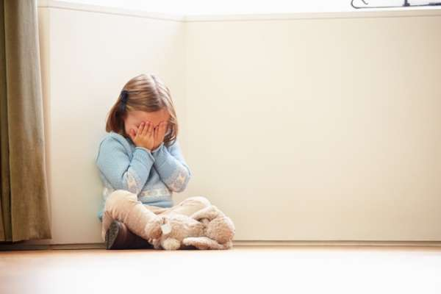
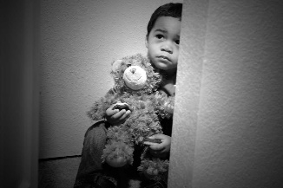
List Five Causes of Trauma
Accidents
Bullying/cyberbullying
Chaos or dysfunction in the house (such as domestic violence, parent with a mental illness, substance abuse or incarcerated)
Death of a loved one
Emotional abuse or neglect
Physical abuse or neglect
Separation from a parent or caregiver
Physical abuse or neglect
Separation from a parent or caregiver
Sexual abuse
Stress caused by poverty
Sudden and/or serious medical condition
Violence (at home, at school, or in the surrounding community)
War/terrorism
Notes:
Some Leading Causes
The most common causes of childhood trauma include:
Accidents
Bullying/cyberbullying
Chaos or dysfunction in the house (such as domestic violence, parent with a mental illness, substance abuse or incarcerated)
Death of a loved one
Emotional abuse or neglect
Physical abuse or neglect
Separation from a parent or caregiver
Sexual abuse
Stress caused by poverty
Sudden and/or serious medical condition
Violence (at home, at school, or in the surrounding community)
War/terrorism

Slide 29
Child Developmental Trauma
Childhood trauma is defined as: “The experience of an event by a child that is emotionally painful or distressful, which often results in lasting mental and physical effects.”
Jason has been abused at home and is now living with foster carers. He overhears his foster carers arguing. Because of his previous experience he is afraid he will be attacked. This sends his body into survival mode.
In survival mode, Jason can either attack first to get the upper hand (fight), runaway to a safer place (flight) or stay as quiet and as still as possible so he isn’t noticed (freeze)

Slide 30
Trauma Impacts on Child Development
Trauma causes brain to adapt in ways that contributed to their survival (i.e. constant fight/flight/freeze).
↓
These adaptations can look like behavior problems in “normal” contexts, such as school.
↓
When triggered, “feeling” brain dominates the “thinking” brain.
↓
The normal developmental process is interrupted, and students may exhibit internalizing or externalizing behaviors.

Slide 31
Internalizing and
Externalizing Behaviors
Internalizing
Externalizing
Depression/Anxiety
Social withdrawal
Feelings of loneliness, guilt, low worth
Sad, nervous, fearful
Difficulty concentrating
Changes in sleeping or eating patterns
Unexplained physical symptoms, i.e., headaches and stomach aches, not due to a medical condition
Conduct/Oppositional behaviors
Physical aggression
Destruction of property
Substance use
Running away from home

Slide 32
Child’s Response to
Trauma Affected By
Chronological and development stage
Perception of danger
Whether the child was a victim or witness
Past experience with trauma
Relationship to the perpetrator
Presence/availability of adult(s) to help

Slide 33
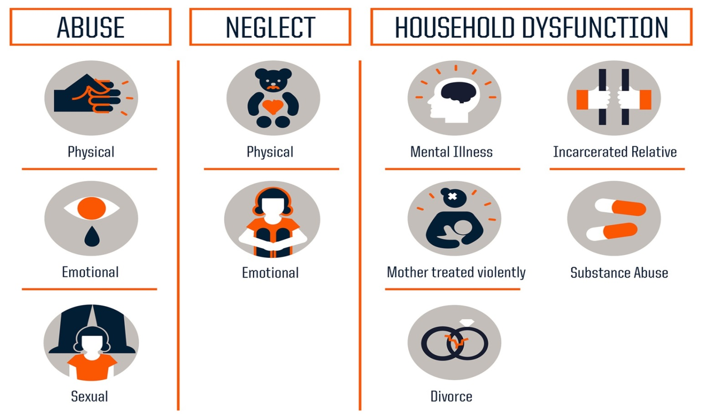
Three Types of Adverse childhood Experiences (ACEs)

Slide 34
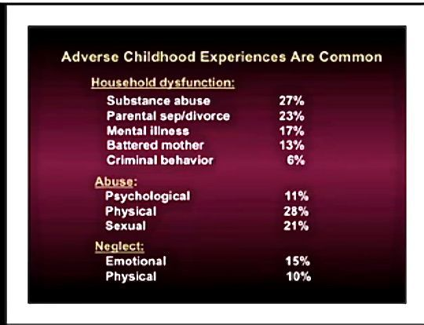
It’s Common!

Slide 35
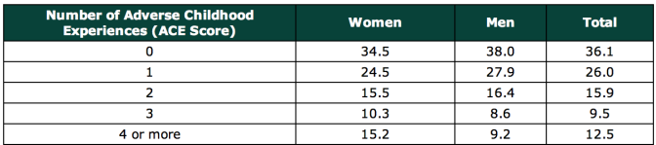
What’s the Connection?

Slide 36

Essential Elements of a Trauma-Informed School System
Identifying and assessing traumatic stress.
Addressing and treating traumatic stress.
Teaching trauma education and awareness.
Having partnerships with students and families.
Creating a trauma-informed learning environment (social/emotional skills and wellness).
Being culturally responsive.
Integrating emergency management & crisis response.
Understanding and addressing staff self-care and secondary traumatic stress.
Evaluating and revising school discipline policies and practices.
Collaborating across systems and establishing community partnerships.

Slide 37
Six- Ways to Being a
Trauma Informed School
Provide staff development for educators to better understand trauma’s impact on learning.
Help students feel safe physically, emotionally, and academically.
Meet student’s needs by taking into account their relationships, self-regulation, academic competence and physical and emotional well-being.
Connect students to the school community and provide them with multiple opportunities to practice newly developed skills.
Embrace a shared responsibility for all students.
Staff anticipate and adapt to the ever-changing needs of students.

Slide 38
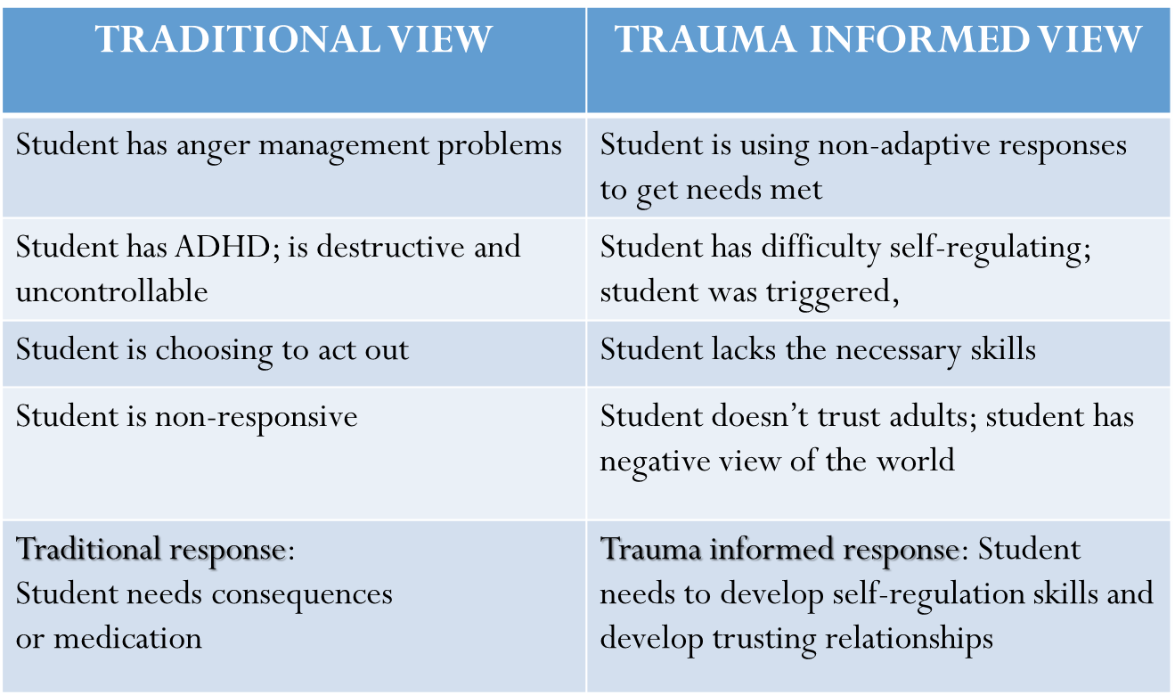
A Comparison

Slide 39
Trauma Informed Care
A program, organization, or system that is trauma-informed:
  Realizes the widespread impact of trauma and understands potential paths for recovery
  Recognizes the signs and symptoms of trauma in clients, families, staff, and others involved with the system
  Responds by fully integrating knowledge about trauma into policies, procedures, and practices
  Seeks to actively resist re-traumatization.
A trauma-informed approach can be implemented in any type of service setting or organization and is distinct from trauma-specific interventions or treatments that are designed specifically to address the consequences of trauma and to facilitate healing.

Slide 40
Trauma Responsive
Educational Practices:
❶ Are grounded in the basic research on trauma and how it affects children’s brain and behavioral development.
❷ Recognize the importance of schools as a sanctuary space and that this is rooted in trusting relationships between students and educators.
❸ Prioritize proactive behavioral supports over reactive disciplinary consequences.
❹ Recognize the necessity of knowing children’s history (and recency) of exposure to traumatic experiences.
❺ Anticipate and respond to challenging student behaviors with de-escalation.
❻ Prioritize classroom management practices that keep students exhibiting challenging behaviors in the classroom.
❼ Recognize that educators must have the institutional and professional support to engage in self-care practices that mitigate vicarious traumatization.

Slide 41
Trauma Responsive
Educators Are:
​❶ Present and in-the-moment with their students, focusing their attention on them.
❷ Attuned and aware of students’ non-verbal cues.
❸ Calm in their interactions with students and in the ways they respond to students' off-task behavior.
❹ Predictable and provide structured, repeated, and consistent positive experiences for students.
❺ De-escalate children’s emotions and remain in control of their own emotions and expression.
SAMHSA. (2014). SAMHSA’s concept of trauma and guidance for a trauma-informed approach. Substance Abuse and Mental Health Services Administration. Walkley, M., & Cox, T. L. (2013). Building trauma-informed schools and communities. Children & Schools, 35(2), 123-126.

Slide 42
The Post-It Note Story
One day, a student in his World History class placed a post-it note on her forehead reading “I’m bored and I hate this class!” In the past, Mr. Smith explained, he would have sent the student out of class immediately and recommend a one-day suspension. Instead, as part of the school’s trauma-informed approach, he turned to the student and asked her to hand out post-it notes to all of her classmates.
He told the students to write down how they felt at that moment, and then place the post-it note on their foreheads. Then, he went around the room and asked each student to explain what they wrote and why. One student wrote “I’m angry my father left.” Mr. Smith was shocked to read notes stating “I am sad that Mr. Smith doesn’t even know my name” or “I wish Mr. Smith liked us.”
The experience gave Mr. Smith new insights and the opportunity to connect to his students and share his own perspective in a way he never had before. He explained that the exercise of post-it notes changed his relationship with his students and made them feel more connected. It improved the classroom dynamic and re-engaged students in learning. “It was a great investment of time that continues to pay dividends.”
Notes:
A teacher shared this story as an example of what it means to be trauma-sensitive in the classroom. One day, a student in his World History class placed a post-it note on her forehead reading “I’m bored and I hate this class!” In the past, Mr. Smith explained, he would have sent the student out of class immediately and recommend a one-day suspension. Instead, as part of the school’s trauma-informed approach, he turned to the student and asked her to hand out post-it notes to all of her classmates.
He told the students to write down how they felt at that moment, and then place the post-it note on their foreheads. Then, he went around the room and asked each student to explain what they wrote and why. One student wrote “I’m angry my father left.” Mr. Smith was shocked to read notes stating “I am sad that Mr. Smith doesn’t even know my name” or “I wish Mr. Smith liked us.” The experience gave Mr. Smith new insights and the opportunity to connect to his students and share his own perspective in a way he never had before. He explained that the exercise of post-it notes changed his relationship with his students and made them feel more connected. It improved the classroom dynamic and re-engaged students in learning. “It was a great investment of time that continues to pay dividends.”

Slide 43
Question
What is it that shows us their social and emotional learning?
Answer:
Their “Behavior”

Slide 44

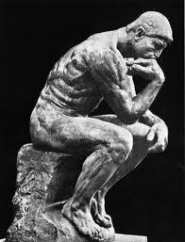
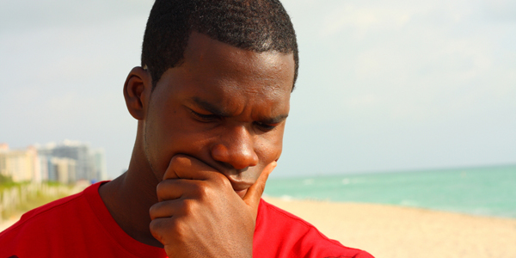
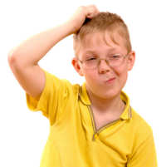


“What is Behavior?”
44
Notes:
What do you know about behavior already? What does the word behavior make you think of?

Slide 45
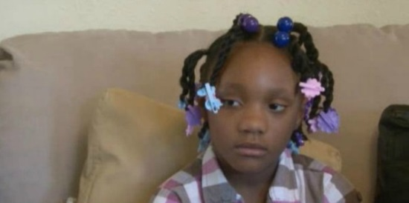

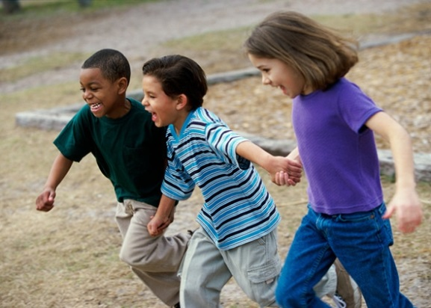
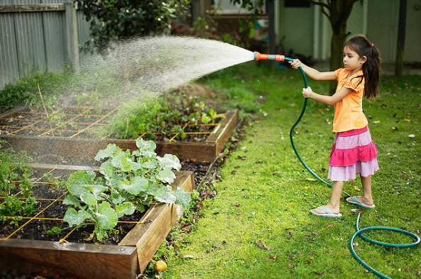
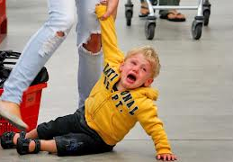
Behavior
is communication.
is learned and serves a specific purpose.
is related to the context in which it occurs.
is used by children to meet their needs.

Slide 46


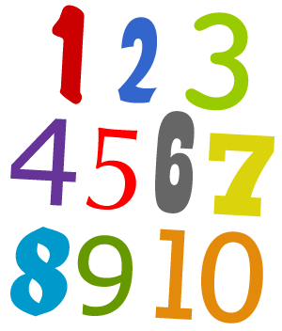
Criteria for Behavior
Observable
Definable
Countable and measurable

Slide 47

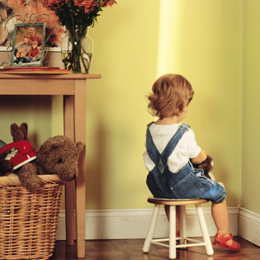

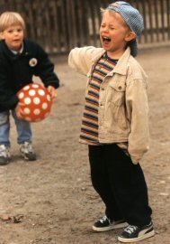

Why Do Children Misbehave?
Notes:
Who can tell me why you feel children misbehave?

Slide 48
Behavior
is communication.
is learned and serves a specific purpose.
is related to the context in which it occurs.
is used by children to meet their needs.

Slide 49


Activity:
Characteristics of Behavior
Identify behaviors and non-behaviors

Slide 50
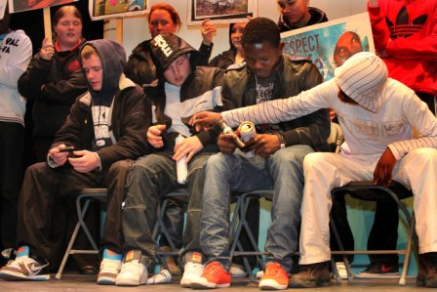
What is Anti-social Behavior?
Notes:
Ask question on slide

Slide 51
Antisocial Behavior Is…
…a recurrent pattern of negativistic, defiant, disobedient, and hostile behavior towards authority figures that persists for at least six months and is characterized by the frequent occurrence of at least four of the following behaviors:
losing temper
arguing with adults
actively defying or refusing to comply with the requests or rules of adults
deliberately doing things that will annoy other people
blaming others for his or her own mistakes and misbehaviors
being touchy or easily annoyed by others
being angry or resentful being spiteful or vindictive
DSM-IV (4th edition of the Diagnostic and Statistical Manual of Mental Disorders

Slide 52
Students with Antisocial Behavior Often:
Don’t know how to:
Solve problems
Talk about their thoughts and feelings
Manage their anger
Build good relationships
Use aggressive or disruptive behavior in order to get attention from other students or adults
Have more trouble following directions given by adults
Have problems on the playground, bus, in hallways, lunchrooms or libraries

Slide 53
Research says…
The causes and developmental courses of antisocial behavior indicate that the patterns of antisocial behavior demonstrated at an early age predict a host of negative, long-term outcomes…
Many of these patterns follow a predictable sequence, beginning in infancy and escalating as children grow older.
(Patterson, Reid, & Dishion, 1992)
Interventions to address the soft signs of antisocial behavior, used in early childhood—sometimes as young as ages three or four—are more likely to prevent the development of more serious antisocial behavior.

Slide 54
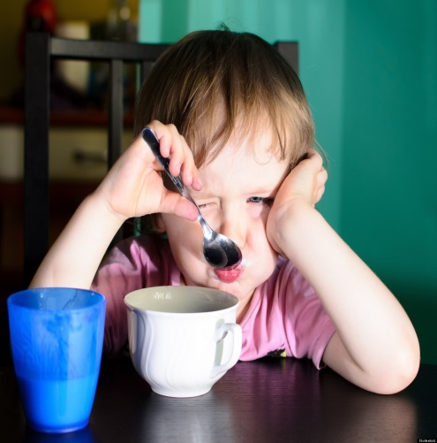


Research says…
Walker and others have found that it is vitally important that aggressive intervention of antisocial behavior take place before the age of 8.
At that point, it becomes durable and stable.

Slide 55
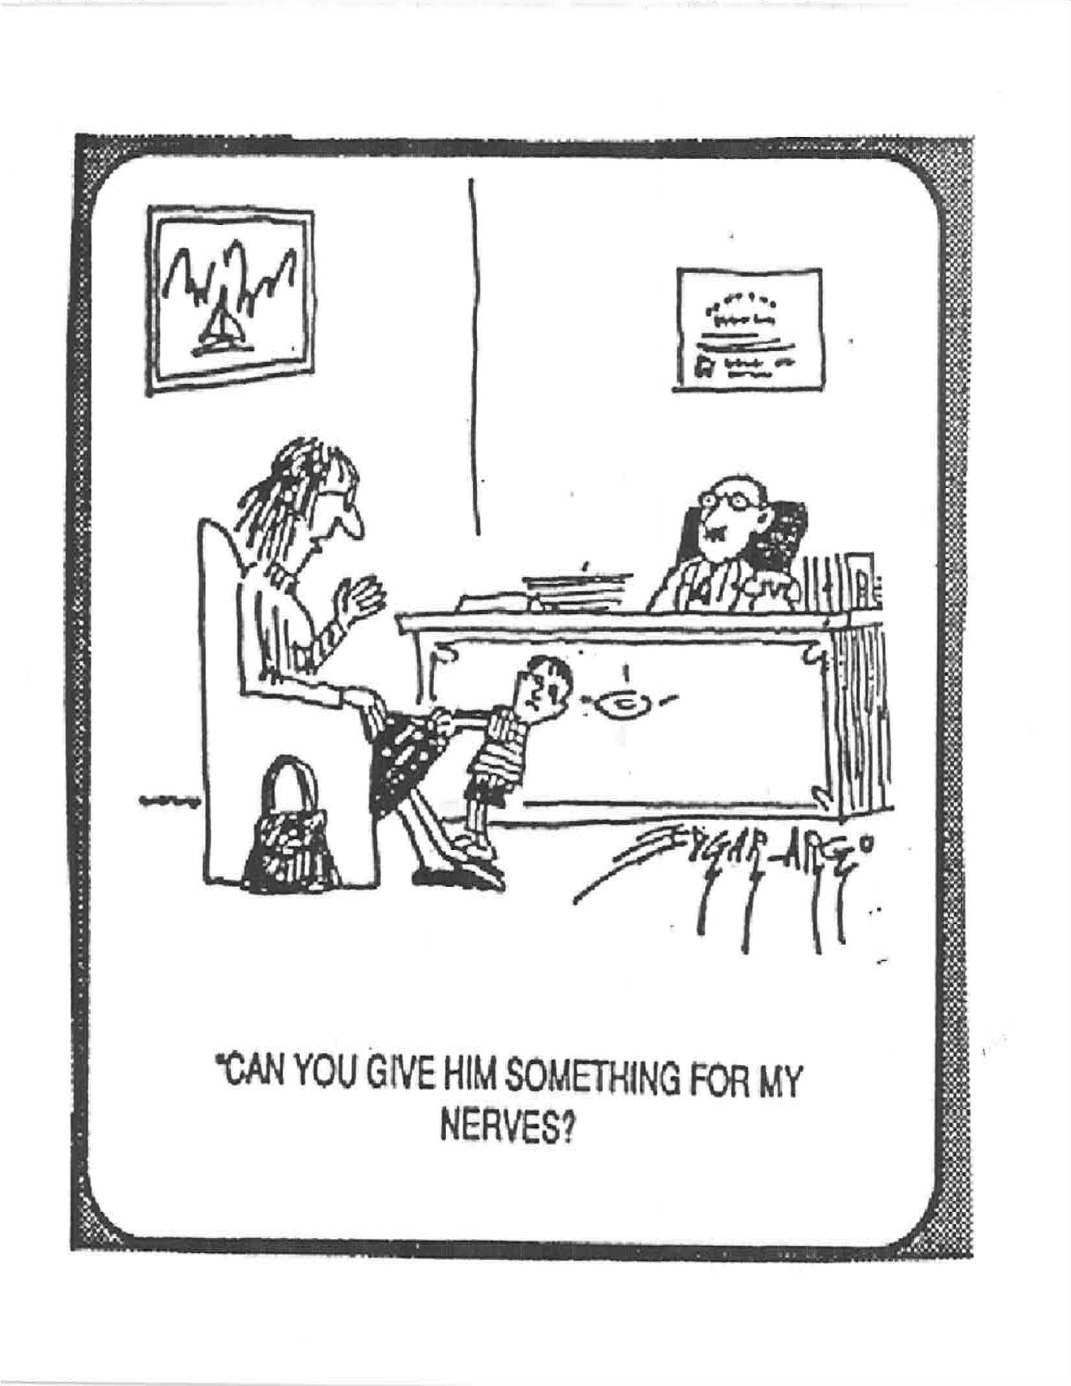

Slide 56
Social Skills Training
“Situation specific, learned behaviors that contribute to an individual’s overall functioning in society”
Social skills training has proven to be effective in teaching children to use appropriate behaviors (Zaragoza, Vaughn, and McIntosh, 1991).
Steps should include: Identifying, modeling, practicing, role play, remind and reinforcing

Slide 57
Social Skills Training: Implementation
Identify students who have deficits
Identify and define target skill
Model target skill
Practice target skill
Provide role-playing opportunities
Remind students to use the skill at appropriate times
Reinforce the target skill
Program for generalization and self-control

Slide 58
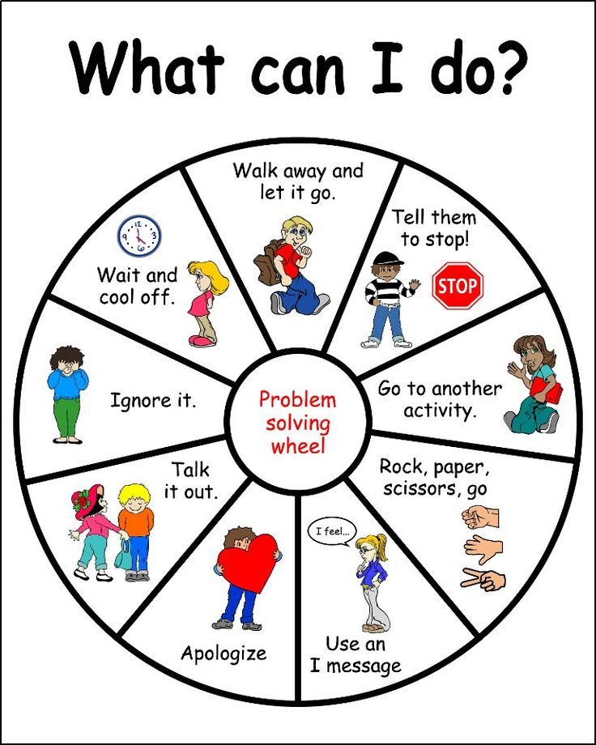
Social Problem Solving
The ability to deal effectively with social situations; used extensively in conflict resolution and peer mediation.
Notes:
The ability to deal effectively with social situations;
used extensively in conflict resolution and peer mediation.

Slide 59
Six Problem Solving Strategies
Alternative Solution Thinking—Think of as many different solutions for engaging a problem.
Consequential Thinking—What is likely to happen if a particular action is taken.
Causal Thinking—Think about how and why a particular event causes the next event.

Slide 60
Six Problem Solving Strategies (cont.)
Interpersonal Sensitivity—Children are encouraged to heighten their awareness and sensitivity in order to identify existing problem(s).
Means-End Thinking—Students learn to develop step by step strategies for successfully approaching social problems.
Perspective Thinking—All children have different opinions and ideas regarding social problems.

Slide 61
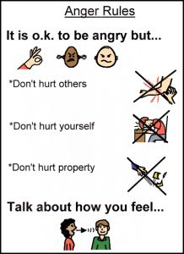
Anger Management
A systematic method of cognitively recognizing anger and managing its effects.
Strategies:
Convince student of the need for change.
Identify personal signals.
Teach self-talk.
Teach problem-solving.
Teach relaxation skills
  Deep breathing
  Progressive relaxation

Slide 62
Modeling
A procedure to modify academic or social behavior using observation and imitation.
Guidelines for implementation
  Select a valid behavior
  Select appropriate models
  Promote student attention
  Promote imitation of modeled behavior
Provide reinforcement for modeled and
imitated behavior.
Notes:
Guidelines for Implementation:
Select a valid behavior
Is the behavior of value?
Is the behavior developmentally appropriate for the student?
Select appropriate models
Models must be able to perform the target skill
Models should share similar interests, values, and skills with the target student
Models should have high status in the eyes of the target student
Use a variety of models
Promote student attention
Provide verbal and physical prompts
Promote imitation of modeled behavior
Provide reinforcement for modeled and imitated behavior.
Direct reinforcement
Vicarious reinforcement

Slide 63
Self-Control
Definition:
Behaviors and strategies that an individual uses to achieve self-selected outcomes.
Includes:
  Self monitoring—observing and recording one’s own behavior
  Self evaluation—compare behavior to self or external standard and judge acceptability
  Self reinforcement—select and administer own positive consequence
Notes:
Self-control is about being able to regulate yourself.
Can you resist distractions? Get a handle on your own emotions? Inhibit your impulses? Delay gratification and plan ahead?
Kids with poor self-control and planning abilities are more likely to have aggressive behavior problems (Raaijmakers et al 2008; Ellis et al 2009).

Slide 64
School Wide Behavioral
Skill Matrix
 | Classroom | Gym | Hallway | Playground | Bus Area
Be Safe | Follow directions | Follow directions | Walk | Go up ladders and down ladders | Wait behind the red line
Be Respectful | Raise your hand to talk Keep hands and feet to self | Play within the rules of the game | Keep hands and feet to self | One minute rule for sharing equipment | Keep hands and feet to self
Be Responsible | Bring hooks and pencil to class Do homework | Participate | Keep books, belongings, and litter off floor | Stay within the recess area | Keep your books and belongings with you

Slide 65
Generalization
When a student performs or adapts
the acquired behavior
under conditions that are different
from those in the place
where the behavior was initially acquired.
Notes:
This is our goal.

Slide 66
Activity: Respect
Answer questions about Respect.
We will report out.
Social Skills Are Essential
Notes:
20 minutes
Pages 10-11
Facilitator’s Notes:
After participants finish the two paragraphs, introduce this slide with emphasis on the research finding. Research finds that the best way to teach social skills is to teach those skills just as you would teach any academic content. Summary—what students don’t know that keeps them from being a success in our classrooms, they need somehow to be taught.
Ask table groups to complete the grid for what “respect” looks like, sounds like, and feels like. Once participants have completed that step, about 3-4 minutes, ask them to discuss possible ways to teach respect to their students and to come up with one idea as a table group AND one way to demonstrate an example of “respect” in action—a 2-minute skit.
Share the ideas, one group at a time.
Debrief:
What are the advantages of this activity?
What are some lesson plan ideas your teams developed?
What are some challenges in teaching behaviors and appropriate attitudes to children?
Move to Slide 27 - Our To-do List: Enrich!

Slide 67
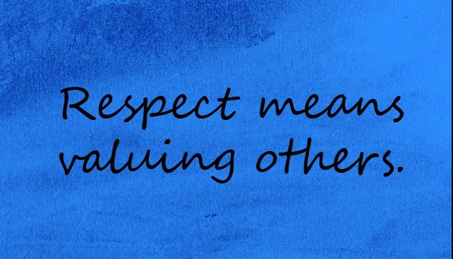
Respect
You should always behave in a respectful manner as this reflects on you, your character, integrity and values of who you are as a person.

Slide 68

Achievement is Related to the Quality of Social Skills
Ego-centricity: Having difficulty looking at someone
else's behavior from that person's point of view
Social-sensitivity: Able to see things from another
person’s point of view and consider a variety of
possible motives for their actions and attitudes
Notes:
3 minutes
Page 10
Facilitator’s Notes:
Mini-lecture: Research tells us that students learn and retain more when they are more socially-sensitive. What can we do in our classrooms to help students become less ego-centric and more social-sensitive?
Key Points: In the past, people have questioned the links between the academic and the affective in the classroom, whether time spent on the affective, or social-emotional, aspects has any relation to students’ academic achievement. One important discovery coming out of research are findings that as students develop and become more mature, more “socially sensitive” and less “ego-centric,” they are better able to think abstractly, to look at problems from multiple points of view, and generally become more successful academically. In short, there are direct connections between the affective and the academic in every classroom.
There is strong evidence that educators have control over many factors that help students become more socially mature. For example, one instructional strategy related to increasing students’ ability to be socially-sensitive is the use of cooperative small group learning, when students are taught cooperative behaviors as content, especially when they are taught these behaviors before participating in the groups to study the academic curriculum.
Assign Reading: Assign the two paragraphs at the top of the page – “Teaching Social and Emotional Skills and Values as Content is Essential”
Move to Slide 26 - Activity Seven: Teaching Social Skills is Essential

Slide 69
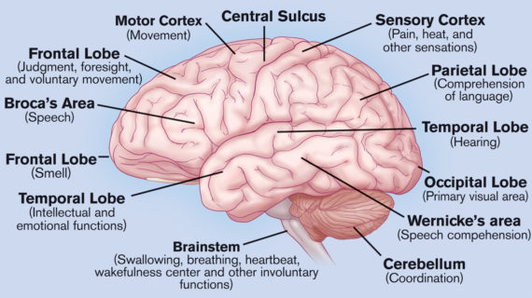
The Brain

Slide 70
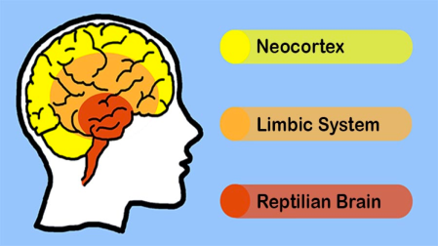
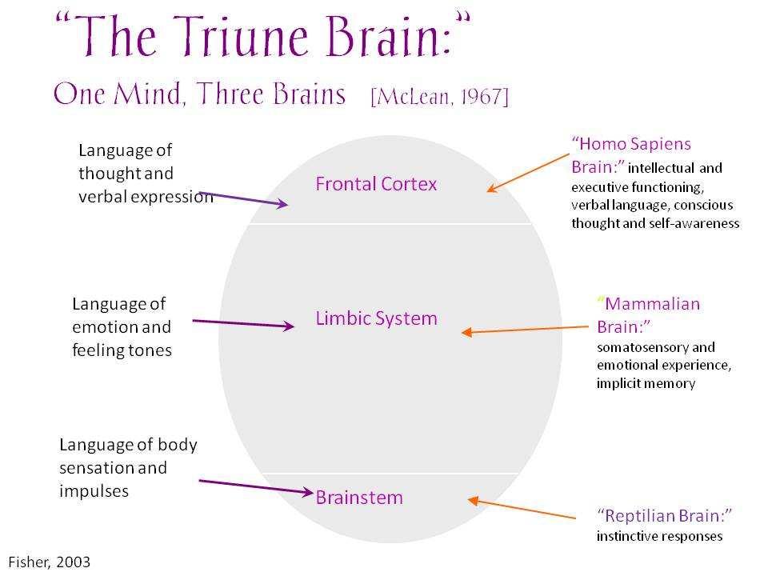
The Brain:

Slide 71
The Triune Brain
First: Brain Stem:
is the seat of autonomic or automatic response, as well as the seat of habits. It connects us to our external world through our skin, our pores and our nerves
Emotional (limbic system):
helps us know what things to approach and what to avoid by guiding our preferences
Rational (neocortex):
assists us with functions related to thinking and language: planning, questioning, making decisions, solving problems and generating new ideas.
The Emotional/Rational Brain Connection:
allowing the emotional and the thinking brains to influence one another in a myriad of ways and providing rich data on which to draw conclusions and initiate action.
Notes:
The first brain (brain stem) is the seat of autonomic or automatic response, as well as the seat of habits. It connects us to our external world through our skin, our pores, and our nerves. It controls what impulses get recognized and passed along to the two higher levels. This brain learns through imitation, avoidance, and repetition until something becomes habitual. Information usually enters at this point without our conscious awareness. We can make much of this information conscious and use it to our benefit, as biofeedback and hypnosis have shown us.
The emotional brain (limbic system) helps us know what things to approach and what to avoid by guiding our preferences. As we move through life and have more experiences, we have stronger intuitions, hunches, and gut reactions because more things are stored in the limbic warehouse. We have “learned” from experience. Intuition is emotional learning gained over many years; a 14 year old has little intuition because he or she has not experienced enough life to make connections between experiences. As we mature, we accumulate more reliable emotional data that can offer us valuable clues and guide our behavior, providing we become aware of its existence and learn how to interpret it. Unfortunately, many adults have been taught to ignore this type of information.
The rational brain (neocortex) assists us with functions related to thinking and language: planning, questioning, making decisions, solving problems, and generating new ideas. This layer is connected to the emotional brain with millions of connections, allowing the emotional and the thinking brains to influence one another in a myriad of ways and providing rich data on which to draw conclusions and initiate action.

Slide 72
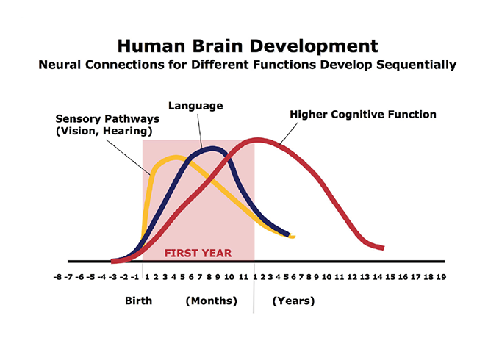

Slide 73
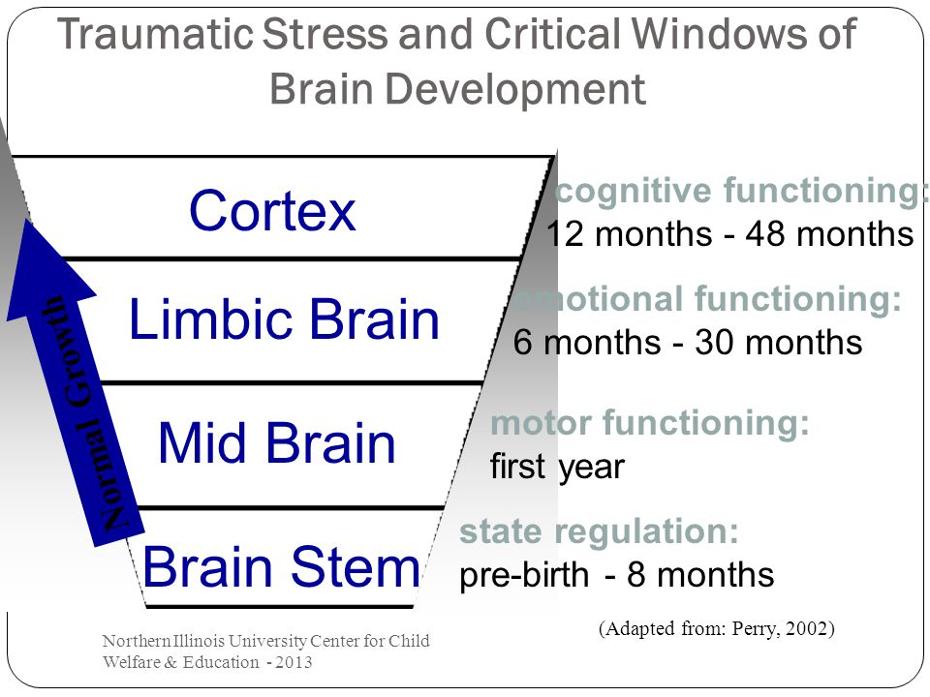

Slide 74
What Do We Know
About the Brain?
Brain matures in an “environmental” context
Shift from concrete thinking to abstract thinking
(“Feeling” brain to “Thinking” brain)
Present Future
Increased impulse control
Increased emotional regulation
Concrete Possibilities
Self centered Perspective

Slide 75
The Brain
Is an interconnected system with different brain areas having distinct and specialized jobs.
“Mirror neurons helps connect us to other people’s brains.”
Brain development and SEL are linked.
The brain is a social organ that is not static, but continually adapts throughout the life span.
Our relationships trigger neuroplasticity and learning.
There is an intensely interconnected relationship of the mind, body and emotions, all of which are connected through the biochemistry of the body.
Our body influences the state of our brain and which system (impulse or self-control) is activated.
Notes:
For example: Impulse control directly correlates to sleep---teens with less sleep are more susceptible to risky choices.
Movement is another way our body influences our brain. Brain area is prefrontal cortex which is seat of executive function and emotional regulation. Five minutes of physical activity shifts our brain toward allowing us to resist temptation.

Slide 76
Focusing
Gateway to all thinking including perception, memory, language, reasoning, problem solving and decision making.
Enemy is multi-tasking: The human brain is a single-core processor.
Connected to the skill of mindfulness, an active and open attention to the present or task at hand.
The brain is very sensitive to interference or being distracted.

Slide 77
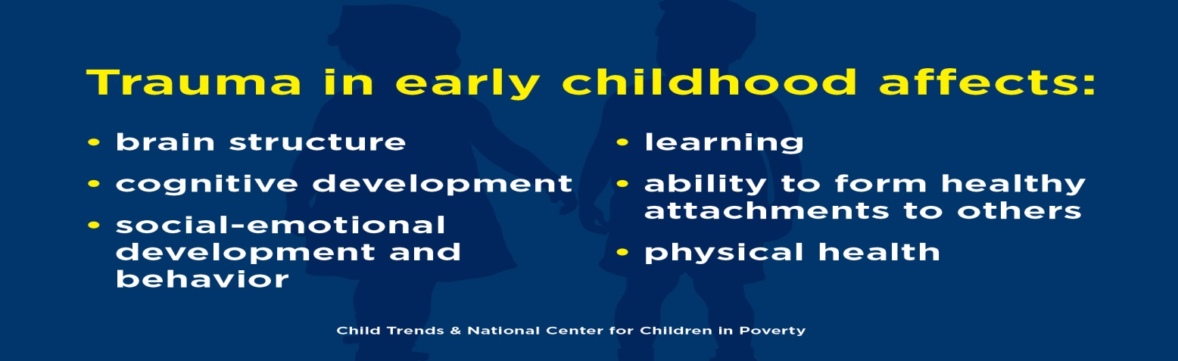
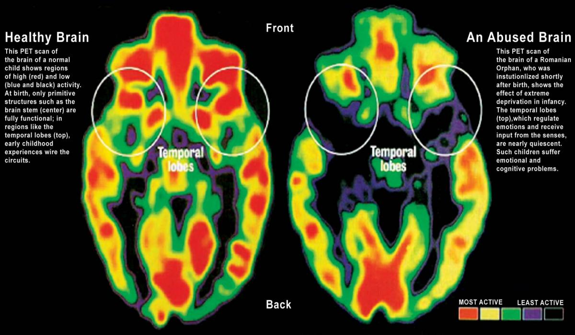

Slide 78
The Adolescent Brain
Adolescents are more likely to:
act on impulse
misread or misinterpret social cues and emotions
get into accidents of all kinds
get involved in fights
engage in dangerous or risky behavior
Adolescents are less likely to:
think before they act
pause to consider the consequences of their actions
change their dangerous or inappropriate behaviors
Notes:
Based on the stage of their brain development, adolescents are more likely to:
act on impulse
misread or misinterpret social cues and emotions
get into accidents of all kinds
get involved in fights
engage in dangerous or risky behavior
Adolescents are less likely to:
think before they act
pause to consider the consequences of their actions
change their dangerous or inappropriate behaviors

Slide 79
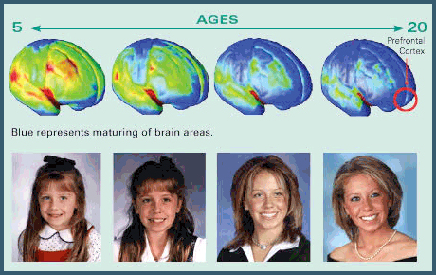
What Do We Know
About the Teen Brain?
Brain develops until mid-20’s
Major brain growth spurt during teen years
“Use it or lose it” principal & brain “plasticity”

Slide 80
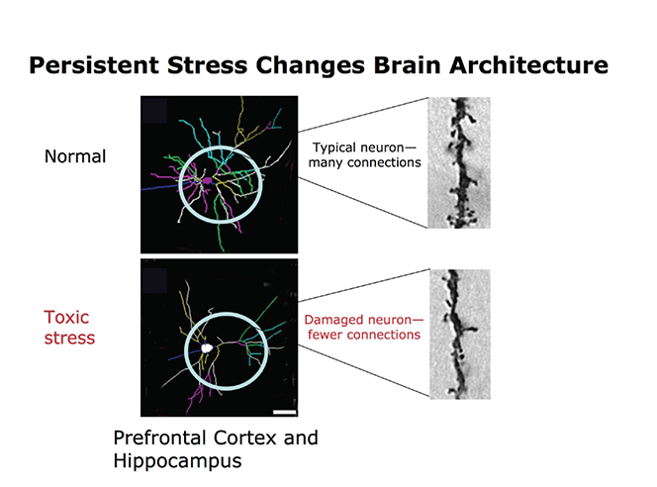
Notes:
Brains subjected to toxic stress have underdeveloped neural connections in areas of the brain most important for successful learning and behavior in school and the workplace. Source: Radley et al (2004); Bock et al (2005). Credit: Center on the Developing Child.

Slide 81
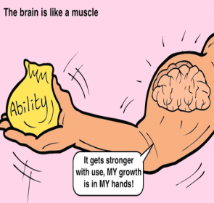
Brain Plasticity
The ability of the brain to change physically, functionally and chemically throughout life.
Neuroplasticity occurs in the brain:
  At the beginning of life: when the immature brain organizes itself.
  In case of brain injury: to compensate for lost functions or maximize remaining functions.
  Through adulthood: whenever something new is learned and memorized
Notes:
You may have heard that the brain is plastic. As you know. the brain is not made of plastic…Neuroplasticity, or brain plasticity, refers to the brain’s ability to CHANGE throughout life. The human brain has the amazing ability to reorganize itself by forming new connections between brain cells (neurons).
In addition to genetic factors, the environment in which a person lives, as well as the actions of that person, play a significant role in plasticity.
Neuroplasticity occurs in the brain:
1- At the beginning of life: when the immature brain organizes itself.
2- In case of brain injury: to compensate for lost functions or maximize remaining functions.
3- Through adulthood: whenever something new is learned and memorized

Slide 82
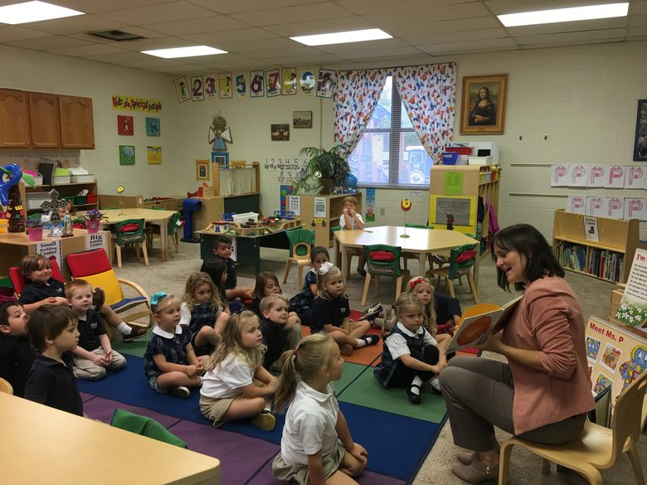
The School Environment

Slide 83
Activity: What Kinds of Places
Should Schools Be?
“At a time when the traditional structures
of caring have deteriorated, schools must be places where students and teachers live together, talk with each other, take delight in each other’s company. My guess is that when schools focus on what really matters in life, the cognitive ends we now pursue so painfully and artificially will be achieved somewhat more naturally… It is obvious that children will work harder and do things—even odd things like adding fractions—for the people they love and trust.”
(Noddings, 1998; in Bernard, 2004)
Notes:
7 minutes
Page 8
Facilitator Notes:
Ask participants to follow the directions on the slide.
Debrief:
What are key words in the first sentence of the paragraph? What are key words in the second sentence? What are the key words in the third and last sentence?
What kinds of places should schools be, according to research? (Take 2 or 3 responses, only, to save time. Record points on newsprint and post.)
Transition: Let’s move to look at more research in order to discover HOW we can turn schools into the kinds of places they SHOULD be, beginning with perceptions and wishes as revealed in research.
Move to Slide 18 - Research Overview: What Teachers See as Caring

Slide 84
Social and Emotional Learning
Intrinsically, schools are social places and learning is a social process. Students do not learn alone but in collaboration with their teachers, in the company of their peers, and with the support of their families. Emotions can facilitate or hamper their learning and their ultimate success in school. Because social and emotional factors play such an important role schools, schools must attend to this aspect of the educational process for the benefit of all students.
Joseph E. Zinns Michele R. Bloodworth
Roger P. Weissberg Herbert J. Walberg

Slide 85
What Is Social and
Emotional Learning?
Social and emotional learning (SEL) is a process which helps children cultivate essential life skills including:
awareness of one’s own emotions
fostering respect and care for others
establishing strong relationships
making ethical and responsible decisions
handling adversity constructively
Notes:
Social and emotional learning is one of the most important strategies available to promote student success and effective school reform. Extensive evaluations have found that social and emotional learning enhances academic achievement, helps students develop self-management and self-control, improves relationships at all levels of the school-community, reduces conflict among students, improves teachers’ classroom management, and helps young people to be healthier and more successful in school and life.” ~The Collaborative for Academic, Social and Emotional Learning

Slide 86
School Culture
Tells people what’s important and how they are supposed to act.
Norms
Values
Rituals
Ceremonies make up the
Rituals persona of the school
Symbols
Symbols
Stories
Notes:
Every school has a:
Formal culture = (job descriptions, traditions, mission statement, and values defined by symbols, school mascot, school song
Informal culture = How people interact with each other, share information, how work gets done and by whom
Subcultures = grade levels. Departments, young teachers/old teachers ; jocks/nerds
Family culture. A school that is a family or a team. The most important element is concern for each other, and staff commitment to students and their culture is common.
Machine culture. A school that runs like a well-oiled machine. The focus is on precision rather than on nurturing learners.
Cabaret culture. A circus-type culture. The relationships and status in the school come from theatrical practices. These schools are "all show and no go."
Little Shop of Horrors. The school culture is viewed as unpredictable. Tension and stress abound. People view it as a prison. They have no choice but to function or try to escape.

Slide 87

School Climate
Results from the appearance, comfort and orderliness of the school facility or school bus.
Results from the peer norms that are present.
Results from the nature of the administrative staff-student cohesion and support systems.
The quality of interaction in the teacher’s lounge.
The noise levels in the hallway and cafeteria.
Physical comfort levels (heating, cooling, lighting, etc.).
How safe people feel.
How easy it is for students to interact with one another informally (school size affects this).
Notes:
Climate is to a school what personality is to an individual
The communication of its beliefs, norms, and values through various behaviors and interactions and their effects on others, with the primary focus being on students.
Is driven by and reflected in the daily interaction of staff, administration, support staff, students and the outside community.

Slide 88
School Culture/Climate Activity
Read the scenario for each student below:
How do you think the school culture and climate affects their social and emotional learning? Their academic behavior?
Reiko
Kyoshi
Mitch
Rachel
You

Slide 89
Activity: SEL Research
Blue Card
Green Card
Yellow Card
Pink Card
Purple Card

Slide 90
The Five SEL Competencies in the Classroom
▪ Self-awareness • “What are you good at in this class and how do you know you are good at it?” • “When you don’t understand something in this class, what do you do?”
▪ Self-management • “How do you move toward your goal, especially when you lose focus or are stuck or stressed?”
▪ Social awareness • “When you are working in a group, how do you make sure it is fair for everyone?”
▪ Relationship skills • “What do you do so that your classmates and teacher have heard and understand your ideas/what you are saying?” |
▪ Responsible decision making • “When you are working with others, how do you make a decision?”

Slide 91

Three Basic Human Needs
Competence
Autonomy
Relatedness

Slide 92
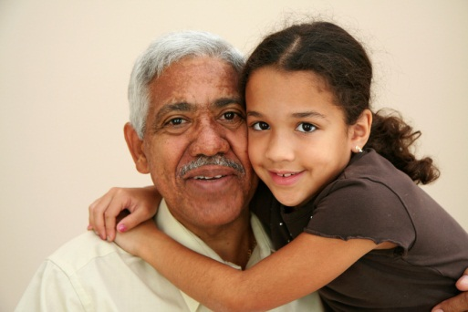
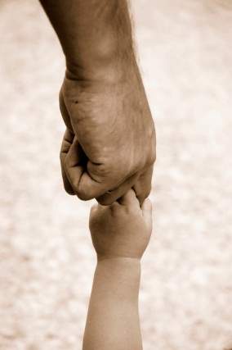
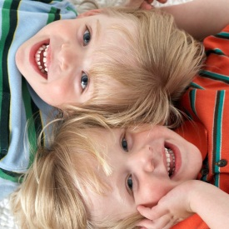

Reaching All Students…
Research concludes that “student engagement is optimized when the social context fulfills children’s basic psychological needs.” Connell & Wellborn
The basic psychological needs are:
    a sense of competence
    a sense of autonomy
    a sense of relatedness to others.
Notes:
3 minutes
Facilitator Notes:
Whole group to focus on quote – Use this slide as a transition.
Say: Research findings reveal that when our classrooms or schools address all 3 of these needs – the whole human being – our students are more engaged in academic work. When they are more engaged in this way, they learn in greater depth and breadth, and consequently move closer to realizing their potential as students.
Move to Slide 32 - Three Basic Needs Defined

Slide 93

Three Basic Human Needs Defined
Competence: A sense of being able to problem-solve successfully
Autonomy: A sense of
independence, knowing you
have what it takes to find
answers
Relatedness: A sense of belonging to the group
Notes:
8 minutes
Pages 15-16
Facilitator Notes:
Mini-lecture: Decades of research affirm that human beings of all ages are more successful when these three interrelated and interdependent needs are met within the social context of a classroom, school, or other social environment.
Assign Reading: Ask participants to read “Three Basic Needs” in their handbook, pages 15-16.
Discussion: Ensure that participants understand these three concepts in preparation for the next activities. One way is to ask them to define each in turn.
Competence means knowing you have the skills and knowledge it takes to problem-solve successfully on a large percentage of the challenges you face, even if it means simply knowing where to go to find the answers at least half the time. Competence in a classroom may mean, for example, you know how to complete different tasks, either social or academic. It also means you know how to get the teacher’s attention without getting in trouble. It means you know how to resolve a variety of conflicts. It means you believe that the brain isn’t fixed in intelligence – that you can expand your abilities, skills, and knowledge.
Autonomy is interrelated with the other two needs, and high-level autonomy means you have the skills and knowledge to operate successfully within the social context. This also means we know ourselves and can judge our own performance—and knowing ourselves means we have a sense of relatedness within the group.
Relatedness allows us to learn about ourselves and our world through our interactions with others. Relatedness in a classroom, for example, allows us to get the teacher’s attention, ask for help, or make a mistake in front of the others in the room without fear. It also means that we have something of value to contribute to the group as well as to receive something of value from the group.
Move to Slide 33 - Three Basic Needs Described

Slide 94
Competence Support:
is “the amount of information in the [classroom] context about how to effectively achieve desired outcomes; its opposite is chaos.”
(Skinner & Belmont)
Notes:
6 minutes
Page 17
Facilitator Notes:
Mini-lecture: This research is an affirmation that we need to create a healthy learning environment, we need to ensure that we establish a predictable environment. Researchers have found that good teachers tend to structure their classrooms through such things as rules and procedures and instructional strategies chosen to fit our students’ specific needs in order to help students feel competent and comfortable.
For example, researchers observed that good teachers teach rules and procedures as content. They enforce them consistently and fairly, and they help students learn the reasons behind the rules. They make sure that students know how to get their teacher’s attention. Students are taught things like how to get an assignment that was given when they were away from the classroom. They’re taught how to behave when they’re frustrated and can’t solve a problem, or how to greet a new student coming into the classroom. Students learn to feel a sense of competence in the classroom – socially and academically. Teachers need to prepare students for success in lessons.
Popcorn a Guided Practice: Name one thing students need to know to feel competent.
Independent Practice: In Table Groups, respond to the question in Box 1, Competence. Jot down notes in the box.
Debrief: Get 1-2 sample responses from Table Groups.
Move to Slide 35 - Autonomy Support

Slide 95

Autonomy Support:
is the amount of freedom we provide a student so the child can make decisions about his or her own behavior.
The amount depends on developing
levels of student competence, such
as the students’ ability to
  learn the rules (social & academic)
  to automaticity;
  understand how to work successfully
  within the rules; and
  grow capable of solving problems with a minimum of teacher intervention.
Notes:
6 minutes
Page 17
Facilitator Notes:
Mini-lecture: Second, we support students’ sense of autonomy when we teach them where to find the resources they need to complete assignments, how to ask questions, how to do an assignment (getting all the necessary instructions), and when we ensure that they know how to succeed at one level of learning before they have to move to the next level, for example—learning the alphabet before going on to books; learning the rules of a game before playing the game. We can also help them by providing options.
Following the process used with Competence, ask Table Groups to identify one strategy for helping students feel a sense of autonomy when presented with some new content. Jot group notes down in the box.
Debrief: Get responses from Table Groups.
Move to Slide 36 - Relatedness Support

Slide 96

Relatedness Support:
We need to involve students in activities and lessons that…
                Build quality interpersonal
                relationships with teachers
                and peers.
                Build self-determination,
                self-esteem, and
                engagement in the class.
Notes:
6 minutes
Page 17
Facilitator Notes:
Ask and discuss:
What are some examples you’ve experienced of students who’ve appeared to feel uninvolved with their fellow students in the classroom? How do they behave? NOTE: Feeling interrelated involves give-and-take on the part of all members of a group. (All individuals have something to give. No one person has all the skills and knowledge needed.)
What social skills do students need, in order to build quality relationships with their peers and with adults?
Continue the process: Ask Table Groups to identify one strategy for building all students’ sense of relatedness. Jot down the group strategy in the assigned box.
Debrief: Get sample responses from Table Groups.
Move to Slide 37 - A Metacognitive “Sound Check”

Slide 97
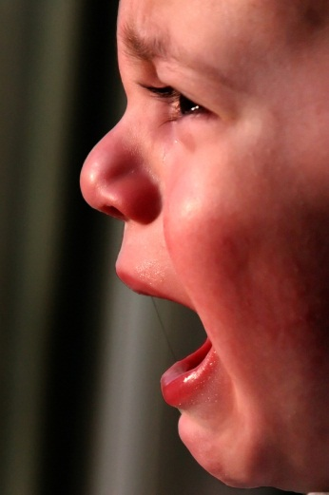


What if we knew more about our students?
Mary’s Story
How does knowing more
about our students help us
help them?
Notes:
3 minutes
Facilitator Notes:
Facilitate a short discussion to answer the question on the slide after participants have read the first paragraph about Mary.
Depending on the available time, this could be a whole-group discussion, or Think-Pair-Share.
Move to Slide 41 - What Are We Modeling?

Slide 98
Five things adult role models can do for kids:
Listen to them
Comfort them
Inspire them
Collaborate
Celebrate them

Slide 99
Activity: SEL Research
Blue Card
Green Card
Yellow Card
Pink Card
Purple Card

Slide 100




Relationships

Slide 101



Relationships Matter
The problems of schooling (low achievement, dropout rates, teaching issues) were the consequences of the deeper issues of human relationships.
Poplin & Weere
Claremont Graduate School Study (1992)
Notes:
2 minutes
Page 9
Facilitator Notes:
Mini-lecture: This research finding has been affirmed many times over in research. Ask participants to read silently to themselves or ask for a volunteer to read it aloud. Emphasize that more and more research studies are coming to the same conclusions – that teachers need to work on social and emotional needs as well as academic needs, because one helps the other.
(Note the date, because the next slide is a conclusion drawn from many studies showing connections between mind, body, and relationships.)
Debrief: What are some examples of any evidence of this finding that you’ve seen in your own professional experience? Share out in whole group – one or two examples.
Move to Slide 22 - Emotions and the Brain

Slide 102


Slide 103
The Post-It Note Story
One day, a student in his World History class placed a post-it note on her forehead reading “I’m bored and I hate this class!” In the past, Mr. Smith explained, he would have sent the student out of class immediately and recommend a one-day suspension. Instead, as part of the school’s trauma-informed approach, he turned to the student and asked her to hand out post-it notes to all of her classmates.
He told the students to write down how they felt at that moment, and then place the post-it note on their foreheads. Then, he went around the room and asked each student to explain what they wrote and why. One student wrote “I’m angry my father left.” Mr. Smith was shocked to read notes stating “I am sad that Mr. Smith doesn’t even know my name” or “I wish Mr. Smith liked us.”
The experience gave Mr. Smith new insights and the opportunity to connect to his students and share his own perspective in a way he never had before. He explained that the exercise of post-it notes changed his relationship with his students and made them feel more connected. It improved the classroom dynamic and re-engaged students in learning. “It was a great investment of time that continues to pay dividends.”
Notes:
A teacher shared this story as an example of what it means to be trauma-sensitive in the classroom. One day, a student in his World History class placed a post-it note on her forehead reading “I’m bored and I hate this class!” In the past, Mr. Smith explained, he would have sent the student out of class immediately and recommend a one-day suspension. Instead, as part of the school’s trauma-informed approach, he turned to the student and asked her to hand out post-it notes to all of her classmates.
He told the students to write down how they felt at that moment, and then place the post-it note on their foreheads. Then, he went around the room and asked each student to explain what they wrote and why. One student wrote “I’m angry my father left.” Mr. Smith was shocked to read notes stating “I am sad that Mr. Smith doesn’t even know my name” or “I wish Mr. Smith liked us.” The experience gave Mr. Smith new insights and the opportunity to connect to his students and share his own perspective in a way he never had before. He explained that the exercise of post-it notes changed his relationship with his students and made them feel more connected. It improved the classroom dynamic and re-engaged students in learning. “It was a great investment of time that continues to pay dividends.”

Slide 104

What Are We Modeling?
Bryk & Schneider’s extensive study of Chicago schools (2002) found that “relational trust” was an essential ingredient in improving education, involving:
  Respect
  Competence (doing our jobs well)
  Personal regard for others
  Integrity
Notes:
3 minutes
Facilitator’s Notes:
Mini-lecture:
Bryk and Schneider found in their research that effective schools requires that all members of the school community learn to trust each other – and to model the behaviors that students need to learn to automaticity.
Debrief (Popcorn answers):
Why is it important that we model these behaviors, in your own words?
If time allows:
What’s Already Working: What’s working in your school or district right now, to promote this ideal?
Challenges: What are the challenges in creating an environment of trust among adults in school/district? What are the challenges of modeling the right behaviors for students? What is one way you can meet one of the challenges you’ve mentioned?
Move to Slide 42 - Working Together

Slide 105
Learning
Relationships affect student achievement
Student’s of teaching and teacher’s matter
Teachers and students see things differently in reason’s for schools, what caring is and what is important.
Differences in student’s and teacher’s perceptions affect academic learning
Student’s perceptions are tied to maturity levels, which influence learning

Slide 106
Activity: SEL Research
Blue Card
Green Card
Yellow Card
Pink Card
Purple Card

Slide 107
Five things adult role models can do for kids:
Listen to them
Comfort them
Inspire them
Collaborate
Celebrate them

Slide 108
Learning Operates in Contexts
”I’ve come to believe
that human intellectual
performance is far more
fragile than we customarily
think; it can rise and fall
depending on social context.”
(J. Aronson 2004)
Notes:
4 minutes
Facilitator Notes:
Say: Knowing what we know so far, about perceptions and wishes, it’s important to begin examining some more pieces of the “elephant” and ways of taking action in the classroom that creates the optimum environment (social and physical) for learning.
Debrief: This quote was addressed earlier, but it’s serving as a transition and for deeper study here.
First, what could the researchers mean by the term “social context”?
Second, what are the individual components of a classroom that comprise the context for learning?
Examples: other students, yourself and your teaching style, physical situation, classroom arrangement, differences in student achievement levels, social differences (“in” as opposed to “out” groups)
Move to Slide 25 - Achievement is Related to the Quality of Social Skills

Slide 109

Student Mindsets
Notes:
Students with a fixed mindset believe that their intelligence and talent are innate traits that don’t change. For example, they might say “I just can’t learn math.” These students typically worry about not looking smart, get upset by mistakes, and give up sooner on tough tasks.
Students with a growth mindset believe that ability can change as a result of effort, perseverance, and practice. You might hear them say, “Math is hard, but if I keep trying, I can get better at it.” Students with a growth mindset see mistakes as ways to learn, embrace challenges, and persist in the face of setbacks. High-performing students and low-performing students may have either mindset.
Studies show students with a growth mindset:
Are more motivated and engaged, even when work is challenging
Are more likely to review or revise their work
Score better on math and verbal standardized tests
Fail fewer classes and have higher GPAs
Are more likely to persist in high school and college
GET THE FREE TOOLKIT

Slide 110


Mindset: Struggle for Smarts
Mother: Do you know that's what smart people do, smart grown-ups?
Child: I know…talk about books.
Mother: Yeah. So that's a pretty smart thing to do to talk about a book.
Child: Hmmmmmmm.
The boy won first place in a competition, and the mother is explaining to him why.
"You practiced and practiced with lots of energy," she tells him. "It got really hard, but you made a great effort. You insisted on practicing yourself."

Slide 111


What are desired academic behaviors?
Regular class attendance
Arriving ready to work
Paying attention
Participating in instructional activities and class discussions.
Studying out-of-school
Doing and returning homework
Others?
Notes:
Academic behaviors are those behaviors commonly associated with being a “good student.”
Academic behaviors are extremely important for achievement.
Strong evidence that academic behaviors are malleable and affected by classroom context.

Slide 112



The S&E Learning Goal: Academic Performance
I belong in this academic community.
My ability and competence grow with my effort.
I can succeed at this.
This work has value for me.

Slide 113


Slide 114


