Slide 1
ACEs Adverse Childhood Experiences
August 2021
Sonia Henriquez
District Professional Development

Slide 2
ACEs-Adverse Childhood Experiences come in many forms, from physical and mental abuse to neglect and household dysfunction and have a tremendous impact on lifelong health and opportunity. We know that how toxic stress affects the minds and bodies of children but, we can interrupt these changes by providing safe, stable, nurturing environments, while helping children build social-emotional skills and resilience. Working together, we can help create neighborhoods, communities, and a world in which every child can thrive. In this workshop we will learn more about ACEs and how to prevent or interrupt ACEs in our community by assuring safe, stable, nurturing relationships and environments for our students.

Slide 4
The ACEs Study [published in 1998] is important because it found links between childhood trauma and long-term health, behavior and social consequences among adults.
Permanente Medical Group (Kaiser Permanente), Centers for Disease Control and Prevention (CDC), Emory University and the University of Arizona – asked adult patients about any exposure they had as a child to the following:
An ACE score is a tally of different types of abuse, neglect, and other hallmarks of a rough childhood. According to the Adverse Childhood Experiences study, the rougher your childhood, the higher your score is likely to be and the higher your risk for later health problems.

Slide 5
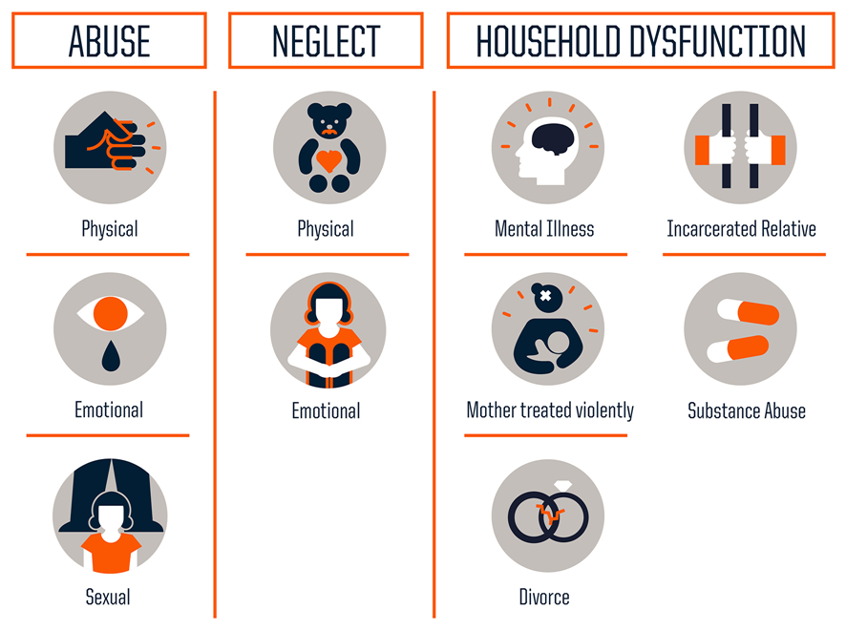
Recurrent physical abuse
Recurrent emotional abuse
Contact sexual abuse
Alcohol and/or drug abuser in the household
An incarcerated household member
Someone in the household who is chronically depressed, mentally ill, institutionalized or suicidal
Mother is treated violently
Parents are separated or divorced
Emotional neglect
Physical neglect

Slide 7
The following are the 10 questions in the ACES study
Please read the following questions and add one point for each question that your answer is yes.
*Note that some questions have multiple components.
Your score is personal and you do not need to share it if you do not wish to

Slide 8
1. Before your 18th birthday, did a parent or other adult in the household often or very often…
swear at you, insult you, put you down, or humiliate you?
or
act in a way that made you afraid that you might be physically hurt?
2. Before your 18th birthday, did a parent or other adult in the household often or very often…
push, grab, slap, or throw something at you?
or
ever hit you so hard that you had marks or were injured?
3. Before your 18th birthday, did an adult or person at least five years older than you ever…
touch or fondle you or have you touch their body in a sexual way?
or
attempt or actually have oral, anal, or vaginal intercourse with you?

Slide 9
4. Before your eighteenth birthday, did you often or very often feel that…
no one in your family loved you or thought you were important or special?
or
your family didn’t look out for each other, feel close to each other, or support each other?
5. Before your 18th birthday, did you often or very often feel that…
you didn’t have enough to eat, had to wear dirty clothes, and had no one to protect you?
or
your parents were too drunk or high to take care of you or take you to the doctor if you needed it?
6. Before your 18th birthday, was a biological parent ever lost to you through divorce, abandonment, or other reason?

Slide 10
7. Before your 18th birthday, was your mother or stepmother:
often or very often pushed, grabbed, slapped, or had something thrown at her?
or
sometimes, often, or very often kicked, bitten, hit with a fist, or hit with something hard?
or
ever repeatedly hit over at least a few minutes or threatened with a gun or knife?
8. Before your 18th birthday, did you live with anyone who was a problem drinker or alcoholic, or who used street drugs?
9. Before your 18th birthday, was a household member depressed or mentally ill, or did a household member attempt suicide?
10. Before your 18th birthday, did a household member go to prison?

Slide 11
People have an ACE score of 0 to 10. Each type of trauma counts as one, no matter how many times it occurs.

Slide 12
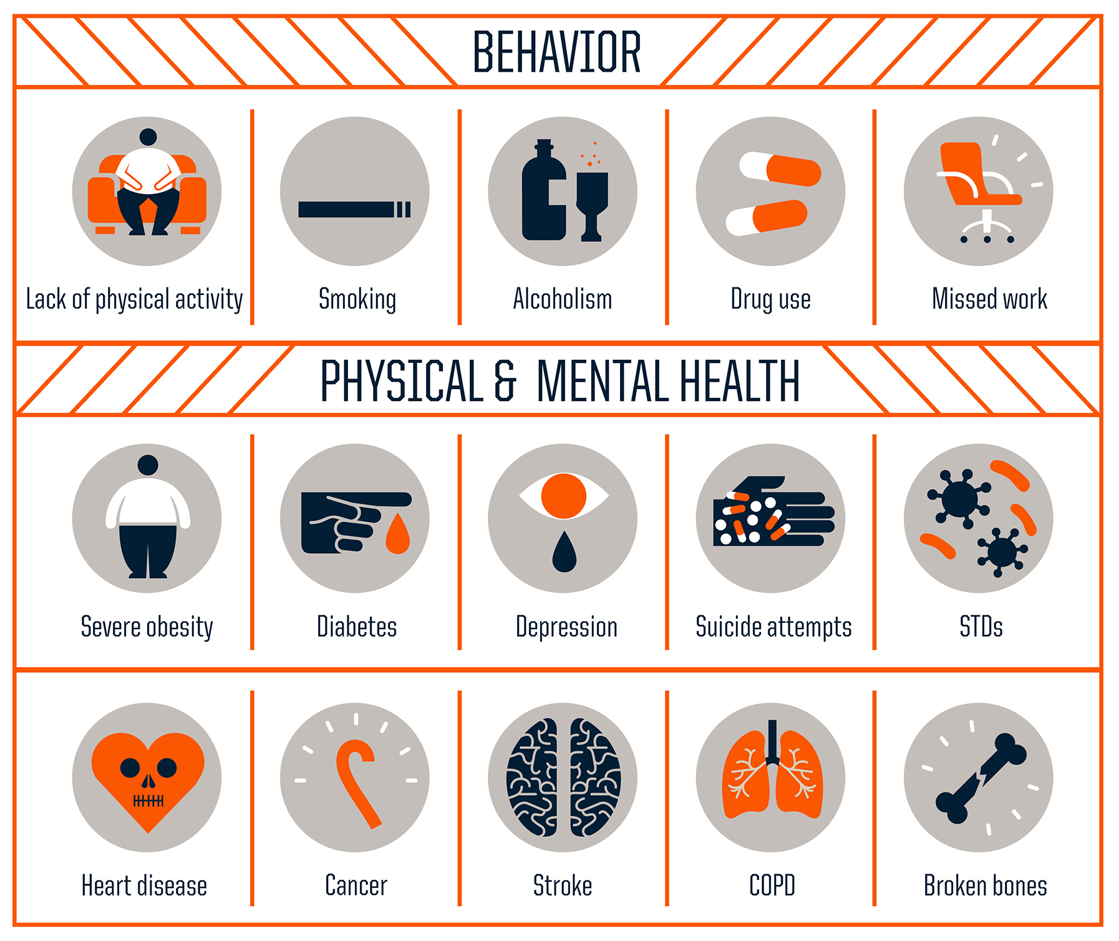
ACEs Increases Health Risks
According to the Adverse Childhood Experiences study, the rougher your childhood, the higher your score is likely to be and the higher your risk for various health problems later.
ACEs are common…nearly two-thirds (64%) of adults have at least one.
They cause adult onset of chronic disease, such as cancer and heart disease, as well as mental illness, violence and being a victim of violence
ACEs don’t occur alone….if you have one, there’s an 87% chance that you have two or more.

Slide 13
The more ACEs you have, the greater the risk for chronic disease, mental illness, violence and being a victim of violence. You can think of an ACE score as a cholesterol score for childhood trauma.
For example, people with an ACE score of 4 are twice as likely to be smokers and seven times more likely to be alcoholic. Having an ACE score of 4 increases the risk of emphysema or chronic bronchitis by nearly 400 percent, and attempted suicide by 1200 percent. People with high ACE scores are more likely to be violent, to have more marriages, more broken bones, more drug prescriptions, more depression, and more autoimmune diseases. People with an ACE score of 6 or higher are at risk of their lifespan being shortened by 20 years.

Slide 15
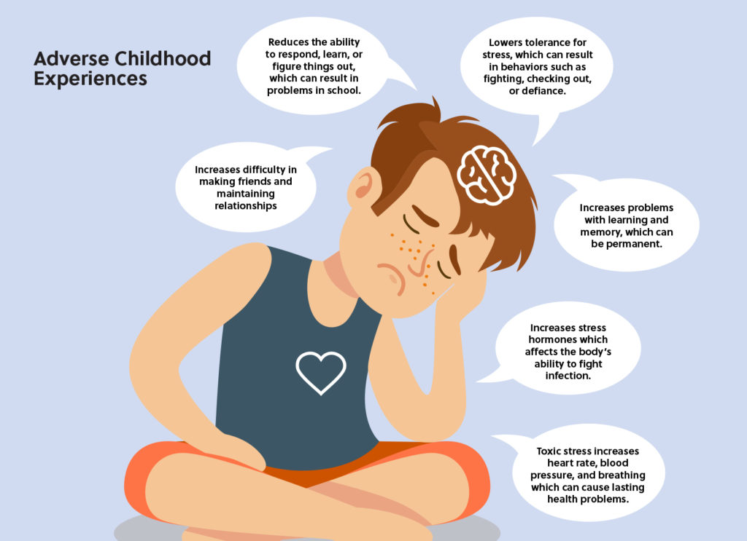
At the same time that the ACE Study was being done, parallel research on kids’ brains found that toxic stress damages the structure and function of a child’s developing brain. This was determined by a group of neuroscientists and pediatricians, including neuroscientist Martin Teicher and pediatrician Jack Shonkoff, both at Harvard University, neuroscientist Bruce McEwen at Rockefeller University, and child psychiatrist Bruce Perry at the Child Trauma Academy.

Slide 16
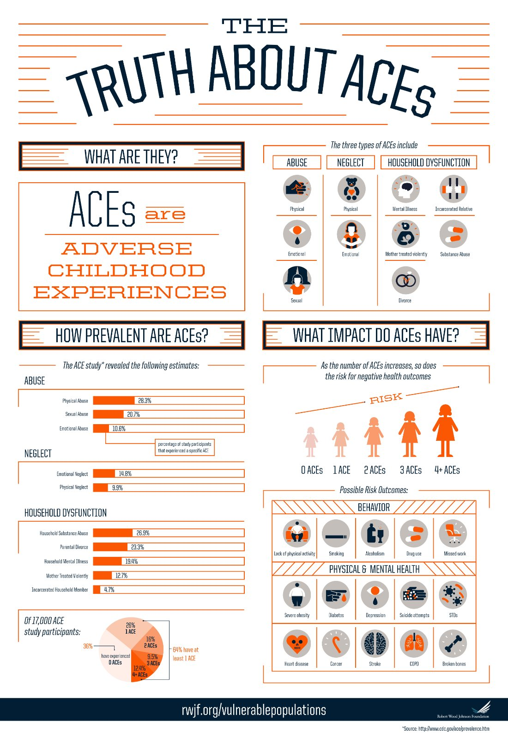
When children are overloaded with stress hormones, they’re in flight, fright or freeze mode. They can’t learn in school. They often have difficulty trusting adults or developing healthy relationships with peers (i.e., they become loners). To relieve their anxiety, depression, guilt, shame, and/or inability to focus, they turn to easily available biochemical solutions — nicotine, alcohol, marijuana, methamphetamine — or activities in which they can escape their problems — high-risk sports, proliferation of sex partners, and work/over-achievement. (e.g. Nicotine reduces anger, increases focus and relieves depression. Alcohol relieves stress.)

Slide 17
The 3 Realms of ACEs are Community, Household, and Environment. ACEs in these realms intertwine throughout people's lives, and affect the viability of families, communities, organizations, and systems.
Left unaddressed, toxic stress from ACEs harms children and families, organizations, systems and communities, and reduces the ability of individuals and entities to respond to stressful events with resiliency.

Slide 18
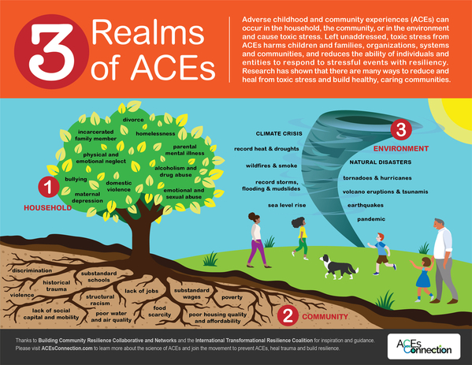

Slide 19
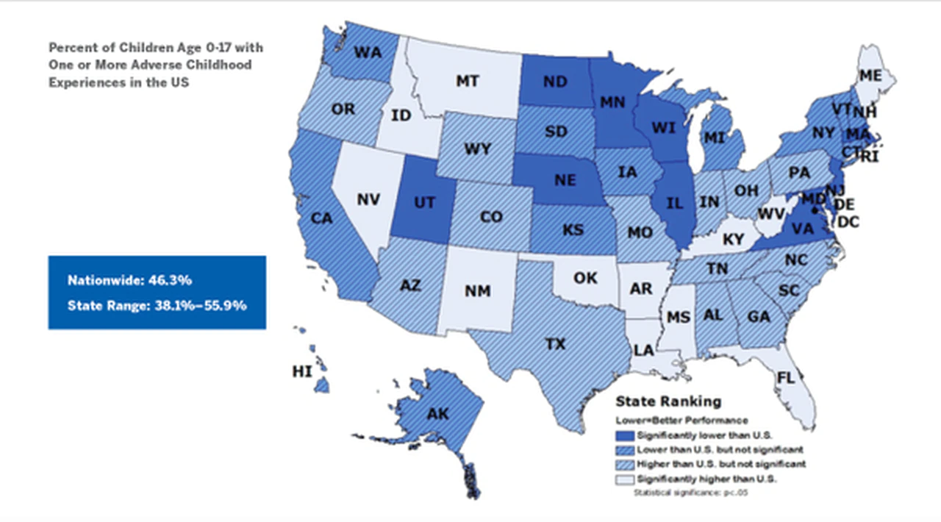

Slide 21
Fortunately, brains and lives are somewhat plastic. Resilience research shows that the appropriate integration of resilience factors — such as asking for help, developing trusting relationships, forming a positive attitude, listening to feelings — can help people improve their lives.
Although there is still much to learn about ACEs and how to prevent and mitigate their effects, we also all know that childhood experiences are not limited to those that involve adversity. All childhood experiences matter. In the last few years, researchers have started to examine the impacts of positive childhood experiences (PCEs) on children and adults.

Slide 22
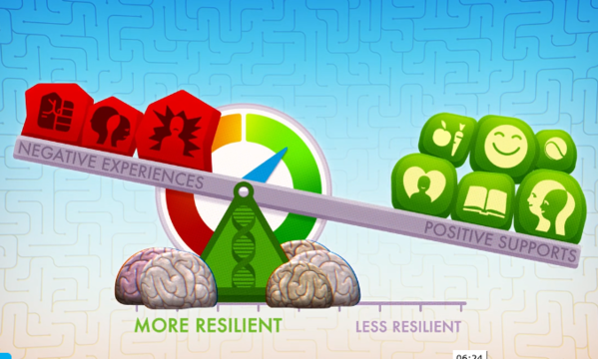
In 2019, a team of researchers — Dr. Christina Bethell, Jennifer Jones, Dr. Narangerel Gombojav, Dr. Jeff Linkenbach and Dr. Robert Sege — found a close response association between positive childhood experiences and adult mental and relationship health among adults who had experienced ACEs, irrespective of how many ACEs they had. This means that it’s really important to have positive childhood experiences, no matter how much adversity you have in your life. And if you have a lot of adversity and a lot of positive childhood experiences, you are less likely to suffer the consequences of ACEs.

Slide 24
To find out what positive childhood experiences you have, answer the following questions. How much or how often during your childhood did you:
feel able to talk to your family about feelings
feel your family stood by you during difficult times
enjoy participating in community traditions
feel a sense of belonging in high school
feel supported by friends
have at least two non-parent adults who took genuine interest in you
feel safe and protected by an adult in your home

Slide 25
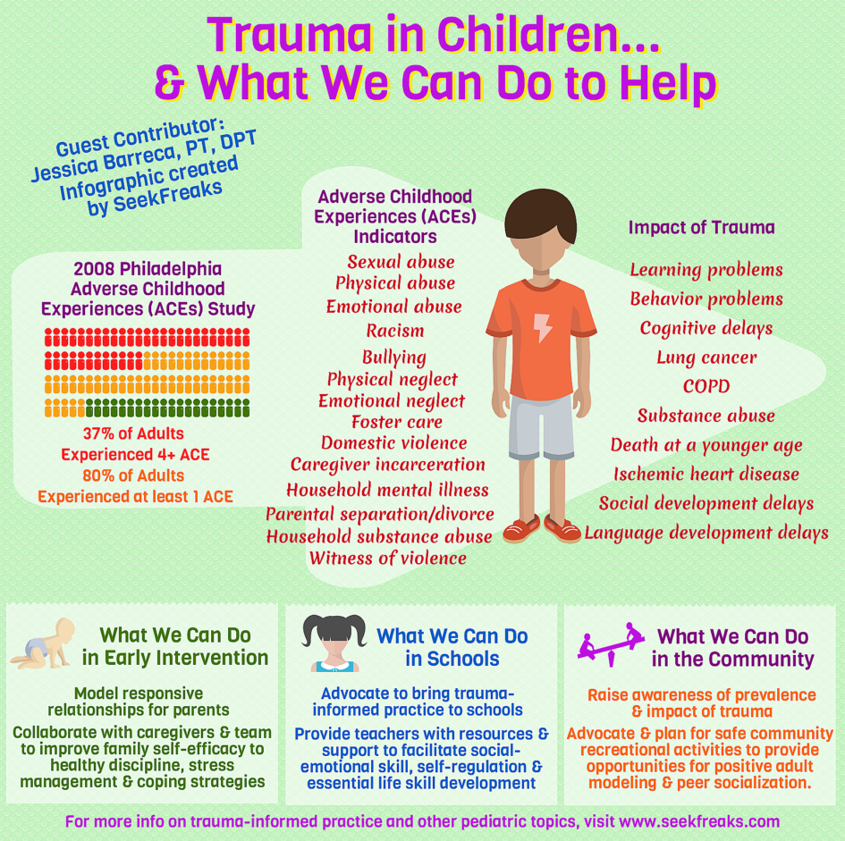

Slide 26
Home City Families
Parent and Community Engagement Center Resources
SPS Local Resources for Families

