Slide 1

Self-Esteem for Kids with Learning and Attention Issues
Cathy Mastronardi
AFT PSRP conference
Las Vegas, NV April 26-28, 2019

Slide 2
Learning outcomes
Know what learning and attention issues are and what they are not.
Understand why some kids with learning and attention issues struggle to maintain positive self-esteem.
Learn strategies that will help students with learning and attention issues develop positive self-esteem.

Slide 3
What Educators Say and Believe
33 % of classroom teachers and other educators believe sometimes what people call a learning or attention issue is really just laziness.
61% of classroom teachers say they are somewhat or not very confident in recommending that a child be evaluated for special education for learning issues.
70% of classroom educators in elementary school say a significant challenge they face is lack of resources needed to provide instruction, related services and support to children with learning and attention issues.
51% of classroom teachers say they are somewhat or not too confident in their ability to implement IEP/504 plans.
Notes:
Source: Survey commissioned by Understood.org and conducted by GfK in September 2014. The survey polled 300 classroom teachers (evenly represented across Pre-K/elementary, middle and high school) and 100 other kinds of educators including school psychologists, special education teachers, reading specialists, speech-language pathologists, occupational therapists, school nurses, guidance counselors, principals and vice-principals.

Slide 4
WHAT IS A SPECIFIC LEARNING DISABILTY?
The Individuals with Disabilities Education Act (IDEA) defines “specific learning disability” as: “a disorder in one or more of the basic psychological processes involved in understanding or in using language, spoken or written, that may manifest itself in the imperfect ability to listen, think, speak, read, write, spell, or to do mathematical calculations.”

Slide 5
What Are Learning and Attention Disorders?
•These brain-based difficulties can affect reading, writing, math, focus, organization and other key skills needed for learning. Common examples are dyslexia and dysgraphia
•Learning and attention issues are not the result of poor eyesight or hearing. They’re also not a sign of low intelligence.
•Learning and attention issues can lead to social, emotional and behavioral challenges. Kids don’t outgrow learning and attention issues. But with the right support from parents and teachers, they can succeed in school and in life.
WHAT’S IT FEEL LIKE?
Notes:
Learning and attention issues are lifelong, brain-based challenges that can cause difficulties in reading, writing, math, organization, focus, listening comprehension, social skills and motor skills. Children with these issues can be just as smart as their peers.

Slide 6
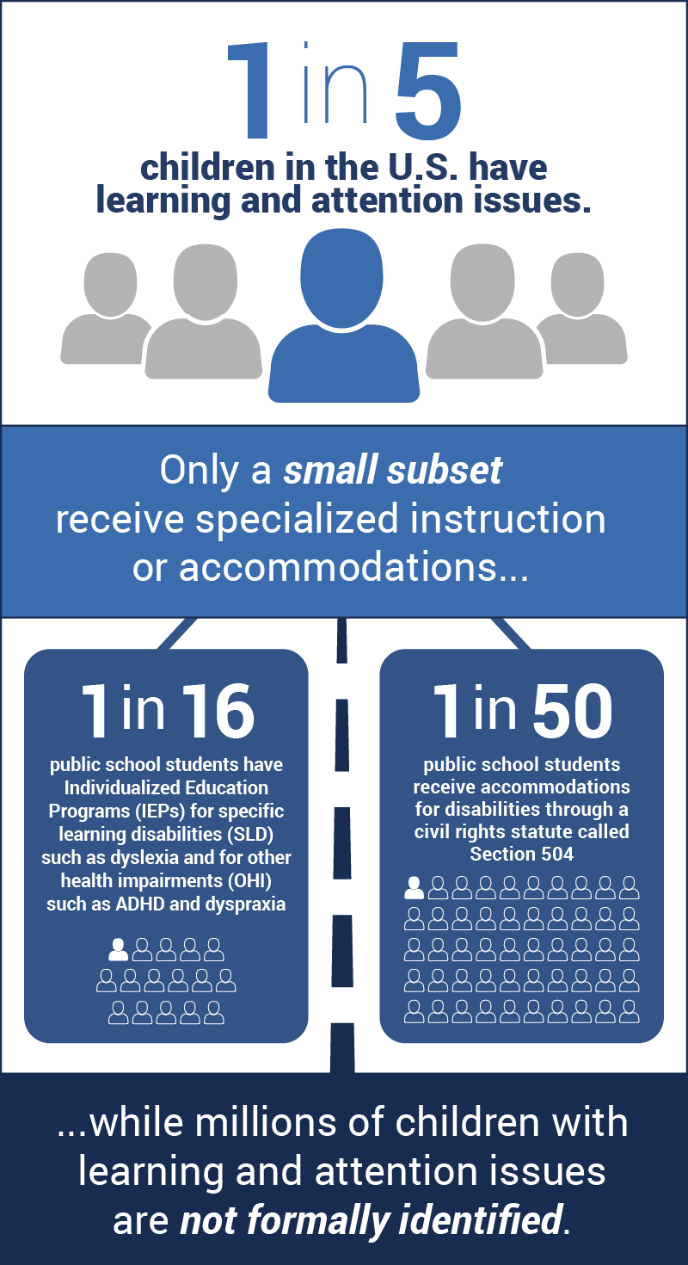
The Numbers
About 56.6 million students attend elementary and secondary schools in the United States

Slide 7
Are These Learning Disorder and Attention Issues?
Intellectual disabilities
Developmental disorders, such as Down Syndrome
Autism Spectrum Disorders (ASD)
Sensory impairments like blindness
Physical and motor impairment, congenital or acquired
Social/emotional disorders
Emotional disturbance or effects of trauma
NO

Slide 8
The Disorders
Learning Disorders
Disabilities that affect learning and behavior
ADHD
Executive Function
Dyspraxia
Non-verbal Learning Disabilities
Dyslexia
Dyscalculia
Dysgraphia

Slide 9



Risk Factors
GENETICS | Learning and attention issues tend to run in families. Genes that can affect brain structure and chemistry get passed down from parent to child.
TOXIN EXPOSURE | Exposure to lead and other environmental factors have been linked to ADHD and other issues that impact learning, attention and behavior.
ADVERSE CHILDHOOD EXPERIENCES | Trauma, such as abuse, neglect, and other adverse childhood experiences, can increase the likelihood of being identified with learning or behavior issues.
Notes:
Genetics:
Learning and attention issues tend to run in families. Genes that can affect brain structure and chemistry get passed down from parent to child.
Toxic Exposure:
Exposure to lead and other environmental factors have been linked to ADHD and other issues that impact learning, attention and behavior.
Adverse Traumatic Experiences:
Trauma, such as abuse, neglect, and other adverse childhood experiences, can increase the likelihood of being identified with learning or behavior issues.

Slide 10
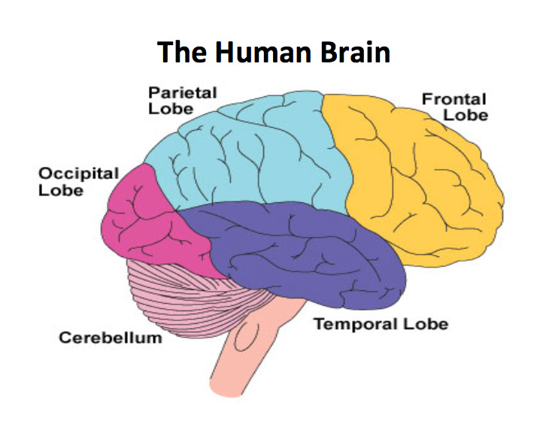
The Brain
The frontal lobe helps with self-control and focus.
The left temporal lobe and parietal lobe help with reading.
The cerebellum is involved with movement and balance.
The parietal lobes are involved with math.
Notes:
Kids with learning and attention issues often have trouble academically and sometimes out of school. But that doesn’t mean that they are lazy or can’t learn. Research shows that certain areas of their brain don’t always function properly affecting learning and behavior.
This part of the brain deals with behavior, decision-making and emotions. In some kids with self-control and focus issues, it’s wired differently. The pathways that carry information are poorly organized and don’t signal properly. Brain chemistry may not be used efficiently, and some areas of the brain may be smaller.
The frontal lobe is the largest and is responsible for controlling speech, reasoning, planning, regulating emotions, and consciousness. In the 19th century, Paul Broca was exploring areas of the brain used for language and noticed a particular part of the brain that was impaired in a man whose speech became limited after a stroke. This area received more and more attention, and today we know that Broca’s area, located here in the frontal lobe, is important for the organization, production, and manipulation of language and speech (Joseph, Noble, & Eden, 2001). Areas of the frontal lobe are also important for silent reading proficiency (Shaywitz et al., 2002).
2. Some areas in the back of the brain are crucial for matching sounds with symbols. Others help with committing site words to memory. In some kids with reading issues, this areas is underactive. There’s also less communication between these areas and other areas of the brain involved in reading.
The parietal lobe is located farther back in the brain and controls sensory perceptions as well as linking spoken and written language to memory to give it meaning so we can understand what we hear and read.
The occipital lobe, found at the back of the head, is where the primary visual cortex is located. Among other types of visual perception, the visual cortex is important in the identification of letters.
The temporal lobe is located in the lower part of the brain, parallel with the ears, and is involved in verbal memory. Wernicke’s area, long known to be important in understanding language (Joseph et al., 2001), is located here. This region, identified by Carl Wernicke at about the same time and using the same methods as Broca, is critical in language processing and reading.
In addition, converging evidence suggests that two other systems, which process language within and between lobes, are important for reading. The first is the left parietotemporal system that appears to be involved in word analysis – the conscious, effortful decoding of words (Shaywitz et al., 2002). This region is critical in the process of mapping letters and written words onto their sound correspondences – letter sounds and spoken words (Heim & Keil, 2004). This area is also important for comprehending written and spoken language (Joseph et al., 2001). The second system that is important for reading is the left occipitotemporal area. This system seems to be involved in automatic, rapid access to whole words and is a critical area for skilled, fluent reading (Shaywitz et al., 2002, 2004).
3. This area of the brain helps coordinate movement including fine motor skills needed to things like write and tie shoes. It’s also involved with maintaining balance and posture. Researchers have been looking into possible links between this part of the brain and other brain functions. These include language processing, emotional processing and ADHD. But there are no clear findings, and it’s still a controversial topic among some scientist.
4. The parietal lobes of the right and left side of the brain support math and computation. In some kids with math issues these areas are less active than in other kids. These areas don’t seem to communicate well with other parts of the brain.

Slide 11
Dyslexia: Trouble with Reading
Dyslexia is the most recognized and best-researched learning issue. It’s what’s known as a “language-based learning disability” and is sometimes referred to as a “reading disability.”
Dyslexia can cause trouble with basic reading skills—including trouble with connecting letters to sounds, sounding out words and recognizing sight words. When kids struggle with these underlying skills, it can lead to trouble with reading comprehension and reading fluency.
But dyslexia can affect more than reading skills. It can make writing, spelling, speaking and even socializing difficult.
It’s a common issue that affects the way the brain processes written and spoken language.
This is what people with dyslexia see

Slide 12
Dysgraphia: Trouble with Writing
May have messy handwriting
May struggle to:
  hold a pencil
  Draw
  form letters
May struggle:
  to organize their thoughts
  express them using proper sentence structure

Slide 13
Dyscalculia: Trouble with Math
Sometimes called a “mathematics learning disability” or referred to as “math dyslexia.”
Dyscalculia causes ongoing trouble understanding and working with numbers and math concepts from 1:1 correspondence to concepts like more and less. But dyscalculia can be missed in the early years because kids learn many basic math skills through memorization.
Although many kids (and adults) have anxiety about math, dyscalculia is not the same thing as math anxiety. Researchers know less about dyscalculia than they do about other learning issues. But they’re looking more at the causes of dyscalculia and ways to help.
Notes:
Dyscalculia is sometimes called a “mathematics learning disability.” You may even hear it referred to as “math dyslexia.”
Dyscalculia causes ongoing trouble understanding and working with numbers and math concepts from 1:1 correspondence to concepts like more and less. But dyscalculia can be missed in the early years because kids learn many basic math skills through memorization.
Although many kids (and adults) have anxiety about math, dyscalculia is not the same thing as math anxiety. Researchers know less about dyscalculia than they do about other learning issues. But they’re looking more at the causes of dyscalculia and ways to help.
Dyscalculia Dyscalculia 2

Slide 14
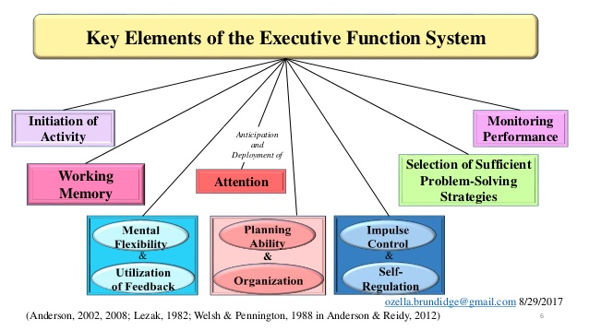
Executive Function

Slide 15

Let’s fill our shopping cart!

Slide 16
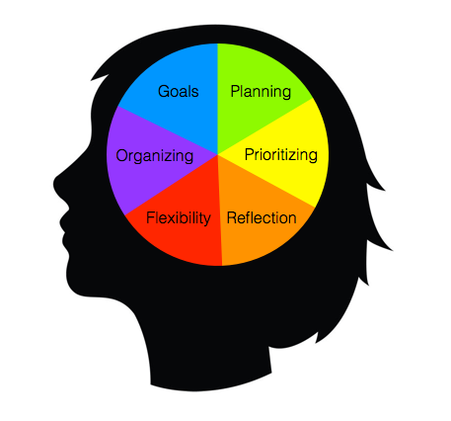
The Executive Function Malfunction
Preschool–Grade 2
Gets frustrated easily, and gives up instead of asking for help
Has frequent tantrums over minor things
Insists on doing things a certain way
Grades 3–7
Starts a task, gets distracted, and never finishes it
Often mixes up school assignments and brings home the wrong books
Seems to focus on the least important point in a discussion
Teens
Loses track of time
Engages in risky behavior
Has trouble working in groups
Forgets to fill out job or college applications
Notes:
Since executive function develops over time, a child may struggle in different ways at different ages.

Slide 17
Dyspraxia
Dyspraxia is a neurological disorder that impacts an individual's ability to plan and process motor tasks.
Problems performing subtle movements, such as tying shoelaces, doing up buttons and zips, using cutlery, and handwriting.
Difficulties with concentration = hard to focus on one thing for long.
Does not follow instructions or remember instructions.
May be extremely sensitive to taste, light, touch, and/or noise.
A higher tendency to bump into things, to fall over, and to drop things.
Notes:
A person with dyspraxia finds it difficult to plan what to do, and how to do it.

Slide 18
Non-verbal Learning Disorder
A disorder which is usually characterized by a significant discrepancy between higher verbal skills and weaker motor, visual-spatial and social skills.
NLD is very like Asperger Syndrome
Remembers information but doesn’t know why it’s important
Is physically awkward and uncoordinated
Has messy handwriting
Thinks in literal, concrete terms
Has poor social skills
Pays attention to details but misses the big picture
Struggles with reading comprehension
Struggles with math, especially word problems
Often go unrecognized and unaided by teachers and other professionals for a large part of a child's schooling.
Note: NVLD is not recognized as a disability covered by the Individuals with Disabilities Education Act (IDEA). Children with NVLD-related symptoms may still be eligible for special education services if they’re found to have a specific learning disability that’s interfering with educational progress.
Notes:
Researchers don’t know the exact cause of NVLD. But they believe it’s related to differences in various brain processes located in the left and right regions of the brain.[4]
Although there’s growing awareness of the condition, NVLD is controversial in medical circles. It does not appear in the Diagnostic and Statistical Manual of Mental Disorders(DSM-5), the latest update of the guide used by doctors and therapists to diagnose learning disabilities.[5]
Also, NVLD is not recognized as a disability covered by the Individuals with Disabilities Education Act (IDEA). Children with NVLD-related symptoms may still be eligible for special education services if they’re found to have a specific learning disability that’s interfering with educational progress.

Slide 21
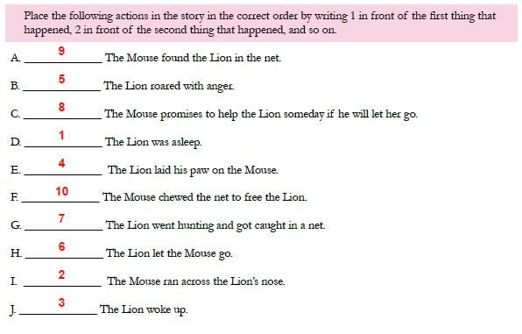
8
5
LESSON
KINDNESS IS NEVER WASTED

Slide 22
ADHD: A Complex Condition
Is not a learning disability, but it affects learning.
Can make it hard for kids to:
  1. Sit still, 2. Concentrate, 3. Focus and 4. Control impulses and emotions
Is a brain-based medical condition.
Exact unknown
Research shows that 1. genetics, 2. differences in brain development, and 3. how the brain processes neurotransmitters (brain chemicals) play a role.

Slide 23
Did you change any of your answers?
Notes:
These are some myths that people have about learning disorder and attention issues.

Slide 24
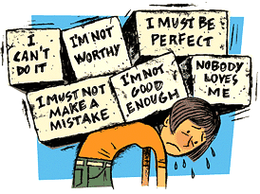
Kids with learning and attention issues can struggle to achieve and maintain positive self-esteem

Slide 25
The Signs
Reads at a lower level than his/her peers.
Has a hard time “getting” math concepts.
Has bad handwriting.
Always loses his/her homework.
Can’t sit still.
Doesn’t want to go to school.
Has a hard time making friends.

Slide 26

Why Does Self-esteem Matter?
It is how we value ourselves
It is how we perceive our value to the world
It is how valuable we think we are to others
It affects:
  our trust in others
  our relationships
  our work
  nearly every part of our lives
Notes:
Self-esteem comes from feeling loved and secure

Slide 27



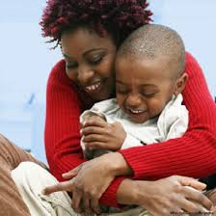

Where Does a Child’s Self-esteem Begin?
Notes:
Self-esteem comes from feeling loved and secure

Slide 28
The Internal Working Model
A cognitive framework comprising mental representations for understanding the world, self and others. A person’s interaction with others is guided by memories and expectations from their internal model which influence and help evaluate their contact with others (Bretherton, & Munholland, 1999).
Your sense of self
Your sense of others
Your relationships with yourself and others
Notes:
The child's attachment relationship with their primary caregiver leads to the development of an internal working model (Bowlby, 1969). This internal working model is a cognitive framework comprising mental representations for understanding the world, self, and others.
You want your internal working model to be healthy.

Slide 29
Attachments
Secure
Children who are securely attached can develop increasing independence, exploring their environment with confidence that they can return to a caregiver who will respond to their needs. Therefore securely attached children have a healthy internal working model, develop good self esteem and know that they are considered worth looking after.
Insecure
Children who don’t get the chance to form good attachments run the risk of developing poor internal working models which can have very negative impacts on their view of themselves and their ability to form relationships with other people.

Slide 30
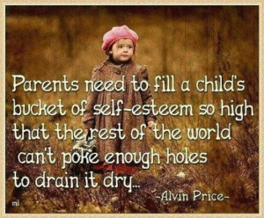

Slide 31
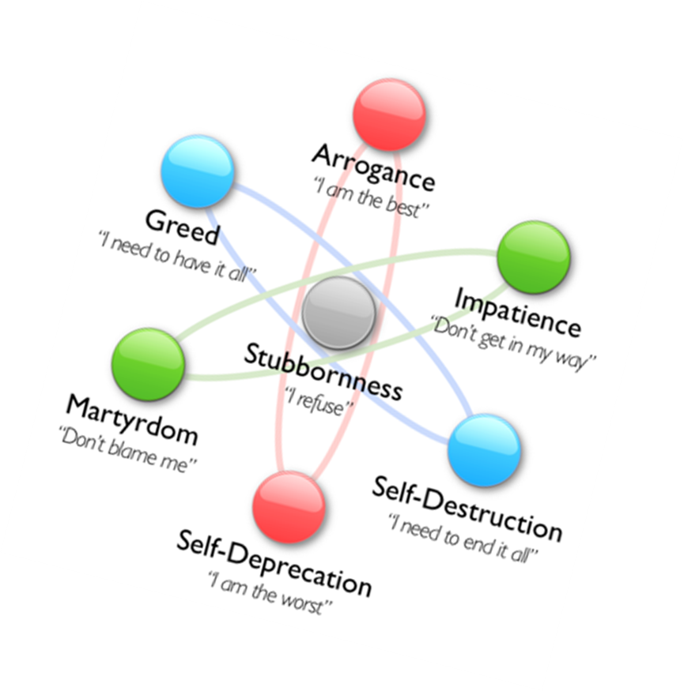


Slide 32
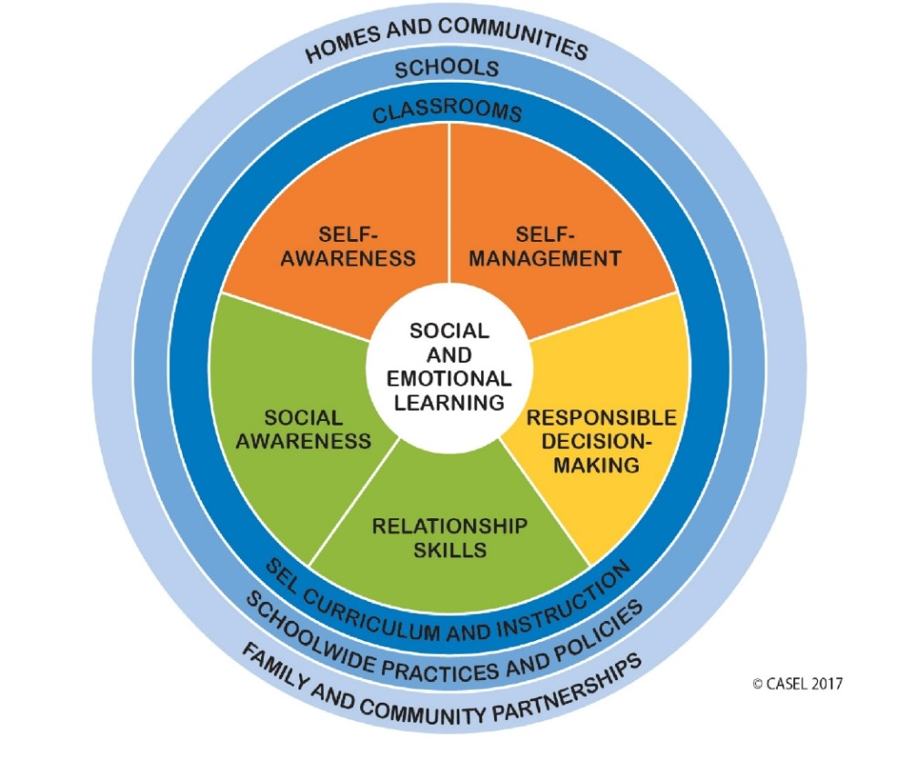
Social and Emotional Learning
Social and emotional learning (SEL) is the process through which children and adults acquire and effectively apply the:
Knowledge
Attitudes
Skills
Necessary to:
Understand and manage emotions
Set and achieve positive goals
Feel and show empathy for others
Establish and maintain positive relationships
Make responsible decisions
Maslow
Notes:
This is where we want these students/children to be even with their issues.

Slide 33
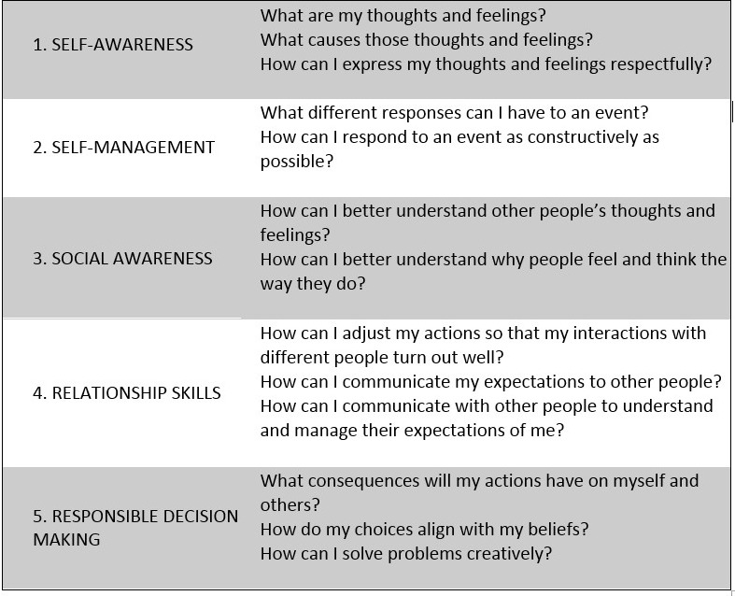

Slide 34




High Self-esteem
Having a healthy self-image and believing that you are worthy of respect and love from others.
Feel:
Good about themselves
Liked and accepted
Have confidence in themselves
Have a sense of pride
Think good things about themselves
Believe in his or her self
Notes:
How High Self-Esteem Helps Kids
How High Self-Esteem Is Developed
Children develop positive self-esteem by experiencing repeated successes. Past accomplishments show them that they have what it takes to face new challenges. Their success makes them feel good about themselves.
Their success also pleases other people, like their friends and the adults who care about them. This also makes them feel good. Over time, success and the feedback that comes with it help children develop the positive characteristics associated with high self-esteem.

Slide 35
Low Self-esteem
At the root of other serious challenges because:
Repeated failure can lead to feelings of frustration, anger, anxiety and sadness.
Children in this situation often lose interest in learning.
Friendships can suffer as frustrated kids seek negative attention.
Children can become withdrawn or give in to peer pressure.
Notes:
At the root of other serious challenges because:
Repeated failure can lead to feelings of frustration, anger, anxiety and sadness.
Children in this situation often lose interest in learning.
Friendships can suffer as frustrated kids seek negative attention.
Children can become withdrawn or give in to peer pressure.
Many children with low self-esteem develop self-defeating ways to deal with challenges, like quitting, avoidance, silliness and denial.

Slide 36
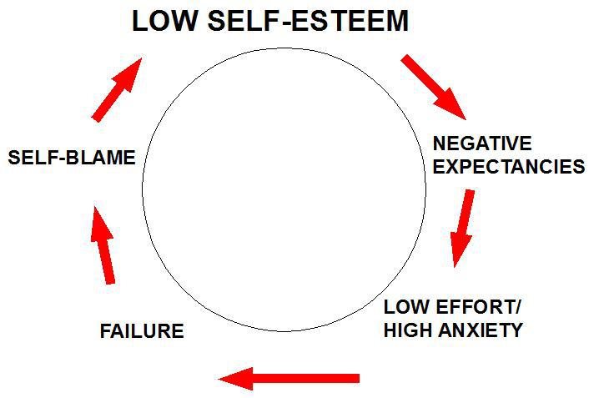
Experiences that Can Lead to Low Self-esteem
  Kids with learning and attention issues:
  Often receive negative feedback
  Often experience feelings of frustration, shame, anxiety
  Experience rejection by their peers
  Are uncertainty in their own abilities
  Feel the cumulative effect of repeated failures (“Cascade effect”)
  Call themselves stupid, slow or dumb
Notes:
These experiences, and others, can lead to low self-esteem because they focus on the person and the person sees themselves in a negative light.

Slide 37
Kids with Low Self-esteem
Don’t feel good about themselves.
Are self-critical and hard on themselves.
Feel they're not as good as other kids.
Think of the times they fail rather than when
they succeed - lack confidence.
Doubt they can do things well.
Many children with low self-esteem develop self-defeating ways to deal with challenges, like quitting, avoidance, silliness and denial.
Notes:
Children with low self-esteem may not believe they’re worthy of good treatment. Because they feel this way, they may not ask for help or stand up for themselves. In other words, they don’t develop self-advocacy skills.
Children with low self-esteem may have trouble gaining the confidence they need to face and deal with their learning and attention issues. This is a lack of what’s often referred to as self-awareness.
Low self-esteem is also at the root of other serious challenges because:
Repeated failure can lead to feelings of frustration, anger, anxiety and sadness.
Children in this situation often lose interest in learning.
Friendships can suffer as frustrated kids seek negative attention.
Children can become withdrawn or give in to peer pressure.
Many children with low self-esteem develop self-defeating ways to deal with challenges, like quitting, avoidance, silliness and denial.

Slide 38
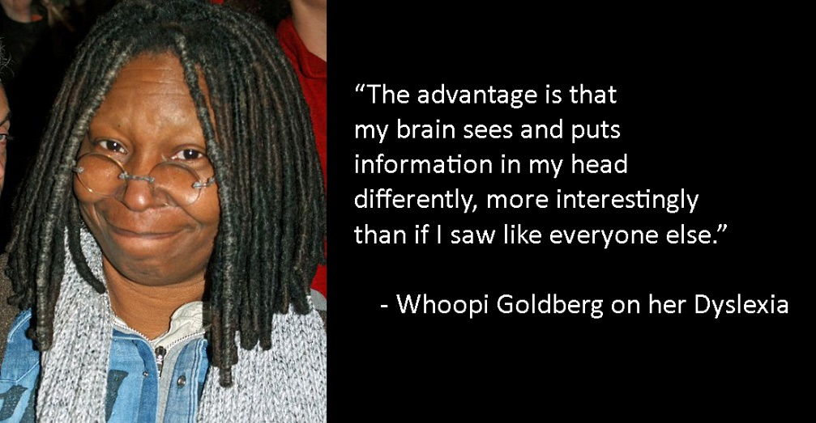
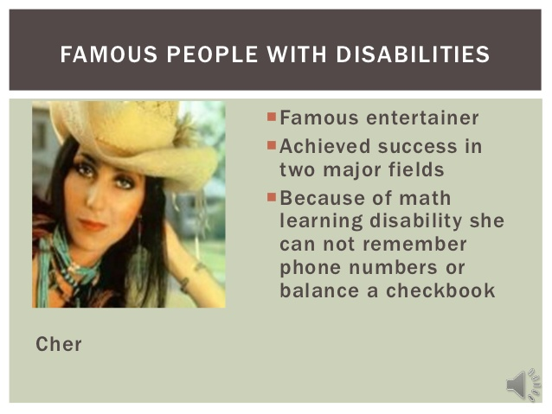
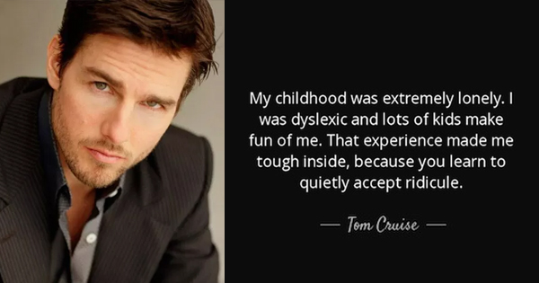
Famous People with Learning Disorders
Albert Einstein
Alexander Graham Bell
Thomas Alva Edison
Winston Churchill
Leonardo da Vinci
Tom Cruise
Whoopi Goldberg
Exercise

Slide 39
Why was this so difficult? What changes could you make?
Proper tools
Lined paper
Easy to hold writing instruments
Proper Instructions
Clarification
  Instructions
  Length of time
Present in “chunks”
Repeat
Proper Environment
Lessen distractions

Slide 40
Self-esteem vs Confidence
Confidence is belief in one’s ability to be successful in a task based on previous experience or an understanding of the challenge level involved.
Self-esteem is having a healthy self-image and believing that you are worthy of respect and love from others.
A child can be confident in his or her ability to do well in a baseball game or succeed in school exams, but still have a poor self-image and still struggle with low self-esteem.
In the case of a child with a learning difficulty like dyslexia, there may be a lack of confidence when it comes to reading and spelling.

Slide 41
Confidence (What They Can Do)
Have realistic expectations.
Help the child with problem solving and decision making skills.
Avoid judgmental comments.
Praise the effort children put into their work.
Highlight a child's strengths in non-academic areas.
Be empathic about the child's special learning needs and their level of frustration when learning.
Notes:
Have realistic expectations.
If we have realistic expectations about a child's performance it will help the child develop a sense of control.
Help the child with problem solving and decision making skills.
Solid problem solving skills have been linked to higher self-esteem. Instead of providing a child with the solution to their difficulty (whether academically, socially etc.), help the child brainstorm possible solutions and the possible consequences of different decisions.
Avoid judgmental comments
Praise the effort children put into their work
Often children with learning disabilities are putting effort into their work but still struggle.
Highlight a child's strengths in non-academic areas (whether in music, art, athletics, etc.,)
Be empathic about the child's special learning needs and their level of frustration when learning.

Slide 42
Self-esteem Steps (Who They Are)
Help the student realize that they are a person first.
Help the student feel special and appreciated.
Highlight the strengths of the student’s personality.
Don't compare the student to peers or siblings.
Provide opportunities for the student to help others.
Help the student appreciate them-self—all of them-self
Notes:
Help the child realize they are a person first, then they are disabled.
We are people first, and then we are disabled. They are somebody!!!!!
Help the child feel special and appreciated
There is research that shows that the presence of at least one adult who makes a child feel special and appreciated leads to greater resilience and hopefulness in the child. Children feel special when their efforts are appreciated, when adults notice what makes them different in a positive light and when adults carve out special time to spend with the child.
Highlight the strengths of their personality, (kindness, tenacity, helpfulness, sense of humor, etc.).
Don't compare child to peers or siblings
Provide opportunities for a child to help others.
Helping others helps children show that they have something to offer their family and community. Children often enjoy participating in volunteer activities with their friends and family. Helping others bolsters self-esteem.
Help the child appreciate themselves - all of themselves
This means appreciating your disability too. There may be times when you believe that it is more annoying than appreciable, but focus on the positive aspects of your disability. One way to do this is making a list of your strengths including how your disability, or your methods of coping with it, can be an asset.

Slide 43
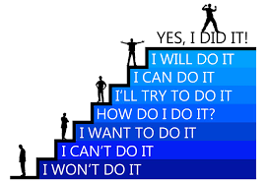
So Let’s Continue To
Learn
Observe
Encourage
Praise
Engage
Support
Kid President

Slide 44


Slide 45


