Slide 1
Mindfulness
“Our life is shaped by our mind, for we become what we think.” – Buddha

Slide 2
Objectives: Once mindfulness is used in daily life it can help you mange daily stressors, enhance sleep, and improve one's self being and health.
Participants will learn and gain meditation stress relief skills and strategies, that can be used in both home and work life.
How these same techniques with some modification can be used to help children and young adults as well.

Slide 3
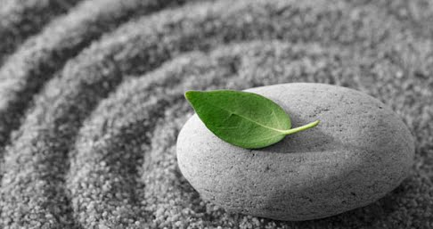
What is Mindfulness
The quality or state of being conscious or aware of something.
A mental state achieved by focusing one's awareness on the present moment, while calmly acknowledging and accepting one's feelings, thoughts, and bodily sensations, used as a therapeutic technique.

Slide 4
A day in your life Activity 1: Take about 5 minutes to think about and make a list on what you do and are responsible for daily, weekly, and monthly. Next share out as a group. Make one list on chart paper or on a dry erase board. Look for similarities, talk about how stress increases around holidays/life events.

Slide 5
Be Mindful
Meditation takes work
Will not happen over night
New and old methods
What meditation or stress relief is best for you
What is your goal
Make it fit your life style
Enjoy it

Slide 6
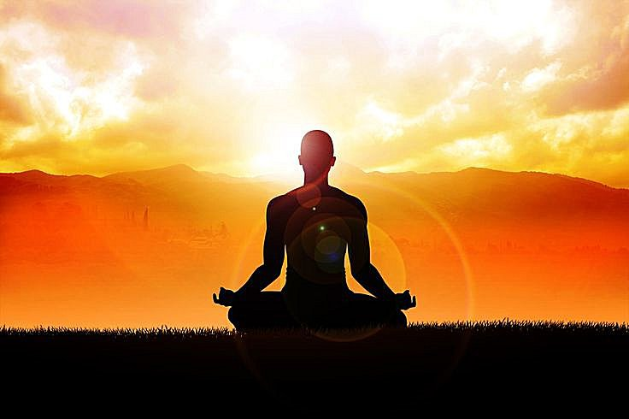
Meditation Meditation can be defined as a practice where an individual uses a technique, such as focusing their mind on a particular object, thought or activity, to achieve a mentally clear and emotionally calm state.
There are many types of meditation.
We will focus on two different types of meditation that share some similarities .
Mindfulness Meditation
Movement Meditation

Slide 7
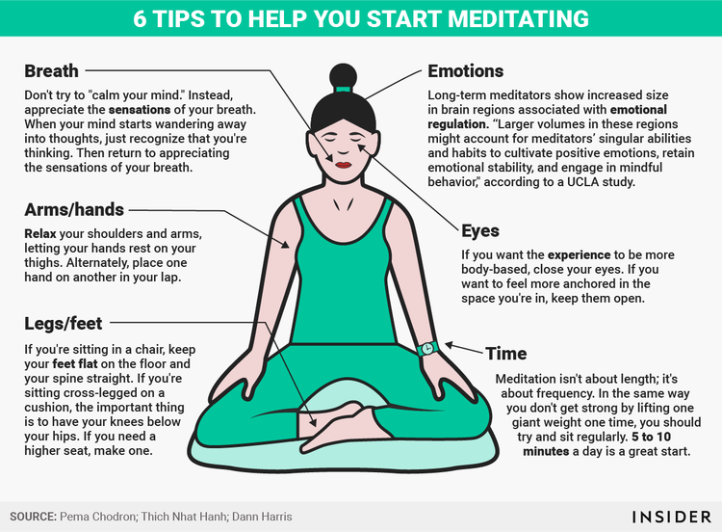

Slide 9
Mindfulness Meditation
This meditation technique is based on the teachings of the Buddha. Mindfulness meditation can be instrumental in helping us understand how our minds work. This self-knowledge serves as a foundation for overcoming dissatisfaction, impatience, intolerance and many of the other habits that keep us from living fuller, happier lives.

Slide 11
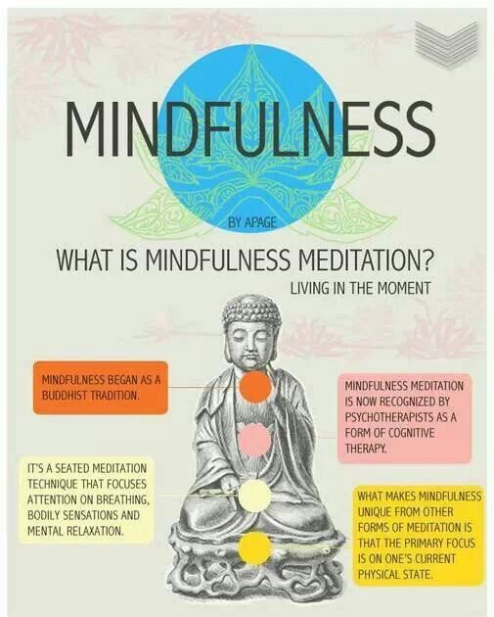

Slide 14
Mindfulness benefits for youth
In the last few years mindfulness has emerged as a way of treating children and adolescents with conditions ranging from ADHD to anxiety, autism spectrum disorders, depression and stress. And the benefits are proving to be tremendous.
Reduces stress, anxiety, and even depression.
Improves grades and performance on standardized tests.
Increases attention and concentration.
Changes the brain in ways that protect against mental illness and improve control over emotions.
Increases compassion and empathy.
Improves sleep.

Slide 20
Movement Meditation
Many forms of meditation encourage you to remain in one position, but movement meditation focuses on the body in motion. Walking meditation is one form of mindful movement; this technique can also be associated with yoga or tai chi and other martial arts. Having a commitment to some form of physical discipline is very beneficial. Once you are able to be present in your body during movement meditation, you can expand your awareness to include just about anything that keeps you moving: gardening, walking the dog, washing up, playing golf, etc. In each case, the movement of your body is the object of meditation.
This technique can be combined with mindful sitting meditation. It can be a good choice for people who have trouble sitting still for long periods, as well as for those who naturally find it easier to concentrate while they’re moving.

Slide 22
Types of movement meditation
Yoga – There are many types of yoga. Some are athletic and demanding. Yoga is composed of gentle stretches, deep breathing, and meditation. The physical poses and focused breathing can help alleviate aches and pains.
Tai Chi – Tai Chi is a mind-body practice which combines meditation, slow movements, deep breathing, and relaxation. Tai Chi reduces mental and physical stress. promotes healing, and emotional stability. It strengthens the heart, boosts the immune system and is gentle on muscles and joints.
Qigong – Qigong combines meditation, dance, movement, and breathing exercises. It is a form of gentle exercise composed of movements that are repeated a number of times, stretching the body and building awareness of how the body moves.

Slide 24
Yoga

Slide 25
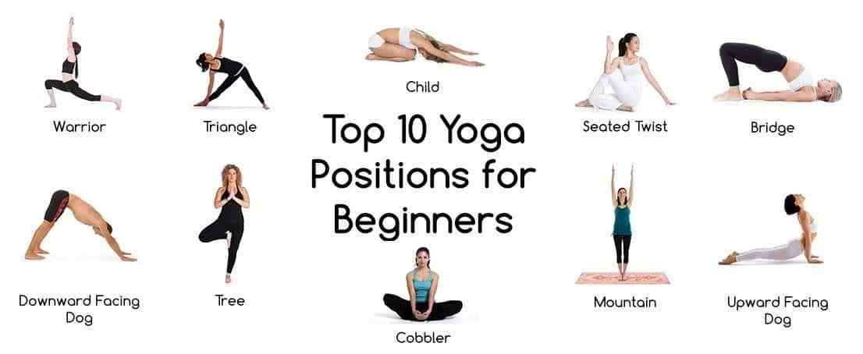
Strike a pose

Slide 29
Tai Chi

Slide 30
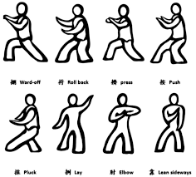

Slide 32
Qigong

Slide 33
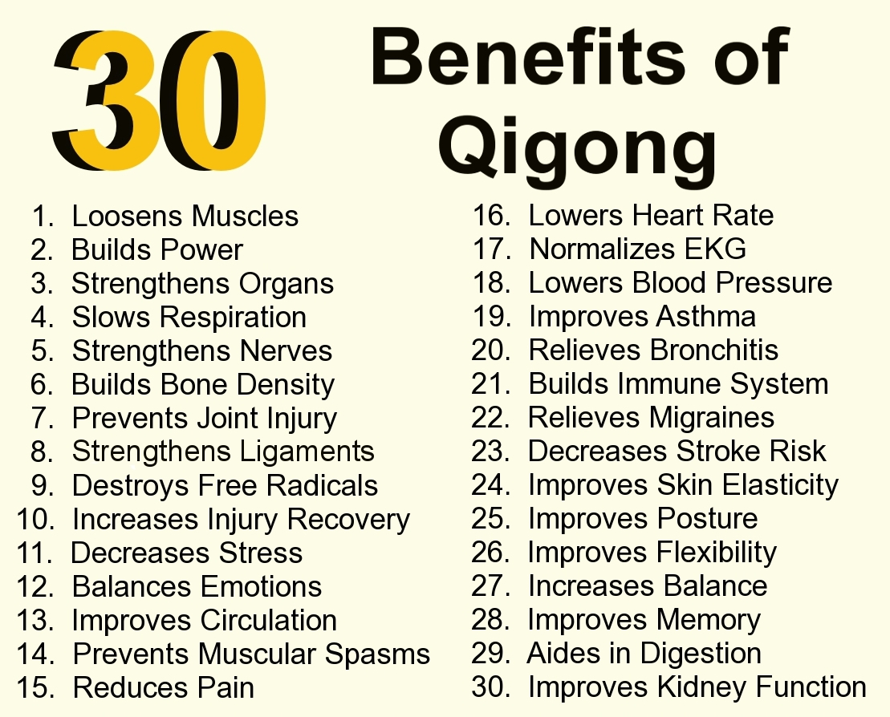

Slide 34
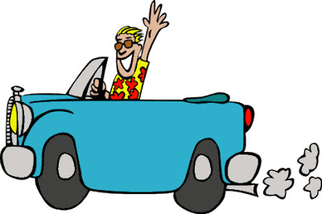
Ticket to Leave What is one practice you will put into your routine...

