Slide 1
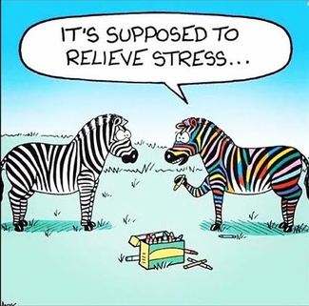
The Art of Minimizing Stress and Practicing
Self-Care in the Workplace and Home

Slide 2

When you learn to recognize what is causing your stress and take steps to minimize the effects of stress you can practice self care and use strategies to take good care of yourself so that:
  You health improves
  Your relationships improve
  Your interactions improve

Slide 3

Think about all of your responsibilities:
What are your responsibilities:
Daily?
Weekly?
Monthly?
On a piece of paper write down three of your responsibilities that fall under each category.

Slide 4
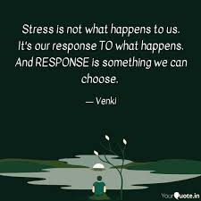
Stress
1. A state of mental or emotional strain or tension resulting from adverse or very demanding circumstances. (noun)
2. The body’s adaptation when facing a situation.
3. Subject to pressure or tension (verb)
4. Has predictable changes:
Biological
Physiological
Cognitive
Behavioral
Notes:
What is Stress? • Stress is a negative emotional experience accompanied by predictable – Biochemical changes – Physiological changes – Cognitive changes, and – Behavioral changes That are directed either toward altering the stressful event or accommodating to its effects.

Slide 5
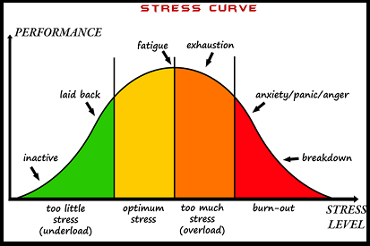
Notes:
The stress curve is a picture of stress from too little stress which is “Don’t worry, be happy” to burnt up and burnt out.
Both of which are outliers, especially burnt up and burnt out.

Slide 6
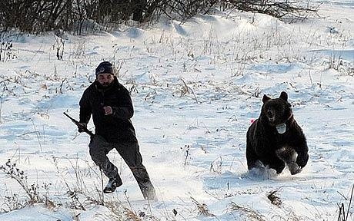

Types of Stress
Acute stress corresponds to our organism`s reactions when facing a threatening, imminent or unforeseeable situation
Chronic stress maintains the physiological mechanisms put in place to face the stressful situation which exhausts the system and leads to harmful effects for our health.
Notes:
Acute stress corresponds to our organism`s reactions when facing a threatening, imminent or unforeseeable situation (public presentation, accident, new learning experience). When this stressful situation ends, stress symptoms generally stop soon after. Hence, it can be useful to help us cope with a situation.
Chronic stress maintains the physiological mechanisms put in place to face the stressful situation which exhausts the system and leads to harmful effects for our health. In a few weeks, physical, emotional, intellectual and behavioral symptoms can appear.

Slide 7
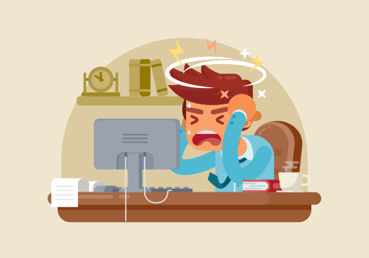
What is a stressor?
Personal and environmental events that cause stress
Major life events
Trauma
Social
Occupational
Nutrition
Substance abuse
Notes:
A point of obvious clarity.
A stressor is what causes the stress. The slide shows common stressors
Workplace stress is occupational stress.
Have participants shout out 2 responses for each stressor

Slide 8
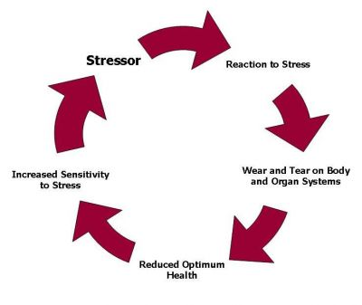
The Cycle of Chronic Stress
Notes:
The cycle of chronic stress is a ride on a bad merry-go-round.
Your body is hard-wired to react to stress in ways meant to protect you against threats from predators and other aggressors. Facing multiple demands each day, such as shouldering a huge workload, making ends meet and taking care of your family. Your body treats these so-called minor hassles as threats. As a result you may feel as if you're constantly under assault.
Stress can be toxic when there is very little or no time for the body to relax in between demanding events. Body is in constant “fight or flight” mode. This type of chronic stress can lead to serious symptoms and eventual illnesses.

Slide 9
Family Stressors
Examples of family stressors

Slide 10
Family Stressors
death (of a loved one)
divorce or separation from a partner
marriage
pregnancy
holidays
changes in health of a family member or close friend
trouble with in-laws
family arguments
children leaving home
childcare
remarriage of a family member
caring for other dependents, such as elderly relatives
family reunion
relationship breakdown or having a long-distance relationship

Slide 11
Personal stressors
Examples of personal stressors

Slide 12
Personal Stressors
Change in financial state
Getting Marriage
money worries
Getting divorced
Giving up smoking,
Abusive Relationship
Going on a diet
Pregnancy
Problems with weight
Poor work/life balance
Losing Job
Experiencing prejudice or discrimination
Problems at work
Lack of friends or support
Emotional problems
Personal injury
Moving
Personal illness
Being a single parent
living with someone with an alcohol, drug problem or other addiction

Slide 13
Social Issues Stressors
social issues that cause stress

Slide 14
Social Issues
Discrimination
Difficulties with neighbors
Poor health services
Poor government services
Poor Schools
Lack of neighborhood
Crime

Slide 15
Daily Hassles
Examples of daily hassles that cause stress

Slide 16
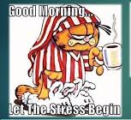
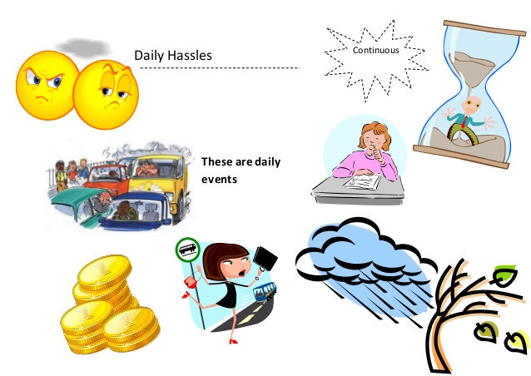
Daily Hassles
Losing your keys
Getting a flat tire
Forget umbrella
Forget your lunch
ATM not working
Can’t find a parking space
Traffic jam
Printer Jams
Long lines at store
Notes:
Daily hassles are the small, day to day irritations, repeated many times, that drive us all crazy.
Daily Hassles are as Toxic to Our Health as Major Life Events
These types of minor irritants are oh so familiar and are constantly triggering your stress response. Research shows that daily hassles affect our longer-term health and mood. In fact, they may take more toll on out health than even major life events like bereavement.

Slide 17
What is workplace stress?
The harmful physical and emotional responses that can happen when there is a conflict between job demands on the employee and the amount of control an employee has over meeting these demands.
Can have many origins or come from one single event or person.
It can impact on both employees and employers alike
Notes:
Workplace stress then is the harmful physical and emotional responses that can happen when there is a conflict between job demands on the employee and the amount of control an employee has over meeting these demands. In general, the combination of high demands in a job and a low amount of control over the situation can lead to stress.
Stress in the workplace can have many origins or come from one single event. It can impact on both employees and employers alike. It is generally believed that some stress is okay (sometimes referred to as “challenge” or “positive stress”) but when stress occurs in amounts that you cannot handle, both mental and physical changes may occur.
If the employer is stressed, the employees will be stressed.

Slide 18
Workplace Stress
Examples of workplace stress

Slide 19
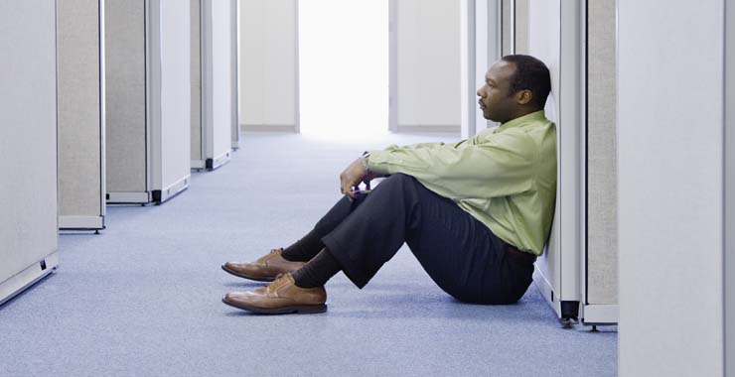
Common Workplace Stress Sources
Having a heavy workload
Too much responsibility
Working long hours
Poor supervision
Lack of administrative support
Unclear expectations of your work
No say in the decision-making process
Working under dangerous conditions
Being unhappy with your job
Sexual harassment
Workplace bullying
Unsafe environment
Low morale

Slide 20
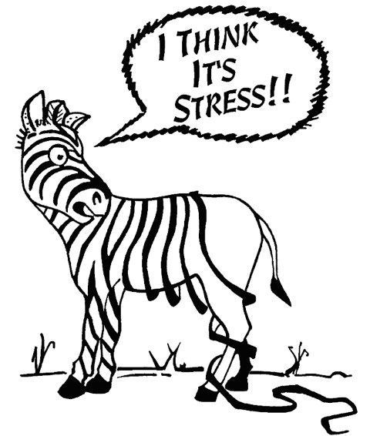
Effects of Stress
How does stress affect your:
1. Mind
2. Body
3. Emotions
4. Behavior

Slide 21

Mental Effects of Stress
Worrying
Nightmares
Muddled thinking
Indecision
Negativity
Hasty Decisions

Slide 22
Emotional Effects of Stress
Anxiety
Restlessness
Lack of motivation or focus
Feeling overwhelmed
Irritability or anger
Sadness or depression
Sensitivity, increased nervousness and worry, tears
Agitation
Irritation
Sadness
Drop in libido
Poor self esteem
Other?

Slide 23
Behavioral Effects of Stress
Angry outbursts
Drug or alcohol abuse
Tobacco use
Social withdrawal
Exercising less often
More difficulty in relationships
Absenteeism
Abuse of TV
Increased consumption of tobacco, caffeine, sugar, chocolate , alcohol and drugs
Avoiding certain situations
Other?

Slide 24
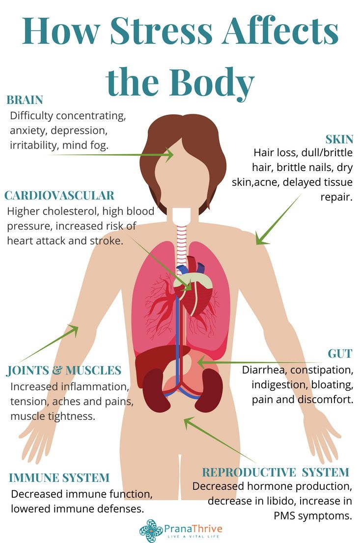
Physical Effects of Stress
Headache
Muscle tension or pain
Chest pain
Fatigue
Change in sex drive
Stomach upset
Sleep problems
Other?

Slide 25
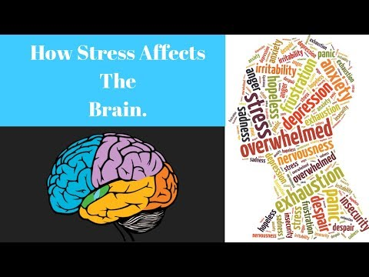

Slide 26
Effects of Chronic Stress on the Brain
makes you forgetful and emotional
creates a vicious cycle of fear and anxiety
depletes critical brain chemicals causing depression
  puts you at greater risk for mental illnesses of all kinds
halts the production of new brain cells
creates free radicals that kill brain cells
  lets toxins into your brain
  shrinks your brain
  increases your risk of dementia and Alzheimer’s

Slide 27
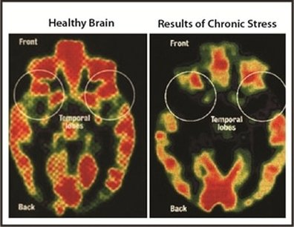

Slide 28
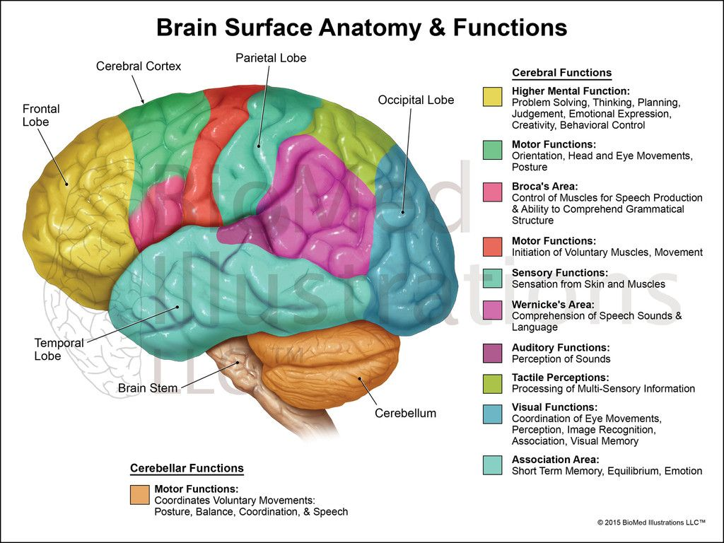

Slide 29
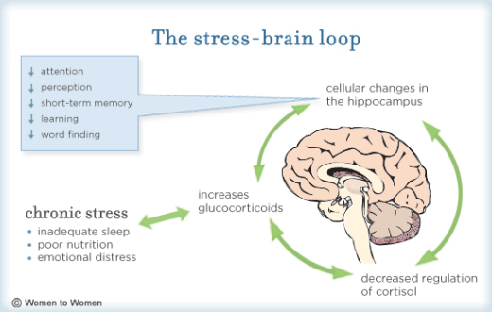
How does stress effect the brain?
Notes:
Stress affects the brain, just like stress affects the body. Let’s keep in mind—no pun intended—the mind/body connection.
Write down six ways stress affects the brain.

Slide 30
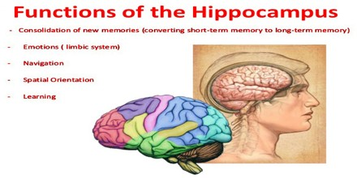
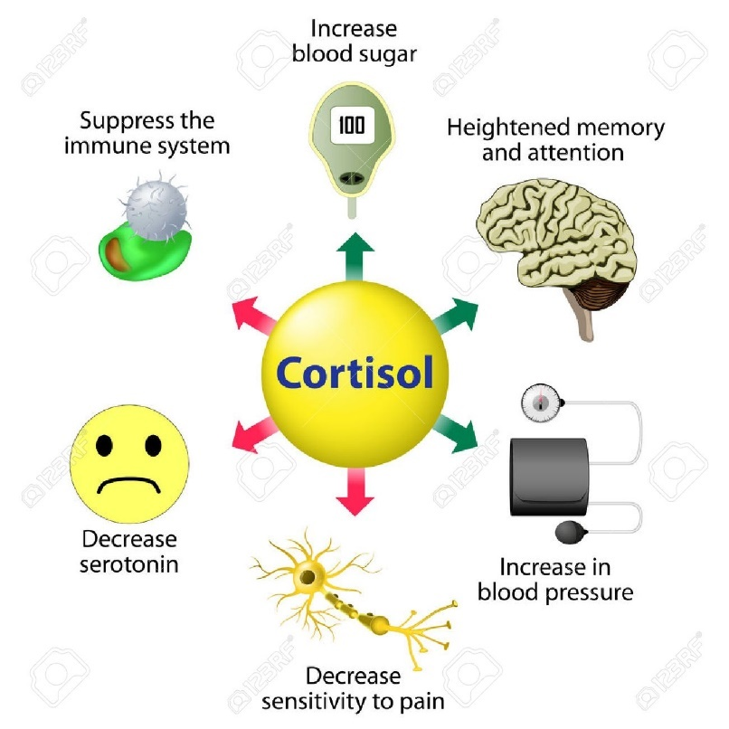
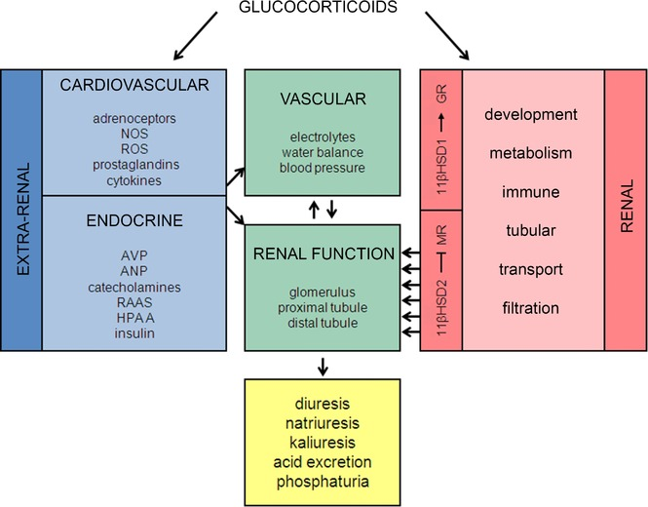

Slide 31
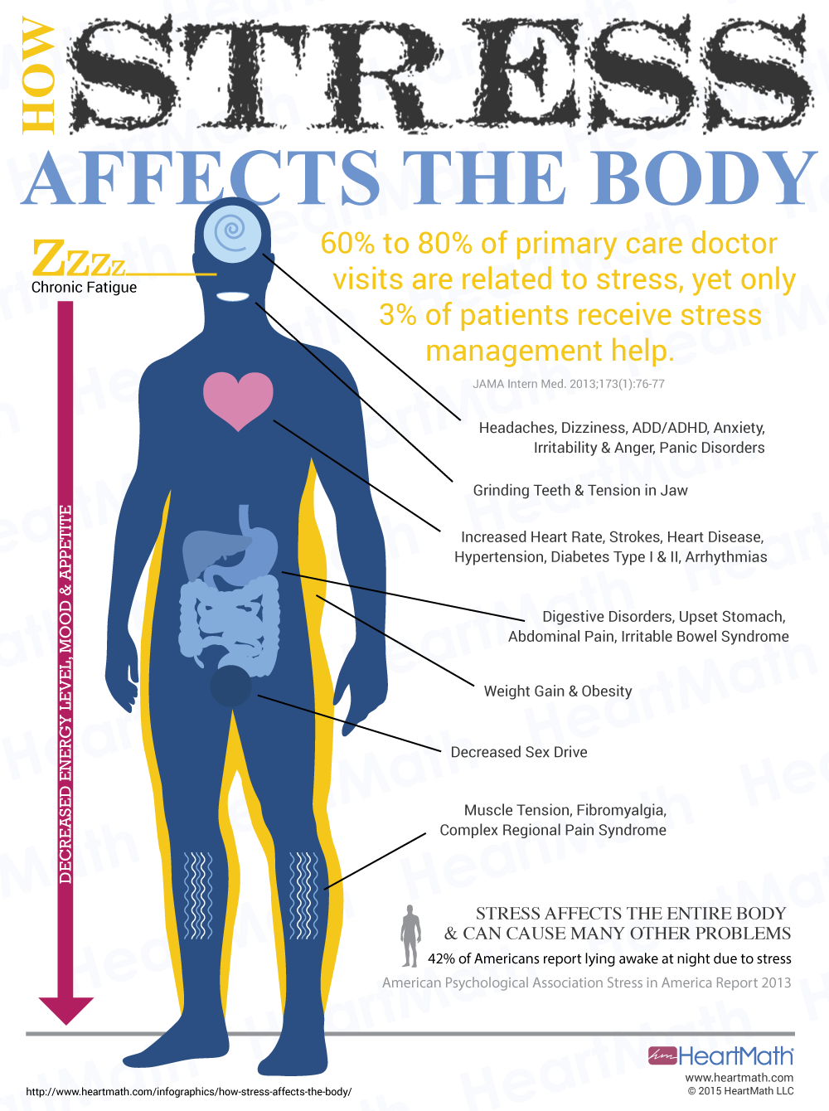

Slide 32
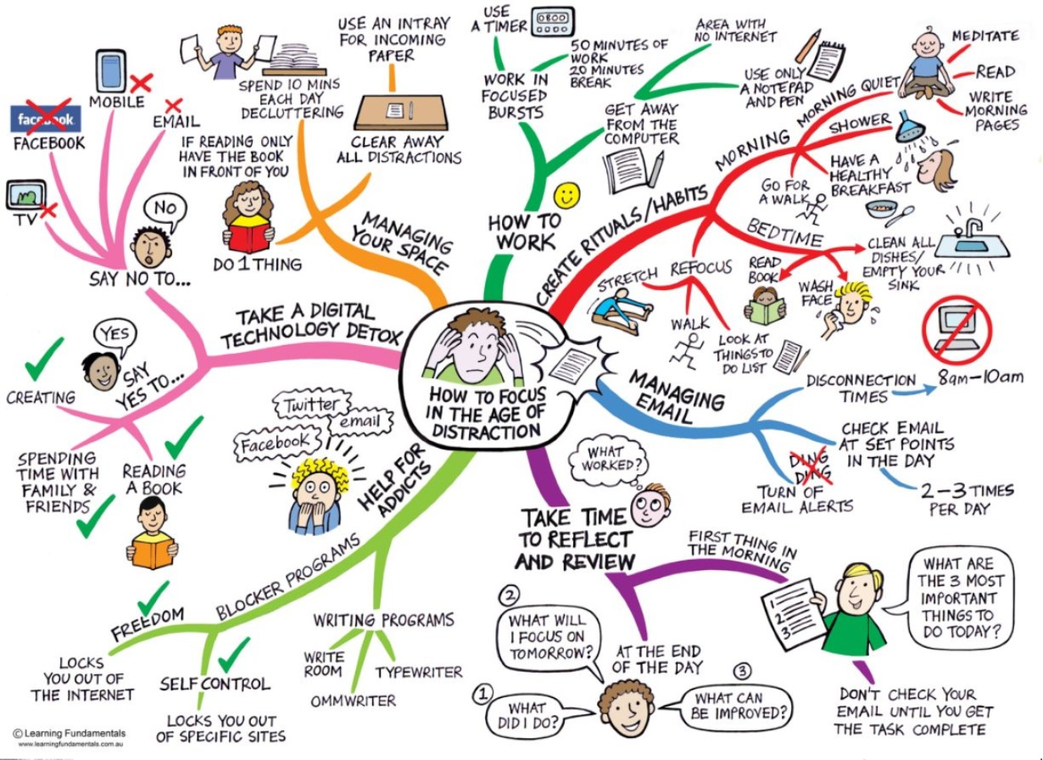
How do we minimize stress?
Control
2. Coping strategies
3. Good Work-life Balance
4. Self-Care
Notes:
How do we minimize stress at work and home?

Slide 33
Control: How much do you have?
Perceived control:
“the belief that one has the ability to make a difference in the course or the consequences of some event or experience
Self-efficacy:
People's internal beliefs about their ability to have an impact on events that affect their lives. Your self-efficacy is your belief in your own effectiveness as a person, both generally in terms of managing your life, and specifically with regard to competently dealing with individual tasks. In the context of stress, self-efficacy describes your beliefs about your ability to handle stressful situations.
Locus of control:
The extent to which people feel that the have control over the events that influence their lives.
Notes:
Defined as “the belief that one has the ability to make a difference in the course or the consequences of some event or experience; often helpful in dealing with stressors”,
perceived control can be a key factor in living longer. Also known as locus of control, the confidence we have in our ability to control our own lives plays an important role in maintaining a healthy lifestyle and avoiding high-risk activities that can cause medical problems later in life.
"self-efficacy" to describe people's internal beliefs about their ability to have an impact on events that affect their lives. Your self-efficacy is your belief in your own effectiveness as a person, both generally in terms of managing your life, and specifically with regard to competently dealing with individual tasks. In the context of stress, self-efficacy describes your beliefs about your ability to handle stressful situations.
Locus of Control: the extent to which people feel that they have control over the events that influence their lives.

Slide 36
External Locus of Control
Blame outside forces for their circumstances
Often credit luck or chance for any successes
Don't believe that they can change their situation through their own efforts
Frequently feel hopeless or powerless in the face of difficult situations
Are more prone to experiencing learned helplessness.

Slide 37
Internal Locus of Control
Are more likely to take responsibility for their actions
Tend to be less influenced by the opinions of other people
Often do better at tasks when they are allowed to work at their own pace
Usually, have a strong sense of self-efficacy (an individual's belief in their innate ability to achieve goals.)
Tend to work hard to achieve the things they want
Feel confident in the face of challenges
Tend to be physically healthier
Report being happier and more independent
Often achieve greater success in the workplace

Slide 38
Coping Strategies
“Coping refers to cognitive and behavioral efforts to manage (master, reduce, or tolerate) a troubled person-environment relationship.” (Folkman & Lazarus, 1985, p. 152)
Problem-Focused Strategy
focus on the problem itself, attempting to tackle the root cause of distress.
Emotion-Focused Strategy
focus their energy on dealing with their feelings rather than the problem itself.
Notes:
Coping refers to cognitive and behavioral efforts to manage (master, reduce, or tolerate) a troubled person-environment relationship.” (Folkman & Lazarus, 1985, p. 152)
Problem-Focused Strategy
Those using a problem-focused coping strategy will focus on the problem itself, attempting to tackle the root cause of distress. Examples include analyzing the situation, working harder, applying what you have already learned in your daily life, and talking to someone that has a direct impact on the situation.
Emotion-Focused Strategy
Those using an emotion-focused coping strategy will focus their energy on dealing with their feelings rather than the problem itself. In this case, you may use mechanisms like brooding, imagining or magical thinking, avoiding or denying, blaming, or seeking social support (Centre for Studies on Human Stress, n.d.).

Slide 40
Coping Strategies
Lowering your expectations
Asking others to help or assist you
Taking responsibility for the situation
Engaging in problem solving
Maintaining emotionally supportive relationships
Maintaining emotional composure or, alternatively, expressing distressing emotions
Challenging previously held beliefs that are no longer adaptive
Directly attempting to change the source of stress
Distancing yourself from the source of stress
Viewing the problem through a religious perspective

Slide 41
Coping No Nos
• Smoking
• Drinking too much
• Overeating or undereating
• Zoning out for hours in front of the TV or computer
• Withdrawing from friends, family, and activities
• Using pills or drugs to relax
• Sleeping too much
• Procrastinating
• Filling up every minute of the day to avoid facing problems
• Taking out your stress on others (lashing out, angry outbursts, physical violence)

Slide 42
Is this you or a variation of you?
You feel mentally or physically exhausted, overwhelmed or stretched too thin
Friends and family tell you you’re working too hard, or have to remind you to take a break
You’ve worked 60-or 70-hour weeks
You missed out on something important you wanted to do
You get recurring colds or a chronic or serious illness
You shortchange sleep, regular meals or exercise to get more into your day

Slide 43
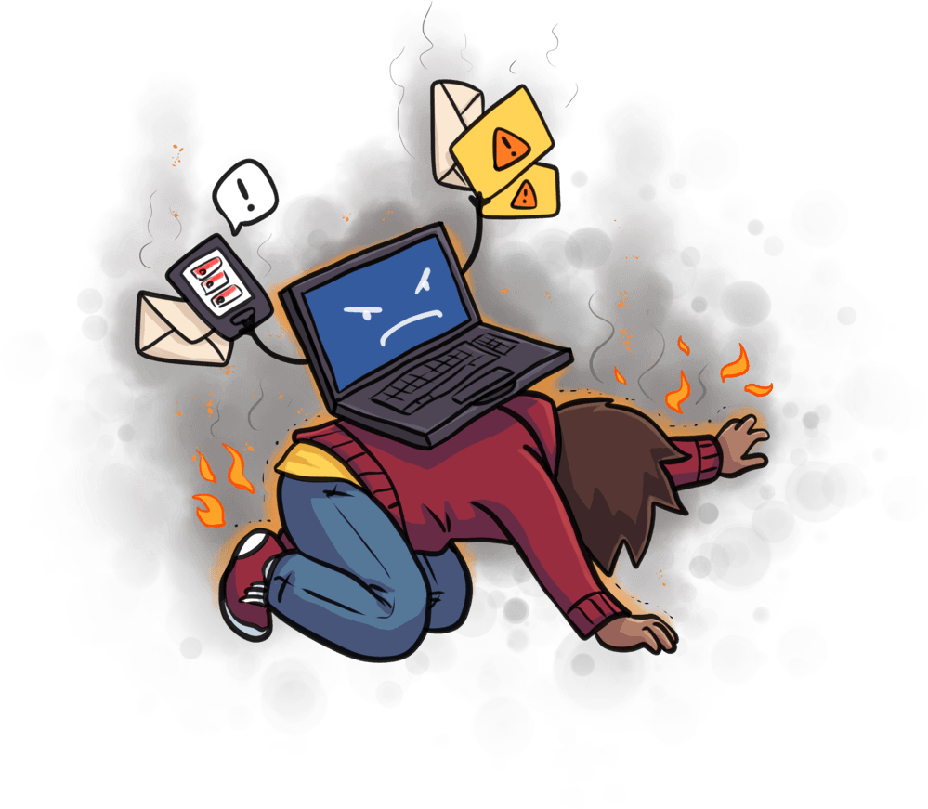
Burn-Out
A state of physical, emotional or mental exhaustion combined with doubts about your competence and the value of your work.
Notes:
A special type of job stress — a state of physical, emotional or mental exhaustion combined with doubts about your competence and the value of your work.

Slide 44
Signs of Burnout
Physical symptoms such as exhaustion most of the time, headaches, and muscle aches
Getting sick often
A negative attitude about work or your career
Feeling like everything is overwhelming or your efforts are futile
Neglecting your own needs, as if you're a pushover
Withdrawing from new responsibilities, challenges, and people
Procrastinating, mainly avoidance or work or it taking long because you can't concentrate
Short tempered, especially with colleagues
Difficultly sticking to regular self-care (i.e. exercise, eating well, etc.)
Loss of motivation and optimism

Slide 45


Work vs Life Partnership
Work
Home
Notes:
The stress that we have at home we bring to work, and the stress that we have at work we bring home.
Thus it is important that we manage the stress
And more importantly you feel that you have some control in both environments.
The lack of control or the feeling of a lack of control, in one or both environments
Leads to chronic stress and burn out.

Slide 46
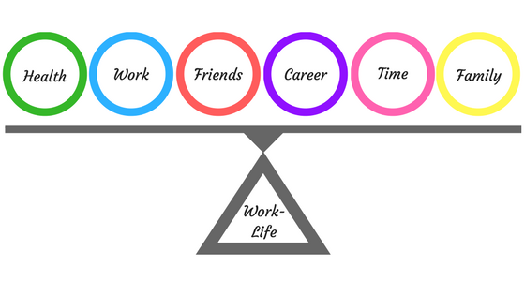
Work-Life Balance
The balance that an individual needs between time allocated for work and other aspects of life
?
Notes:
Ask: What is work-life balance?

Slide 47

What’s your work-life balance?
Work Life
90 10
80 20
70 30
60 40
50 50

Slide 48
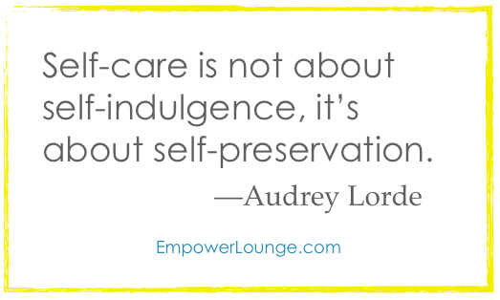
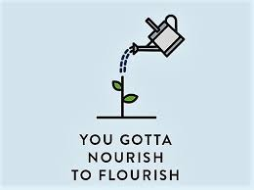
Self-Care
Self-care is any activity that we do deliberately in order to take care of our mental, emotional, and physical health.
The practice of taking an active role in protecting one's own well-being and happiness, in particular during periods of stress.
Self-care is the key to living a balanced life

Slide 49
The 8 Areas of Self-Care
1. Physical = involves movement of the body, health, nutrition, sleep, rest.
2. Psychological = involves learning new things, applying consequential thinking, engaging intrinsic motivation, practicing mindfulness and creative thinking
3. Emotional = involves enhancing emotional literacy, navigating emotions, increasing empathy, managing stress effectively and developing compassion for self
and others.
4. Social = involves having a supportive group and network of relationships around you whom trust and turn to when necessary. Having caring supportive people around you builds a sense of belonging and supportiveness.
Notes:
Just highlight the area. Participants will be reading the details.

Slide 50
The 8 Areas of Self-Care (con’t)
5. Professional = involves sharing your strengths and gifts, having clear professional boundaries, while living your purpose.
6. Environmental = involves having an organized, well-maintained and clutter-free work, business and home environment, having clean clothes and a clean and well-maintained mode of transportation.
7. Spiritual = involves the beliefs and values that are important to you and guide your life.
8. Financial = involves being responsible with your finances and having a conscious relationship with money.
Notes:
Just highlight the area. Participants will be reading the details.

Slide 51
When you feel stressed and need a calm mind, try focusing on the sensations around you—sights, smells, sounds, tastes, touch. This will help you focus on the present moment, giving you a break from your worries.
Breathe in fresh air.
Snuggle under a cozy blanket.
Listen to running water.
Sit outdoors by a fire pit, watching the flames and listening to the night sounds.
Take a hot shower or a warm bath.
Get a massage.
Cuddle with a pet.
Pay attention to your breathing.
Burn a scented candle.
Wiggle your bare feet in overgrown grass.
Stare up at the sky.
Lie down where the afternoon sun streams in a window.
Listen to music.

Slide 52
A great way to take care of yourself when you’re coping with stress is to engage in a pleasurable activity. Try one of these ideas.
Take yourself out to eat.
Be a tourist in your own city.
Garden.
Watch a movie.
Make art.
Do a craft project.
Journal.
Walk your dogs.
Go for a photo walk.

Slide 53
You can also give yourself a boost by doing a task that you’ve been avoiding or challenging your brain in a novel way. This can also boost self-confidence.
Clean out a junk drawer or a closet.
Take action (one small step) on something you’ve been avoiding.
Try a new activity.
Drive to a new place.
Make a list.
Immerse yourself in a crossword puzzle.
Do a word search.
Read something on a topic you wouldn’t normally.

Slide 56
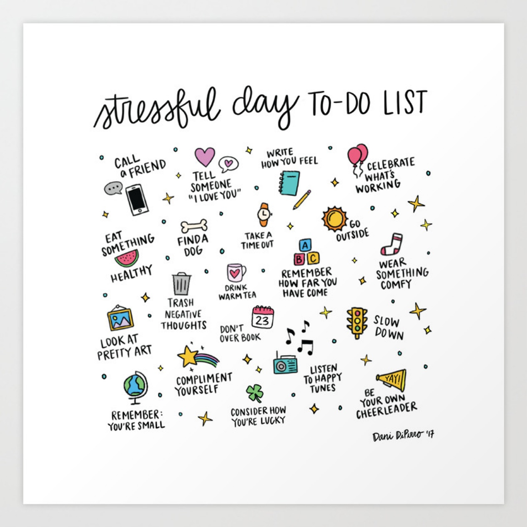

Slide 57
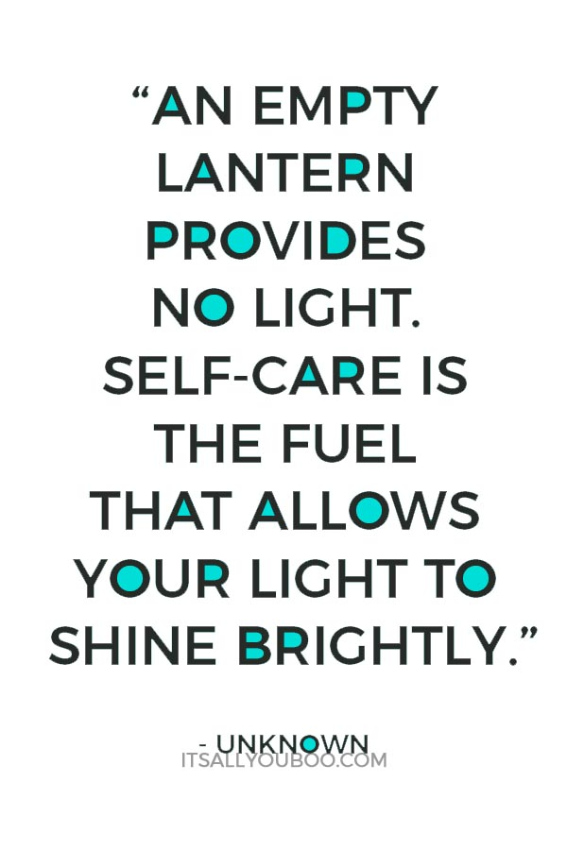
Self-Care Reflection Questions
  What does self-care mean for you?
  How do you currently take care of yourself?
  Do these strategies include your physical, mental, social, financial, spiritual, emotional, environmental and professional well being?
  How do you take care of yourself at work?
  What self-practice or two can you incorporate in your life today?
Notes:
Eating a healthy diet |
Exercise regularly
Getting sufficient sleep
Rest
Practicing a relaxation technique such as trying yoga, practicing deep breathing, getting a massage or learning to meditate
Make time for a time for hobby, such as reading a book or listening to music
healthy friendships
Laugh
Volunteer in your community
Seeking professional counseling when needed
This list isn’t exhaustive. What other suggestions

Slide 58
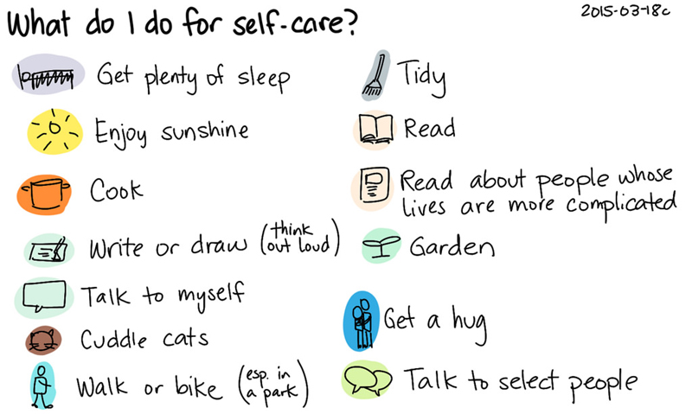

Slide 59
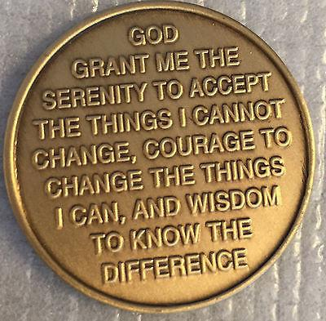
Know the Difference
Notes:
The serenity prayer helps to reduce stress.
We cannot change what we cannot change
We need courage to change what we can
We need to know the difference.
From a non-prayer perspective
We cannot change what we cannot change
We need courage to change what we can
We need to know the difference

Slide 60
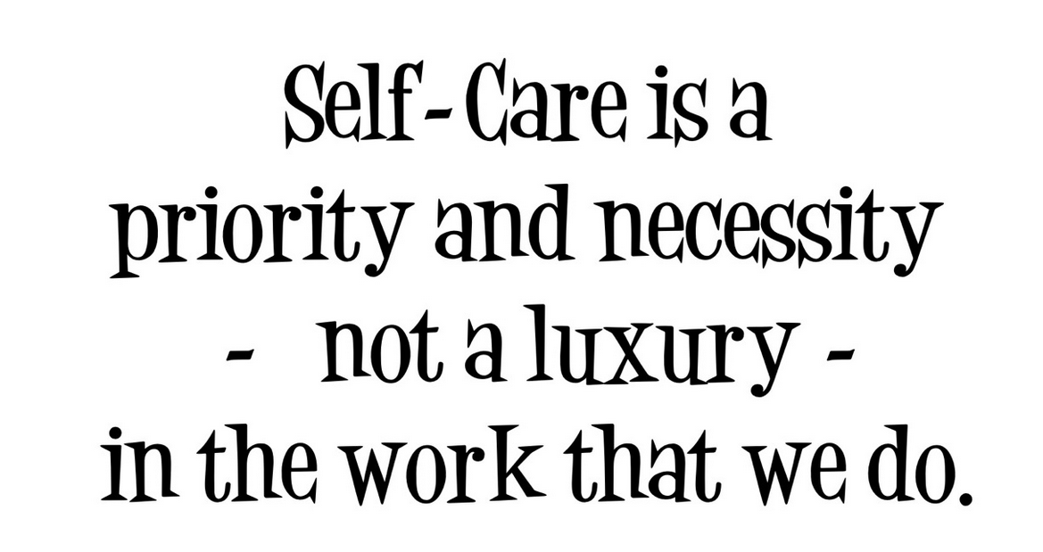
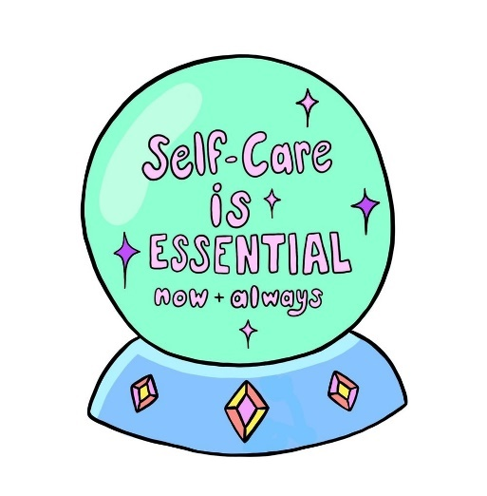
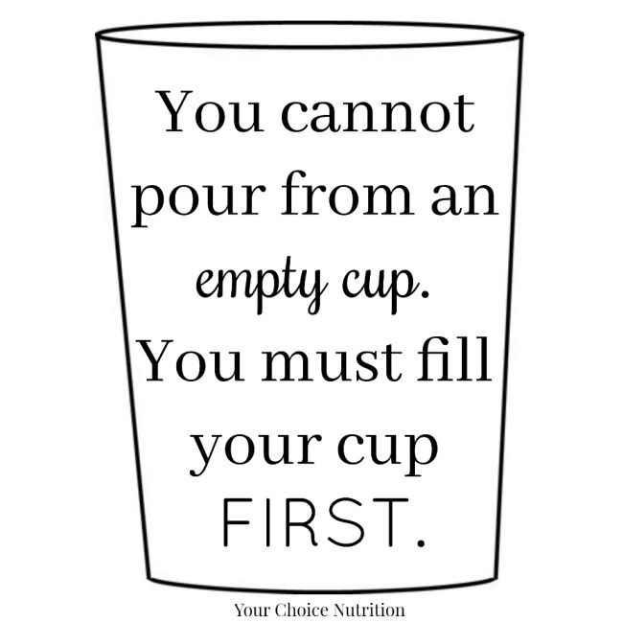
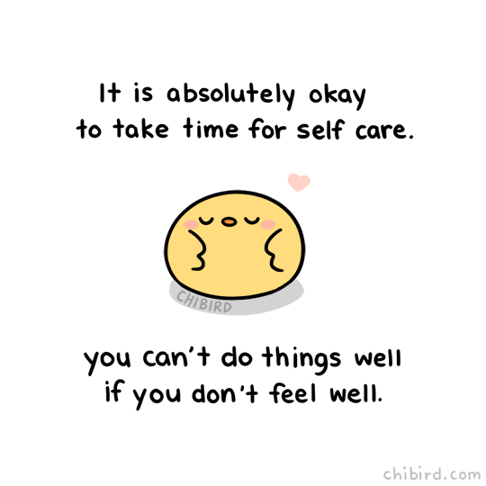
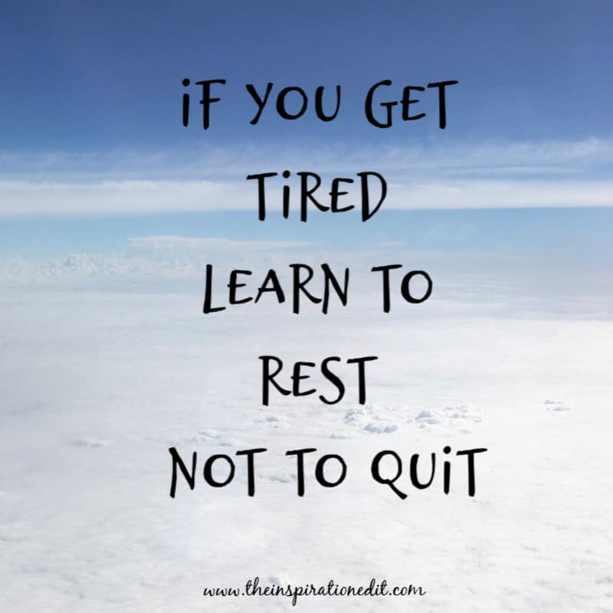
Some Last Thoughts
Notes:
Let participants read

Slide 61


