Slide 1

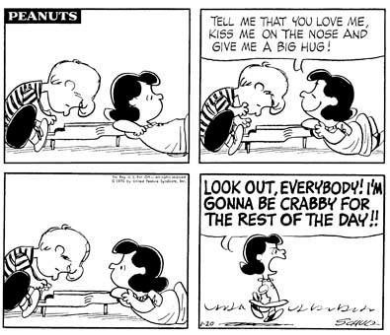
Communicating with Difficult People
Kim Thompson
1st Vice President SFoP
Para-educator HSST

Slide 2
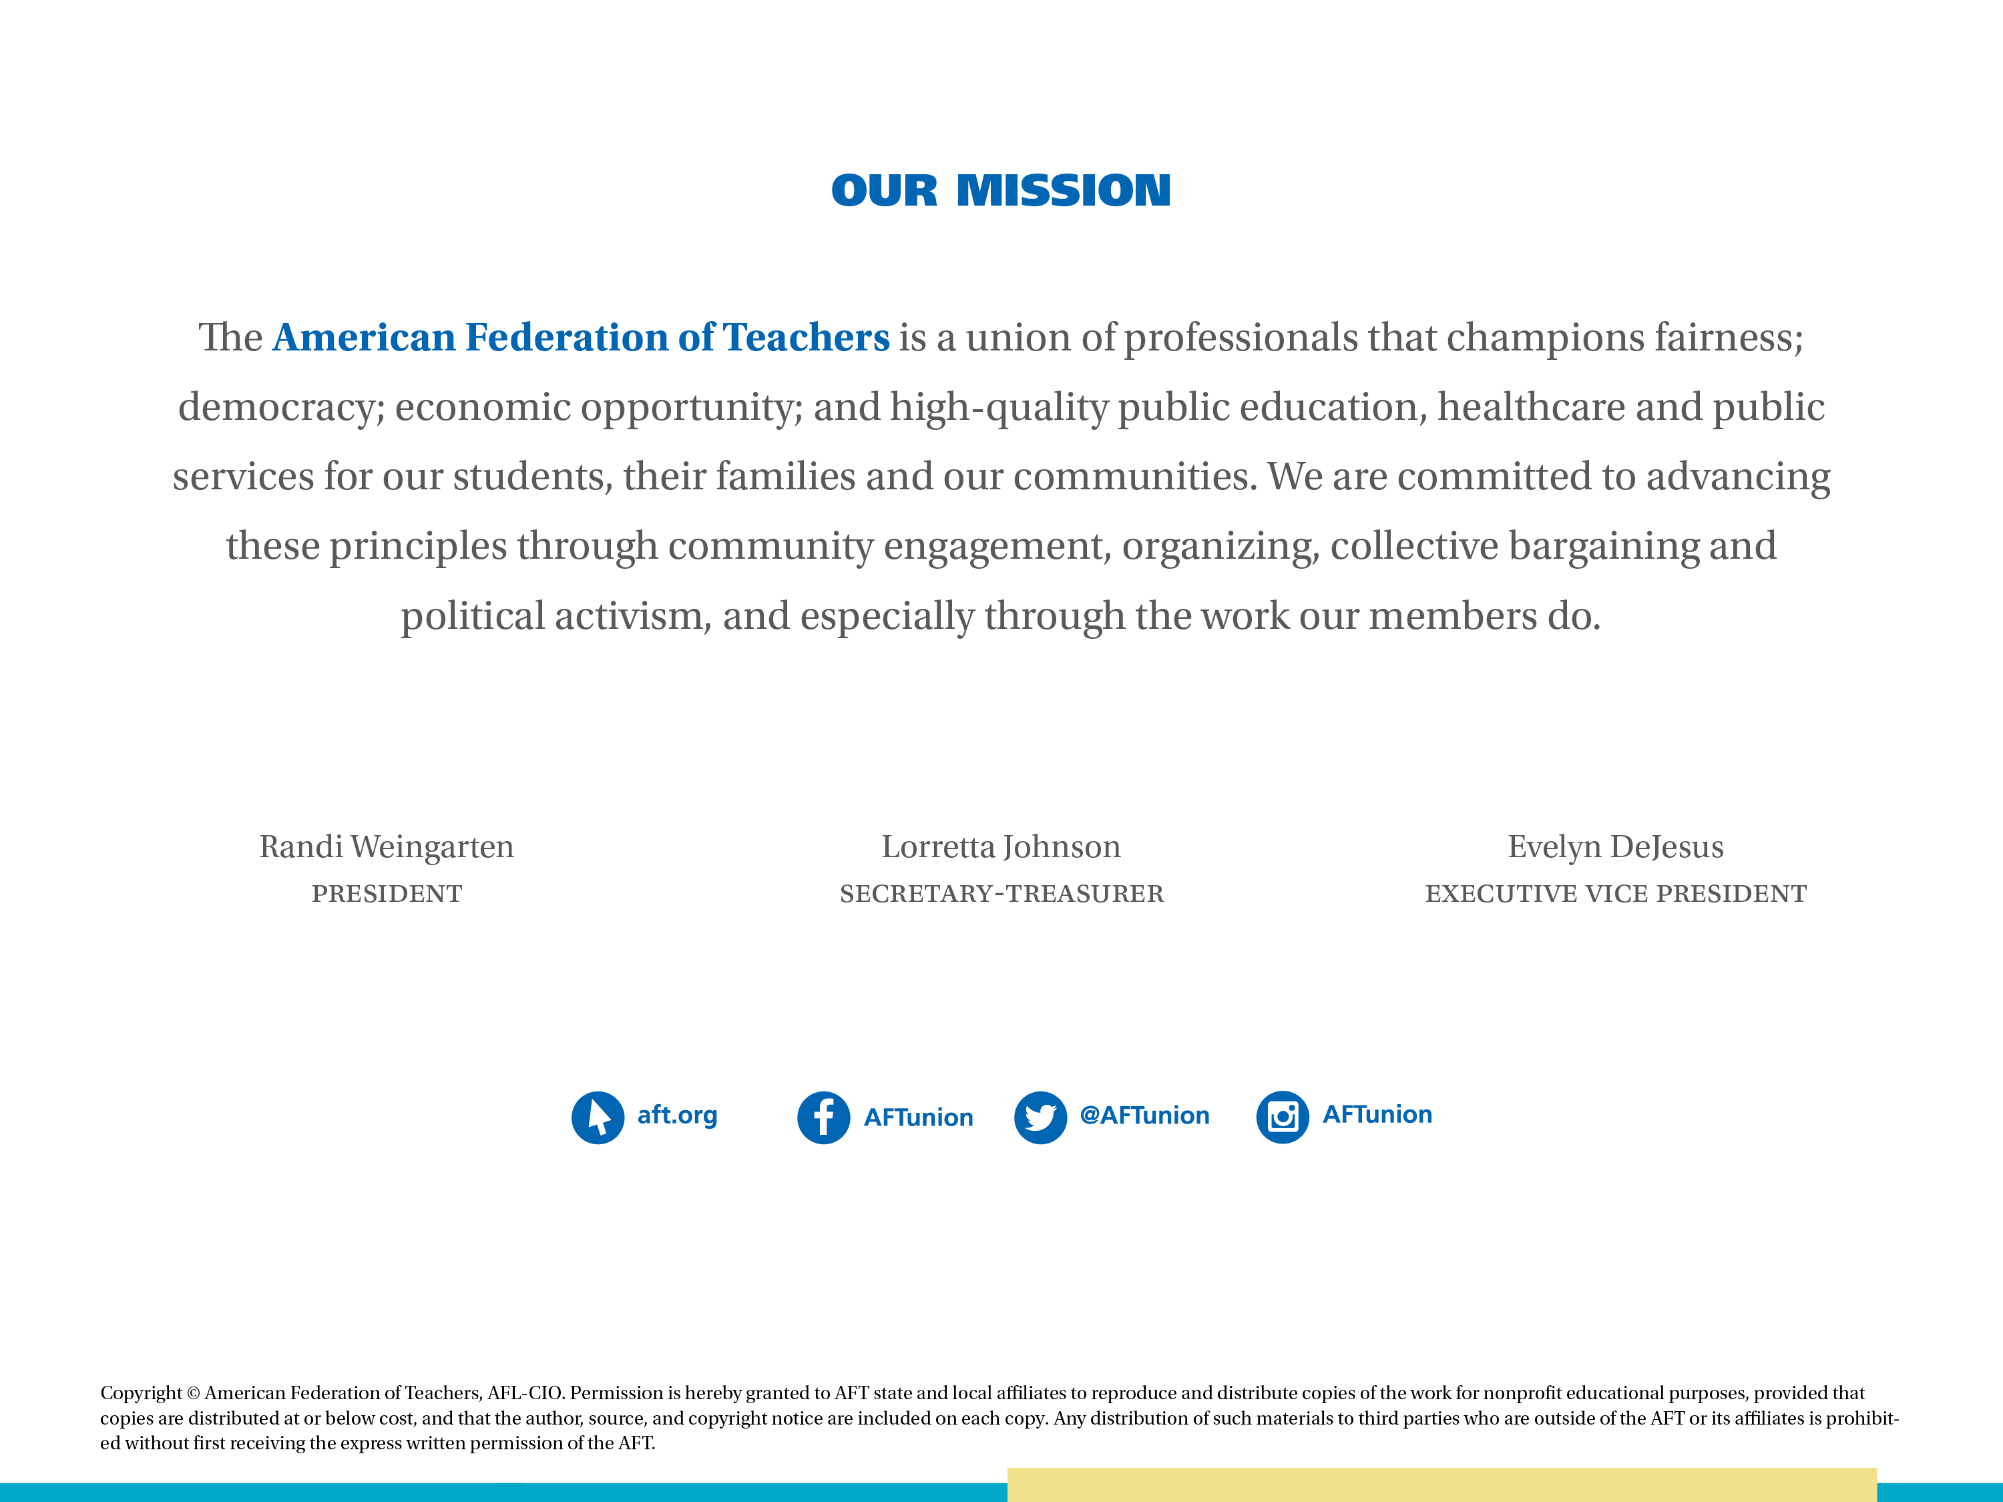

Slide 3

Objectives
Identify “The Difficult People”
The Communication Process
Communicating with Difficult People

Slide 4
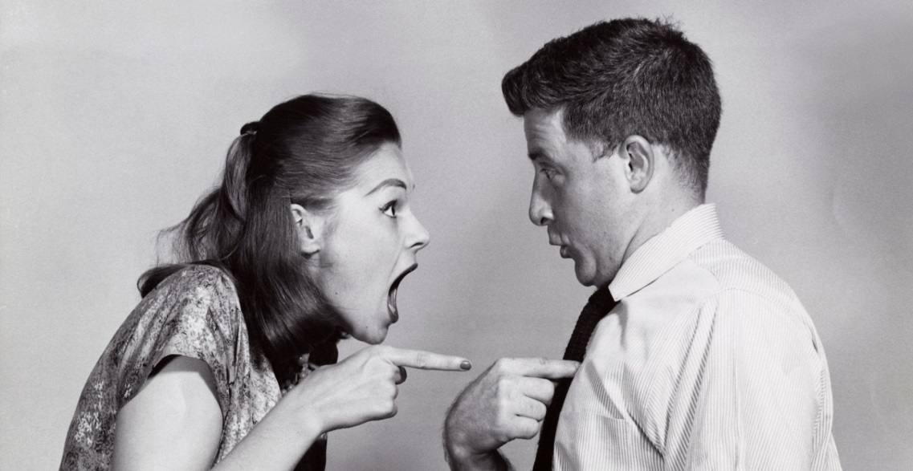
Difficult Person Defined
People with certain personality traits or emotional characteristics that make it difficult for you to communicate with them.

Slide 5
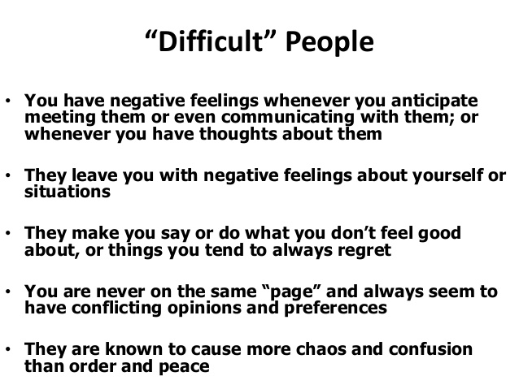
Notes:
This is how difficult people make you feel.

Slide 6
Fill in the blank!
Difficult people are !
Notes:
Have participants raise their hands to fill in the blank. No discussion of answer.

Slide 7
Question
Is the “difficulty”
the person or the behavior?
Notes:
It’s the behavior that could be caused by a situation. The situation could be any number of things. It’s their behavior that makes them difficult, so we must keep that in mind,

Slide 8
Differences Can = Difficulty/Conflict
Information: different points of view
Process: difference of how something should be done
Values: difference in basic beliefs and views
Styles: difference in personality, communication and/or work styles
Notes:
Conflicts(and the difficult people in them) are places where the conversation(and therefore future action) gets stuck.

Slide 9
Activity:
Question
Who is your personal difficult person?
How do they trigger you?
How do you act around this person?
How do you feel around this person?
What do you think is the source of their behavior?

Slide 10
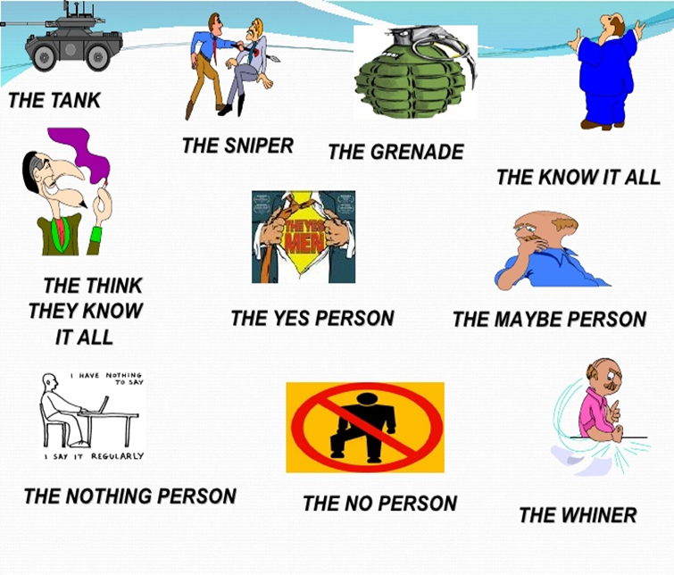
Activity:
What are the difficult people types?
Aggressive
Know-It-Alls
Sarcastic
Nay-Sayers/Yea Sayers
Withdrawn
Notes:
Aggressive:
Sherman Tank
Sniper
Exploder

Slide 11
The Match Game: Part 1
Sniper | This person is unable to make a decision.
The Think-They-Know-It All | This person pushes and plows people over and around.
Whiner | This person says yes to everything.
The No Person | This person is always negative and feel helpless.
The Tank (Sherman) | These people are explosive and unpredictable.
The Nothing Person | This person knows about a lot of stuff.
The-Know-It-All | This person knows just enough to sound like they know something.
The Maybe Person | This person goes quiet or might say a word or two.
The Grenade | This person enjoys throwing cheap shots around.
The Yes Man | This person complains and blames other people and circumstances.
Notes:
Key:
1 I
2 G
3 J
4 D
5 B
6 H
7 F
8 A
9 E
10 C

Slide 12

The Match Game: Part 2
Notes:
Part 2: Matches the difficult person type with ways to deal with them. The key is provided for instructor.

Slide 13
Activity :
Aggressiveness Matrix-Put the 10 categories in the appropriate square
Passive Aggressive of or denoting a type of behavior or personality characterized by indirect resistance to the demands of others and an avoidance of direct confrontation, as in procrastinating, pouting, or misplacing important materials. | Open Aggressive tendency to lash out in anger and rage, becoming physically or verbally aggressive and can often times hurt themselves or others
Constant Complaining do not usually see themselves as negative people -- they see the world as negative and themselves as merely responding appropriately to annoying, aggravating and unfortunate circumstances. In other words, they complain excessively because they believe they have ample reason to do so | Destructive Criticism type of criticism that's intended to harm, undermine, or even destroy someone's creation, reputation, or self-esteem. It's when someone chews you out, mercilessly rips apart your idea, or publicly denigrates your abilities.
Notes:
Put the 10 categories in the appropriate square

Slide 14
Aggressiveness Matrix
Passive Aggressive Yes Person Nothing Person The Maybe Person | Open Aggressive Tank (Sherman) Grenade Know-it-all Think they know-it-all
Constant Complaining The Whiner The No Person | Destructive Criticism The Sniper The No Person The Maybe Person
Notes:
They fall into these four categories

Slide 15
Consider:
People aren’t their behavior.
People demonstrate patterns of behavior.
People are people or task focus.
People demonstrate passive or aggressive tendencies.
Balance is the key.
Notes:
Balance is key. Not aggressive, not passive, but assertive = balance

Slide 16
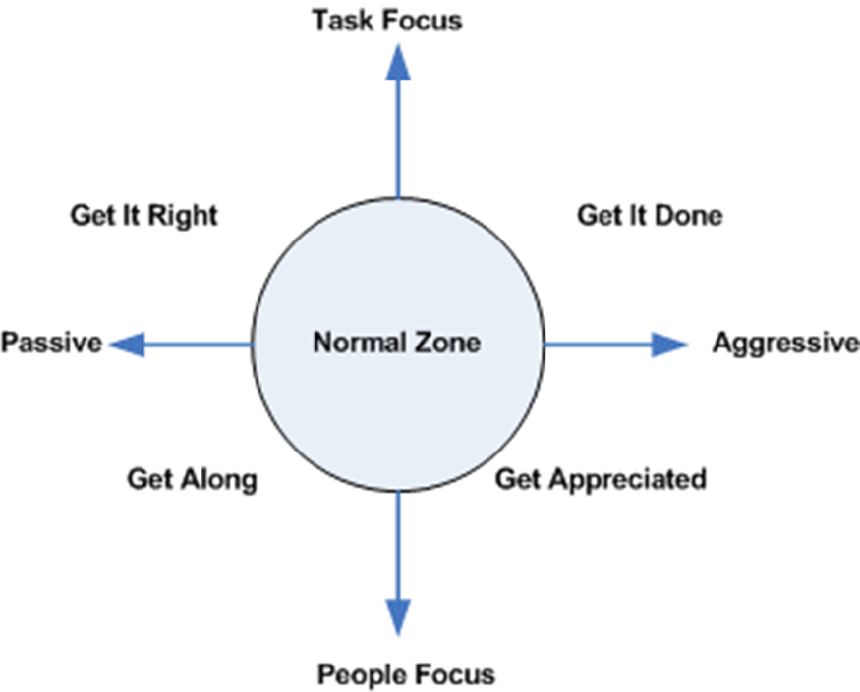
Behavior
People behave based on intent. Here are four general intents that shape behavior:
Get the task done
Get the task right
Get along with people
Get appreciation from people
Notes:
People behave based on intent.
Understand the four intents: They all have their time and place in our lives. When we keep them in balance, the result is often more success and less stress.
When people want to get it done and fear that it’s not getting done, their behavior becomes more controlling. They try to take over and push ahead.
■ When people want to get it right and fear that it will be done wrong, their behavior becomes more perfectionistic. They find every flaw and potential error.
■ When people want to get along and fear that they will be left out, their behavior becomes more approval seeking. They begin sacrificing their personal needs to please others.
■ When people want to get appreciation and fear they’re failing at that intent, their behavior becomes more attention getting. They become difficult to ignore.
“Once people determine that what they want is not happening, or that what they don’t want is happening, their behavior becomes more extreme and therefore less tolerable to others.”

Slide 17

II. The Communication Process
Verbal Communication
Non-verbal Communication
Listening
Active Listening

Slide 18
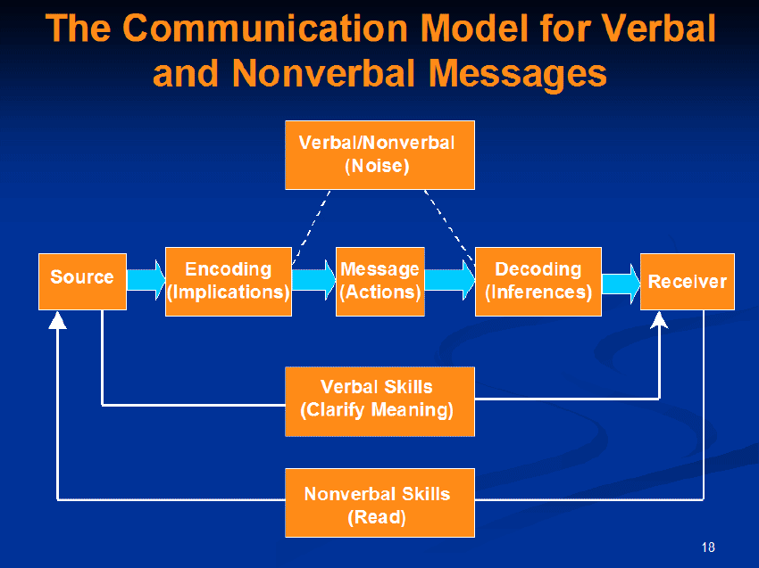
The Communication Process

Slide 19
Understanding Emotions in Communication
All communications contain some emotion or a mix of emotions
Emotions can confuse the message one is sending
Emotions are vital to happiness because they promote action
Negative emotions can drain your energy and everyone else's
Positive emotions promote positive communication
Notes:
There is no communication without emotions.

Slide 20
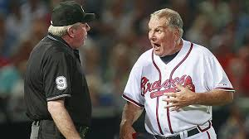
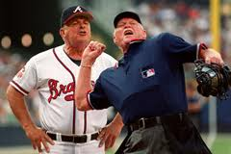
The biggest problem in communication is the illusion it has been accomplished!
-George Bernard Shaw
Notes:
How many times have we thought that we had communicated something only to finds out that we hadn’t? we confuse telling someone something and assuming because we told them, we communicated. But, if we didn’t check to make sure they understood our message, it could and often does lead to miscommunication. In this picture that umpire’s communication is clear!

Slide 21
Four Styles of Communication
Aggressive: bossy, arrogant, bulldozing, intolerant, opinionated and overbearing
Passive Aggressive: sarcastic, deceiving, ambiguous, insinuating, manipulative and guilt-inducing
Submissive: whining, moaning, helpless, passive, indecisive and apologetic
Assertive: direct, honest, accepting, responsible and spontaneous
Notes:
Our communication style is also a reflection of our personality and behavior.
Although, there are times when we use each of them.
One of them is predominant

Slide 22
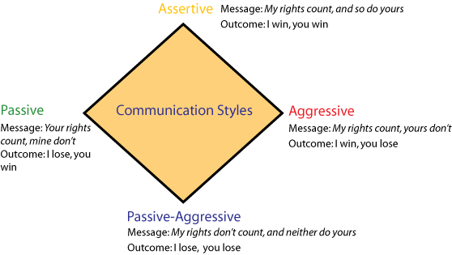
What’s your communication style?
Notes:
Do you know what type of communication style that you have? It usually goes with your personality. Passive people speak passively, although we may actually use each of these styles in different situation. The important thing to remember is that the listener may make an assessment about your communication style that is different that what you think. For instance, you may think that you are assertive, but other people think that you are aggressive. Think of the communication styles of difficult people.

Slide 23
Tact and Candor
Tact = the ability to tell the truth in a way that considers other people's feelings and reactions.
Candor = being frank, sincere and open.
Notes:
Next, communicating tactfully strengthens your reputation and builds your credibility . It allows you to preserve existing relationships and build new ones. A tactful approach shows character , maturity, professionalism , and integrity .
Tact also demonstrates good manners. It’s necessary for dealing with difficult people. Remember: How you say what you say is important.

Slide 24
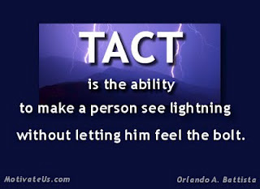
Activity:
Tactful Candor Exercise
Read a statement from the ‘Tactful Candor’ handout and determine if it is tactful or not.
Explain your answer.
If it is not tactful, how would you say it in a tactful way?
Notes:
Ask: What is candor? Candor is the ability to communicate potentially sensitive information to a person without upsetting or offending them? Ask if anyone has been in a situation where someone said something to them in an untactful manner. Ask if anyone has spoken to someone in an untactful manner. Do exercise.

Slide 25

Nonverbal communication is
communication without words.
Notes:
Non-verbal communication is integral to the communication process, and plays a major role in effective communication. It is always part of our communication. We actually communicate more non-verbally than we do verbally.

Slide 26
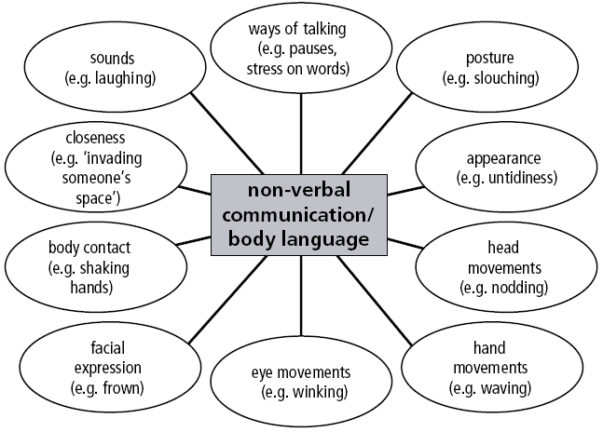
Types of Nonverbal Communication
Notes:
These are the different types of non-verbal communication. Think of them in terms of a difficult person.

Slide 27
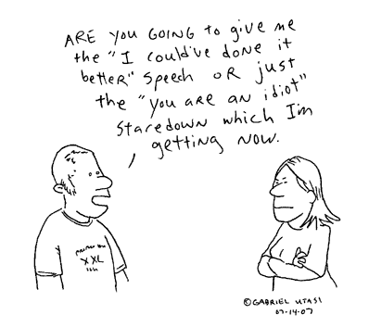
Nonverbal Communication
Intentional
Unintentional
Universal
Cultural
Sometimes Ambiguous
Notes:
Nonverbal communication is intentional and unintentional in that we mean to communicate using non-verbal methods or we miscommunicate using non-verbal methods. All people communicate non-verbally. Non-verbal communication is different in different cultures. What is ok in one culture, may not be ok in another culture. Make sure that you have a working knowledge of other cultures that may be in your school or of a team member, especially in it is prominent. For instance, there is a big Asian or Hispanic population in your school. Non-verbal communication, like the meaning of words can mean different things. For example, crossed arms can mean different things depending on the situation.

Slide 28
Activity 8:
Non-Verbal Test
Define non-verbal communication?
Give three examples of positive non-verbal communication?
Give three examples of negative non-verbal communication?
Which of the following forms of non-verbal communication are the best indicators of what a person may be actually communicating to you? (Rank from most to least influential)
A. Body posturing B. Position of arms and hands C. Eye contact
How much of the meaning of a spoken statement comes from the actual words spoken?
A. 75% B. 8% C. 20%
Notes:
Let’s check our learning about non-verbal communication. Have participants get a sheet of paper. Give them three minutes to do test. Check answers:
Answers:
Communications other than the actual words spoken; includes all forms of body language, eye contact, and other cues, that one might send that give indications of what the person is really communicating.
Examples: smiling, maintaining eye contact, arms unfolded, etc.
Examples: frowning, arms crossed, avoiding eye contact, etc.
1) eye contact 2) body posturing 3) position of arms and hands
8 percent

Slide 29

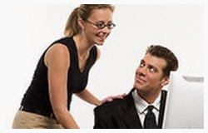




Be Aware!
Make sure you understand the kind of
signals your body is sending every time
you are talking to someone!
Notes:
Because, as we’ve seen, non-verbal communication is so important and constant. Be aware of yours when you are communicating with someone. We are not always aware of the signals we send with our body language. Be aware!

Slide 30
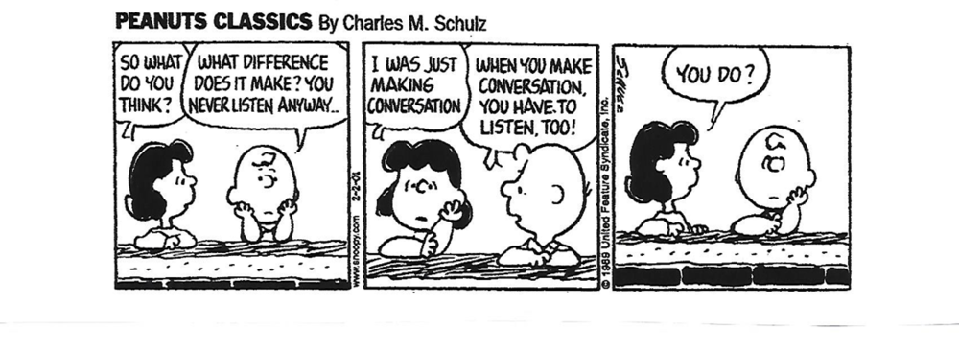
Listening
The process of receiving, constructing meaning from, and responding to spoken and/or nonverbal messages (ILA, 1996)
To hear something with thoughtful and undivided
attention.

Slide 31
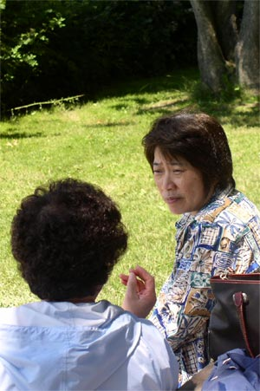
The Slippery Slope of Listening
I know you think you understand what you thought I said, but I’m not sure you realize that what you heard is not what I meant.
Notes:
Think about this quote: What does it mean? Answer: Listening is not a passive activity and requires undivided attention.

Slide 32

You must choose to participate in the process of listening
Listening is the most powerful
form of acknowledgement
Notes:
Listening is not something you can do unwillingly. It is not something that you can do if you don’t want to do it.
ASK: How do you feel when someone is not listening to you?? Get responses. Float in answer…
ASK: How do you say, “I love you”? Get responses. Answer: you listen!

Slide 33
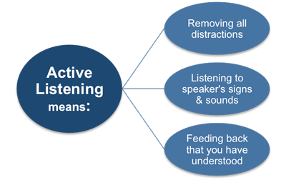
Listening is Active!

Slide 34
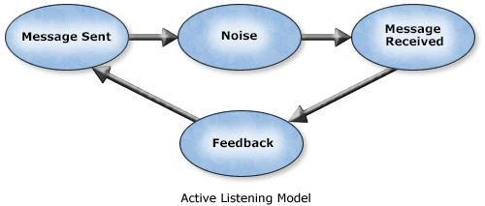
Verify – ask questions about veracity of statement
Clarify – ask questions to clear up ambiguities
Paraphrase – restate speaker’s comments in your
own words
Summarize Responses – review the speaker’s main
points
Notes:
As we saw in the listening test, it is important that you ask questions when you don’t fully understand what the speaker is saying.

Slide 35
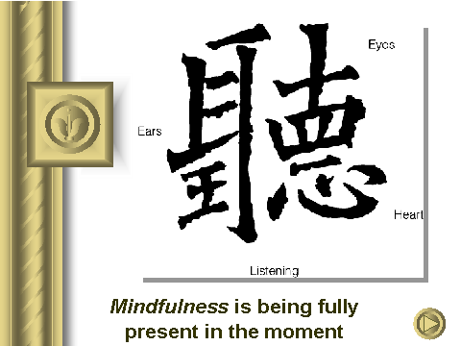
Notes:
These Chinese characters present a wonderful picture of what is involved in listening. The ears hear the words. The eyes sees the body language/ non-verbal communication. The heart is responsive to the speaker’s emotions, and the most important thing is being in the moment as though no one else exist other than you and the speaker.
The key is mindfulness…it’s like there is no one in the world but the two of you.

Slide 36
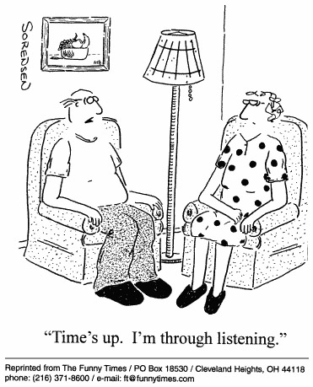
Barriers to Listening
Environmental
Linguistic
Psychological
Physiological
Perceptual
Content
Personal
Notes:
Here are a list of things that can hinder your ability to listen.
Environmental: anything in the environment…too hot…too cold…noisy ( H/VAC or outside construction, etc)
Linguistic: understanding what someone is saying based on their language or accent.
Psychological: What’s on your mind, thinking about many things, stress, pre-occupied ( good or bad)
Physiological: things taking place in your body…pains…uncomfortable chairs.
Perceptual: How you perceive what is being said or the speaker.
Content: If you don’t’ understand what’s being said or interest in subject matter
Personal: If you don’t like the person speaking.
The cartoon is funny, but true. If he is through listening, then time is up for that conversation. It doesn’t mean that she is happy. But it does reiterate that listening involves undivided attention in the moment willingly!

Slide 37
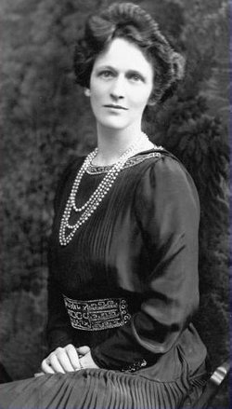
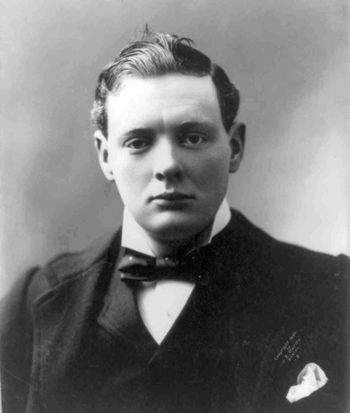
III. Communicating with Difficult People
Sir, If I were your wife, I’d put poison in your coffee.”
Nancy, if I were your husband I’d drink it.”
Lady Nancy Astor
Sir Winston Churchill

Slide 38
Three Ways of Communicating
Care-less: talking within your value system and ignoring theirs. (Arrogant/Insensitive/Aggressive)
Care-ful: speaking within the difficult person’s values and ignoring your own. (Wimpy/ Subservient/Passive/Passive-Aggressive)
Caring: communicating your values within theirs.
(Respectful/Sensitive/Assertive)
Notes:
Careless =

Slide 39
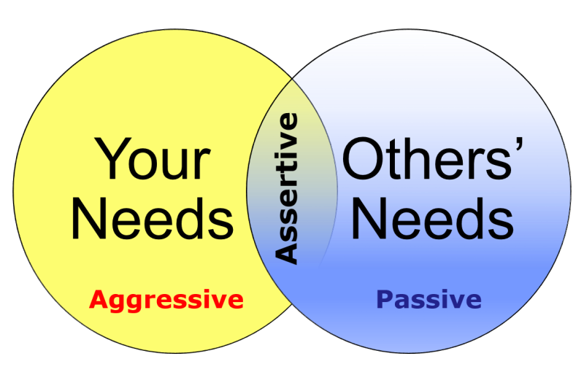
Be Assertive!
Advocate for yourself in a respectful, but determined way, acknowledging the feelings and rights of others.

Slide 40
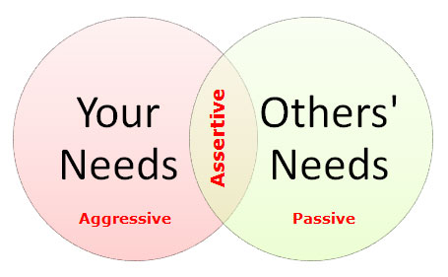
Three Keys to Assertiveness
Know what you want.
Say what you want.
Get what you want.
Notes:
Know what you want. You need to be clear within yourself as to what it is you want.
Say what you want. Communicate clearly to others your intentions, needs, and desires.
Get what you want. Advocate in an assertive way--respectful, determined and controlled--to increase the likelihood of attaining your reasonable and legitimate goals.

Slide 41
Assertive Communication:
I-Messages
For example:
“I need more time to complete this project.”
“I would appreciate it if you could come with me.”
“I am really not in the mood to go.”
“No, I cannot do it.”
“I am sorry; I already explained the consequences for ignoring my wishes and now you will need to live with them.”
Notes:
I-messages communicate how you feel in an assertive manner. However, there is no guarantee that the other person will be receptive. It does avoid the defensiveness that comes with making “you” statements.

Slide 42

Saying No
It’s “ok” to say no.
Don’t apologize.
Don’t feel guilty.
Be respectful.
Maintain self-control.
Keep it simple.
Notes:
Saying no is part of assertive communication. Otherwise you find yourself doing things that you do not want to do or can’t do. Both of which create stressful situations.

Slide 43
Deflection Phrases
I would like to help you, but I need you to. . .
Let me make sure I understand what you need. . .
There are several options you can consider. . .
I don’t have the ability to do that, but let me connect you with. . .
I’m sorry that happened to you, but. . .
Notes:
Deflection phrases keep you from getting sucked into something that you don’t want to get into.
‘t

Slide 44
Value Language
What drives someone to make life choices, what gets them up in the morning and informs their goals and actions.
Predict someone’s behavior or choices
Understand why some people drive you crazy
(they speak a different value language)
Most misunderstandings stem from simple differences in what people value
Win someone over by appealing to what they value
Notes:
Predict someone’s behavior or choices
Understand why some people drive you crazy–they speak a different value language
Learn that most misunderstandings stem from simple differences in what people value
Know how to win someone over by appealing to what they value, instead of what you value

Slide 45
Speak Their Value Language
Image
Money
Power
Fame
Perfection
Experience
Uniqueness
Relationships
Control
Knowledge
Notes:
These are the 10 most common value language categories. Think about them in terms of your difficult person.

Slide 46
Food for Thought
The greatest stress you go through when dealing with a difficult person is not fueled by the words or actions of this person—it is fueled by your mind that gives their words and actions importance.
What gets rewarded gets repeated.
The way you see people is the way that you treat them, and the way that you treat them is the way that they become.
“Everybody has a hot button. Who is pushing yours? You cannot control that person, but you CAN control the way you react to them.”
People reveal themselves through their actions.
Notes:
Things to think about when it comes to difficult people. How is this helpful?

Slide 47
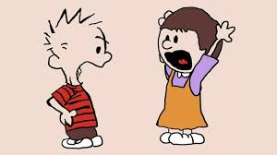
The DO’s
Stay calm
Be proactive
Be assertive
Be respectful
Establish boundaries
Listen (actively)
Don’t judge
Understand their intent
Have a clear intention
Walk away (when necessary)

Slide 48

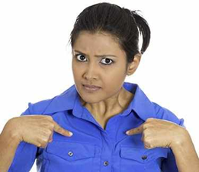

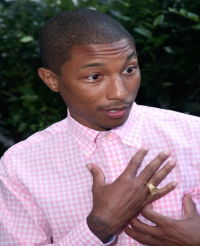
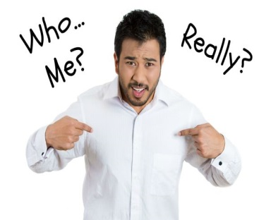
A Parting Note: Remember
Everybody is Somebody’s difficult person!

Slide 49
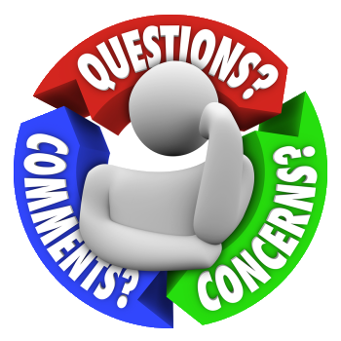

Slide 50


