Slide 1


Slide 2
August 24, 2021 Orientation for Unit D Members
Catherine Mastronardi, President, Springfield Federation of Paraprofessionals, 8:30 – 9:00 am
Darcia Milner, Chief Schools Officer, Springfield Public Schools 9:00 – 9:30 am
Diana Mieltowski: Benefits Department, City of Springfield 9:30 – 10:00 am
Tracy Thibert: Employee Assistance Program, ESI 10:00 – 10:15 am
Break 10:15 – 10:30 am
Kristin Reardon, Senior Administrator of Human Resources, Springfield Public Schools 10:30- 10:45 am
Valerie Williams, Sr. Administrator of Talent Acquisition & Diversity Development, 10:45 -11:00 am
Lydivette Guzman, Human Resources Analyst, 10:45 – 11:00 am
Questions 11:00 – 11:15 am
Lunch 11:15 – 12:15 pm
Caryn Laflamme, Field Representative, AFT Massachusetts 12:15 – 3:00 pm
Break TBD

Slide 3
Overview: The Professional Development Program “Orientation for Unit D Members” has been designed to support new Unit D in the Springfield Public Schools and will be comprised of one day of training. Topics will include detailed information on topics including professional expectations, professionalism, attendance policies, acceptable social media use, probationary period, district policies and the benefit package including competitive wages, paid sick leave, paid holidays, earning incentive days, and Professional Development opportunities including a robust Para to Teacher Pipeline program.

Slide 4
Best Practices:
Be on time
Camera ON and facing you
Audio OFF if not speaking-please don’t speak over others
Use the CHAT for questions
Please turn of your cellphone
Be respectful

Slide 5


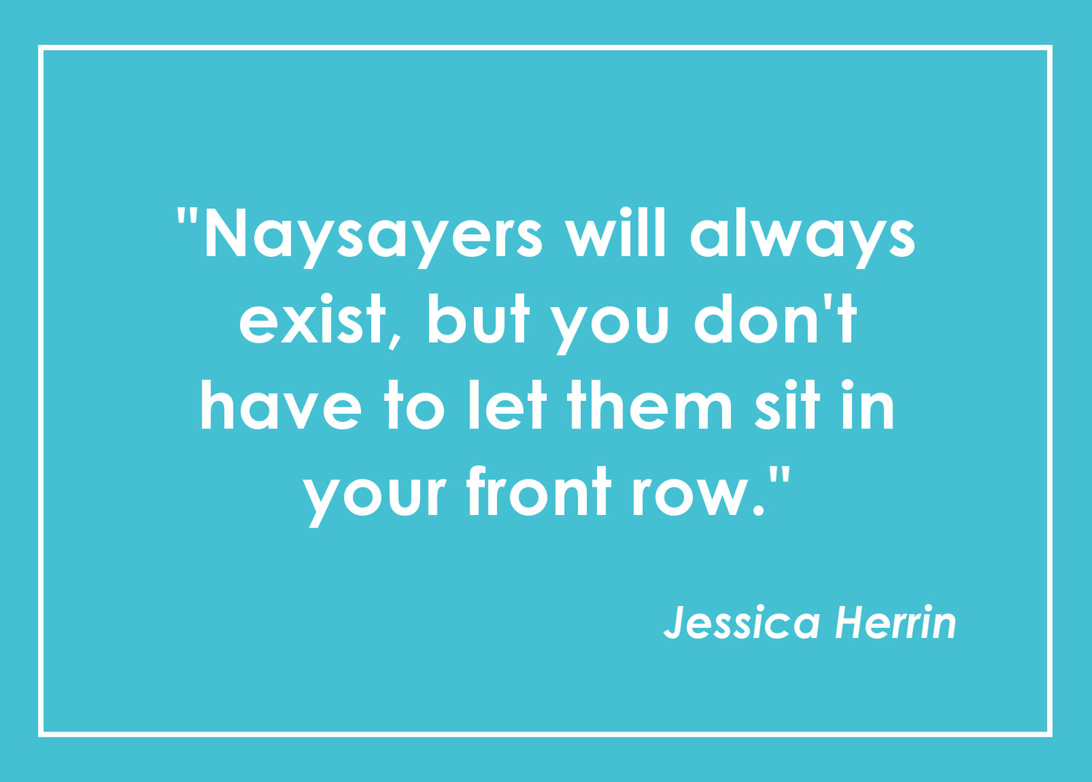
DARCIA MILNER
Chief Schools Officer
Zone 1

Slide 6

Diana Mieltowski
Benefits Department
City of Springfield

Slide 7


Tracy Thibert
Employee Assistance Program
ESI

Slide 8


Slide 9


KRISTIN REARDON
Senior Administrator of Human Resources

Slide 11
Internet Use, Social Media, and Email
Social Media
Use of social media during district time is prohibited. This includes personal blogs, chats, posts, tweets, etc. Use extreme caution with information that you post as it is never truly private. The line between professional and personal relationships can be blurred within social media context. When employees choose to join or engage with District students, families, or coworkers you are advised to maintain professionalism as an SPS employee.
Employees are responsible for what they post on their own site and on the site by others. You may be held liable for commentary deemed libelous, defamatory, obscene or inappropriate.
Internet Use and Email
All messages and information created, sent, or retrieved on an SPS computer or network are the property of the SPS. Electronic mail messages and other use of electronic resources by students and staff, including accessing web pages, should not be considered confidential. Copies of all information created, sent, or retrieved are stored on the computer network’s back-up and archive files. Under the Massachusetts Public Records Law, electronic mail transmissions and other uses of electronic resources by SPS employees may be considered public records
No expectation of privacy

Slide 12
Professionalism and Boundaries
Professionalism
Be polite and courteous
Respect cultural differences
Do not engage in gossip
Remember boundaries with colleagues
Boundaries
Boundaries encompass a wide variety of areas. In this day, boundaries are becoming more difficult to define, manage and maintain
A few examples are: Emotional, Financial, and Communication.
.

Slide 13
Professionalism and Boundaries, cont.
Emotional
• Showing preferential treatment to students
• Intimate relationships with students: engaging in a romantic and/or sexual relationship with a student (current or former)
• Flirtatious behavior/ intimate gestures directed towards a student
• Expressing romantic feelings towards a student in written or other form

Slide 14
Professionalism and Boundaries, cont.
Financial and Communication
Meeting the student alone outside of school or taking the student for an unauthorized outing
Privately giving a student money or a gift
Talking with a student about highly personal and/or sexually inappropriate matters
Using social media to interact with student about personal /sexual matters
Distribution or sale of prescription or non prescription drugs constitutes a danger to the students
Be as transparent as possible and with the knowledge and consent of the Principal or Supervisor.

Slide 15
Professional Boundaries, cont.
If you become concerned about relationships you are developing, ask yourself the following:
Am I dealing in a different manner with a particular student than with other students?
Am I sharing information with a student because I think it will help the student or because I need/want to be liked?
Am I interacting with the student in an ‘online environment’ consistently with how I would act with that student in class or at school?
Would I modify my behavior with a student if a colleague/ Administrator were present?

Slide 16
Questions?

Slide 17

Valerie Williams, Sr. Administrator of Talent Acquisition & Diversity Development
Lydivette Guzman, Human Resources Analyst,

Slide 18

Lunch 11:15 – 12:15 pm

Slide 19





Caryn Laflamme
Lead Field Representative
AFT Massachusetts

Slide 20

Your success is our priority and we have made a commitment to support you!

Slide 21
Weingarten Rights

Slide 22
Basic Weingarten Right: A member who has a reasonable belief that a meeting with a supervisor may lead to discipline has the right to have a union representative present at that meeting.

Slide 23
What situations give rise to Weingarten rights?
•Where the employee has a reasonable expectation that discipline may result; for example, where the meeting is part of the employer's disciplinary procedure.
•Where the purpose of the meeting or interview is to investigate an employees allegedly inadequate work performance or other misconduct, where discipline of any kind is a possible result.
•Where the purpose of the interview of meeting is to elicit facts, the employee's "side of the story," or obtain admissions or other evidence either to determine whether or not discipline is warranted OR to support a disciplinary decision already made.
•Where the employee is required to explain or defend his/her conduct in a situation which the employee reasonably fears could affect his/her working conditions or job security.

Slide 24
What situations DO NOT give rise to Weingarten Rights?
•Where the meeting or discussion is merely for the purpose of conveying work instructions, training, or needed corrections.
•Where the purpose of the meeting is simply to inform the employee about a disciplinary decision that has already been made and no information is sought from the employee.
•Where the employer has clearly and overtly assured the employee prior to the interview that no discipline or adverse consequences will result from the interview.
•Where any discussion that occurs after the employer has notified the employee of the discipline has been initiated by the employee rather than the employer.

Slide 25
If an employer has provided all the necessary Weingarten rights, may an employee refuse to answer questions?
No, unless the matter under discussion has criminal implications. Generally, an employee generally does not have the right to remain silent, as long as his/her representational rights have been honored, nor may the union representative direct the employee to remain silent.

Slide 26




Knowing Your Contract
Caryn Laflamme, Field Representative, AFT Massachusetts and Catherine Mastronardi, President, Springfield Federation of Paraprofessionals

Slide 27
The SPRINGFIELD FEDERATION OF PARAPROFESSIONALS, LOCAL 4098 AMERICAN FEDERATION OF TEACHERS, AFL-CIO
is the exclusive bargaining agent and representative of Paraprofessional employees of the Springfield Public Schools for the purpose of collective bargaining with respect to hours, wages, and conditions of employment. Such unit shall include Para-educators, Certified Nursing Assistants, Licensed Practical Nurses, Health Assistants, Assistant Teachers, Occupational Therapy Assistants, Physical Therapy Assistants and Tutors.
The district will often refer to our group as “Unit D” or “the Paras”

Slide 28
We are contracted to be paid for 202 days per school year.
180 School Days with students in attendance
7 Professional Development Days (4 during PD week in August & 3 during the school year)
1 Convocation Day (Friday of PD week)
14 holidays
Labor Day, Columbus Day, Veterans Day, Thanksgiving (2) days’ pay), Christmas Day (3 days’ pay), New Year’s Day, Martin Luther King Day, President’s Day, Patriot’s Day, Good Friday, and Memorial Day, plus any day when schools are closed due to an emergency and the day is not rescheduled at a later date during the same school year
We do not get paid for snow days…We do get paid for a full day for delay days and early dismissal days.

Slide 29
What is a grievance?
A grievance is a claim by an employee that there has been a violation, misinterpretation, or misapplication of the terms of this Agreement (AKA the Contract)

Slide 30
The probationary period for a Unit D member is 120 working days
Any employee who has completed a 120 working day probationary period as hereinafter defined shall not be discharged, suspended, demoted, or disciplined without good cause, (hereinafter defined). Such good cause shall be given to the employee in writing. In the Springfield Public Schools we follow progressive discipline in most cases.

Slide 31
Disability Days/Business Day
10-4-5 Days
Incentive Days
Disability Days/Business Day: Paraprofessionals will be provided with ten (10) disability leave days at the commencement of the school year. 3 of these days can be used as Business Days.
Ask your building representative about how your principal wishes to be notified in the event that you will be using a disability (sick) day.
Notify your Principal and school clerk by email when you wish to use a business day.
10-4-5 Days: If you use four (4) or less disability leave days in a given year you will have an additional five (5) disability leave days added to your total at the end of the school year. These days accumulate from year to year.
Incentive Days: You can earn one incentive day (based on their regular daily rate of pay) for each school month (September-June) in which you do not have any absences. You can begin earning incentive days in your first complete month of employment.

Slide 32
Incentive days are earned in one school year and available to use in the following school year.
Notify your Principal and school clerk by email when you wish to use an incentive day.
Incentive days may be used any time during the school year for days when school is closed due to weather or vacation periods. Unused incentive days will be paid in the final payroll in June

Slide 33
If you serve as a substitute for a teacher you will be paid at the rate of $4.25 per half hour for any part of a half hour that you perform that service.

Slide 34
Diapering/Toileting
Para-educators performing Diapering/Toileting on a regular basis for up to three full time students in the classroom they are assigned to will be paid a monthly stipend of $100.00 for up to ten months per regular school year to a yearly maximum of $1,000.00.
Para-educators performing Diapering/Toileting on a regular basis for four to six full time students in the classroom they are assigned will be paid a monthly stipend of $200.00 for up to ten months per regular school year to a yearly maximum of $2,000.00.
The maximum number of full time students one Para-educator may diaper/toilet is 6.
If you are asked to diaper/toilet on an emergency basis you will receive $5.00/day

Slide 35
Duty Free Lunch & Break
Break
Each member of the bargaining unit will have one fifteen (15) minute paid unassigned, break per workday, at a time determined by the principal. This time may vary from day to day.
Duty Free Lunch
Your unpaid duty-free lunch period of one half (1/2) hour should occur around the normal lunch time at your school.

Slide 36
Each paraprofessional will be evaluated by the principal or his designee who may be a teacher. The paraprofessional will be rated on:
a. Promptness and good attendance
b. Cooperation with teachers
c. Ability to work with children
d. Dependability in carrying out tasks
e. Quality of work
f. Discretion
You must sign the evaluation, but your signature does not indicate agreement with the contents. You have the right to make a written reply which shall be attached to the report. An unsatisfactory evaluation may only be grieved on the grounds of bad faith or discrimination.

Slide 37
Thirty Hour Professional Development Program
Takes place after regular school hours over a period of ten weeks
Each class is 3 hours long
You are paid for the hours you attend
You must attend a minimum of 27 hours to successfully complete the course
You are eligible to take the 30 Hour PD:
One time during your 1st-5th years of service,
One time during your 6th-10th years of service
Every third year after your 11th year of service.

Slide 38
When you successfully complete the 30 Hour Professional Development Program during one school year, at the beginning of the next school year you would either gain a tier increase or receive an additional $1000.00 added to your base pay ($45.45/week)
For example:
Highly qualified paraprofessionals with one to five (1-5) years of service within the bargaining unit may complete the thirty-hour professional development program once during their one to five (1-5) years of service period. Upon successful completion of the approved thirty-hour training program, they will move to Pay Tier 2 at the start of the next school year, but years of service will remain the same.

Slide 40
If you take the 30 Hour PD during your 2nd year of service the following school year your rate of pay will increase from $16.32/hr to $17.90/hr
$17.90/hr-16.32/hr = 1.58/hr * 6.5 hrs * 202 days = $2074.54/year for your 3rd, 4th and 5th years of service (Total increase: $6,223.62) and if you take it again during your 6th year of service $17.90/hr to $19.88/hr
$19.88/hr - $17.90/hr = $1.98/hr * 6.5 hrs * 202 days = $2,599.74/year for your 7th, 8th, 9th and 10th years of service (Total increase: $10,398.96) and if you take it again in your 11th year of service your check will increase by 45.45 per 22 pay periods in the following school year. ($1,000.00 per year and it is also subject to the negotiated % increase)
For example, the second school year after you completed the 30 Hr PD after you hit 11+ years of service and we got a 2% increase in the hourly rate the amount would increase from 45.45 per 22 pay periods to $46.36 per 22 pay periods. and you can keep on taking the PD every third year after you hit 11+ years of service to keep increasing your take home pay
**example using 2019-2020 rates

Slide 41

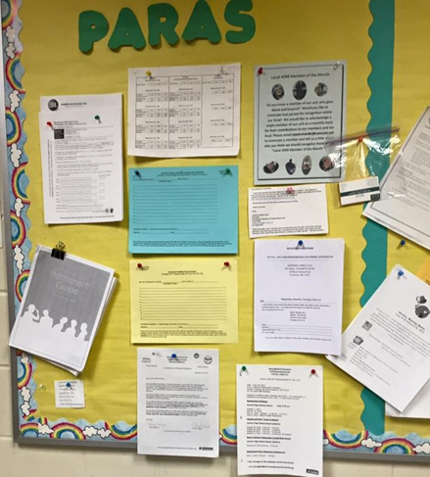


Check your bulletin board regularly
http://www.springfieldfederationofparaprofessionals.org

Slide 42
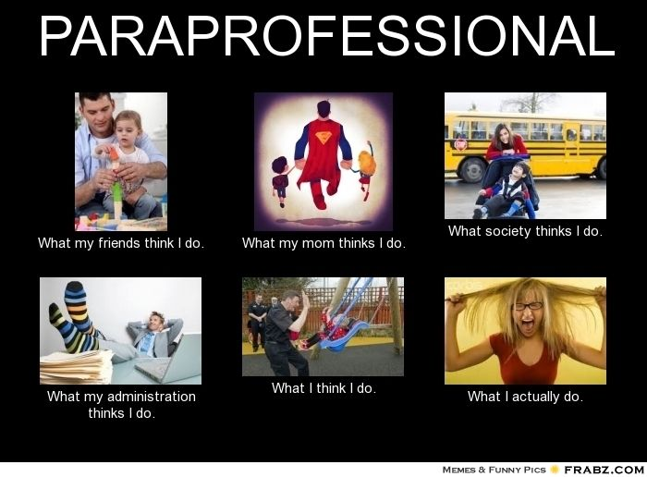

Slide 43
Breakout Rooms
Choose someone in your group to report out on the following questions.

Slide 44

1. What brings you joy in your job?

Slide 45

2. What sucks the life out of you at your job?

Slide 46

3. What is one thing you would change in the contract that would enhance your job?

Slide 47

WHAT ARE YOU WILLING TO DO TO MAKE THIS CHANGE?

Slide 48


