Slide 1
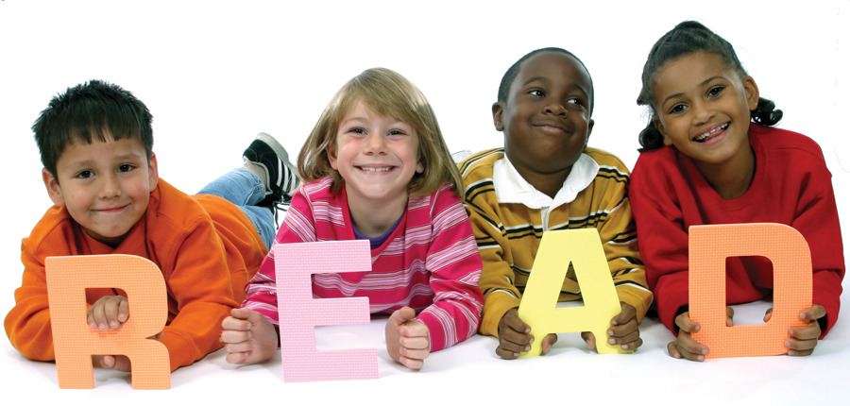
Reading Comprehension for Paraprofessionals
Text Structures
Presenters:
Springfield, MA August 22-23, 2016
Notes:
Good Morning/Afternoon,
Welcome to Reading Comprehension for Paraprofessionals. I am _________________________, and this is my colleague ____________________. We want to thank Cathy Mastronardi for beginning to build a professional development team that will provide some professional development for the paraprofessionals in our district. She is doing this in collaboration with the school district and the AFT Paraprofessional and School Related Department of the American Federation of Teachers in Washington D.C.

Slide 2

In fourth grade, I learned that reading was serious business, not just a pleasant way to pass the time, and that like medicine or engineering, it had a definite, valuable purpose: to foster comprehension.
(Walter Kirn: American novelist, literary critic, and essayist.)
Book: Up in the Air Movie: “UP” starring George Clooney (2009)
Notes:
This quote by American Novelist Walter Kirn does an excellent job of telling us why we read.
Ask participants: What does the word foster mean?
Foster means to encourage or promote the development of (something, typically something regarded as good).
READING is the most important subject
in school. Why? Because a child needs
reading in order to master most of the other
subjects. It’s extremely difficult to do word problems in math if you can’t read the
words. How can you answer the questions in social studies or science if you can’t read
and understand the textbook?

Slide 3
The More Reading: The Better
Notes:
ACROSS the world, children who read the most, read the best. And that includes all social levels—rich or poor, urban or suburban. Here’s a chart involving 250,000 teenagers in 32 countries. Starting with the
left column (low engage.), we see students from three income levels who read the least, then those who read a moderate amount, and finally those who read the most (also the widest variety of print—books, magazines,
fiction, nonfiction). Among all incomes, the more they read at home, the higher they scored, but the biggest gain for low-income students was when they entered that “most engaged” category.

Slide 4
Good Readers
Before reading, good readers tend to set goals for their reading
During reading, good readers read words accurately and quickly, while dealing with the meaning of words (vocabulary).
Good reader are selective as they read.
Good readers use their background knowledge to create mental images, ask questions and make inferences.
Good readers monitor their comprehension as they read.
Notes:
Here are some things that good readers when they read:
Set goals before reading
Accurately and quickly read words and deal with vocabulary as needed
Read selectively
Use prior knowledge, ask questions and make inferences about the text
5. Monitor their comprehension

Slide 5
Poor Readers
Do not have sufficient awareness to develop, select and apply strategies that can enhance their comprehension.
Poor readers rarely prepare before reading.
During reading, poor readers may have difficulty decoding (reading too slowly), and lack fluency.
Often lack sufficient background knowledge and have trouble making connections with text.
Some poor readers are unaware of text organization.
After reading, poor readers do not reflect on what they have just read.
Notes:
On the other hand, poor readers, unlike good readers,
Do not have sufficient awareness of strategies that can help their comprehension
Rarely prepare
Don’t have adequate decoding skills and lack fluency
4. Often don’t have sufficient background knowledge impairs their connection to text
Unaware of text organization
Don’t reflect on what they read

Slide 6
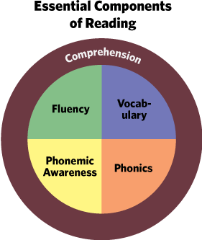
The Essential components of Reading
Notes:
This slide shows us the essential components of reading. Comprehension requires proficiency in phonemic awareness, phonics, vocabulary and fluency. Let’s look at these five components?

Slide 7
Activity: The five components of reading
What is_____________?
Phonological awareness : A broad skill that includes identifying and manipulating units of oral language – parts such as words, syllables, and onsets and rimes.
Phonics: A method of teaching people to read by correlating sounds with letters or groups of letters in an alphabetic writing system.
Vocabulary : A list or collection of words or of words and phrases usually alphabetically arranged and explained or defined
Fluency: The ability to read with speed, accuracy, and proper expression.
Comprehension: The process of constructing meaning from written text.;
the level of understanding of a text/message.
Notes:
This activity is to see how well the participants know the reading components:
Ask:
What is Phonological Awareness? Get a few responses, then show answer.
What is Phonics? Get a few responses, then show answer
What is Vocabulary? Get a few responses, then show answer
What is Fluency? Get a few responses, then show answer
What is Comprehension? Get a few responses, then show answer.
Ok, now that we have defined each of these components, let’s look at each one in a little detail. (Go to next slide)

Slide 8
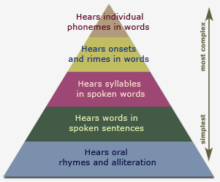
Phonological Awareness
Notes:
This pyramid shows phonological awareness from its simplest through its most complex forms.
The easiest tasks hearing oral rhymes and alliterations:
Rhymes like By, high, tie, or snow, go, toe
Ask: What are alliterations: a series of words in a row (or close to a row) have the same first consonant sound.
“She sells sea-shells down by the sea-shore” and Peter Piper Picked a Peck of Pickled Peppers are alliterative phrases
Hears words in spoken sentences: Leonard, it is time to eat.
Hears syllables in spoken sentences: The (1) silly (2) dog (1) went (1) the (1) hospital (3).
Hears onsets and rhymes: Ask What are onsets? An onset is the part of the syllable that precedes the vowel of the syllable.
Examples: pie = p is the onset/ie split = spl is the onset/ it is the rime.
Hears individual phonemes in words: Sun (3) s-u-n; Rich (3);

Slide 9
Phonological Awareness Activity
How many syllables?
1. salamander
2. How many speech sounds in ox? Boil? Straight? Though?
3. How many words do you hear?
4. What is the onset and rime?
5. What words rhyme?
Notes:
Phonological awareness refers to the ability to segment and manipulate the sounds of oral language. It’s about hearing, not seeing.
The Greek root word phon means “sound.” This word root is the word origin of a number of English vocabulary words, including microphone, phone, and saxophone.
Ask: How many syllables? in salamander? (4) Pies? (1) Unbelievable? (5) Gardener? (3)
, How many speech sounds in ox? (3) Boil? (3) Straight? (4) Though? (2)
How many words do you hear? Today is a great day here in Springfield! (8)
What is the onset and rime? Chick = ch/ick; hat = h/at; plum = pl/um; sort = s/ort.
What words rhyme? (Say yes or no) hat, pat, sat, pin, bat, toe, cat.
Which one is the alliteration?
1. Peter Piper Picked a Peck of Pickled Peppers
2. Peter went to the store to get a (pint of pickled peppers).
“Research has shown that a child’s awareness of the sounds of spoken words is a strong predictor of his or her later success in learning to read.” (ILA)

Slide 10
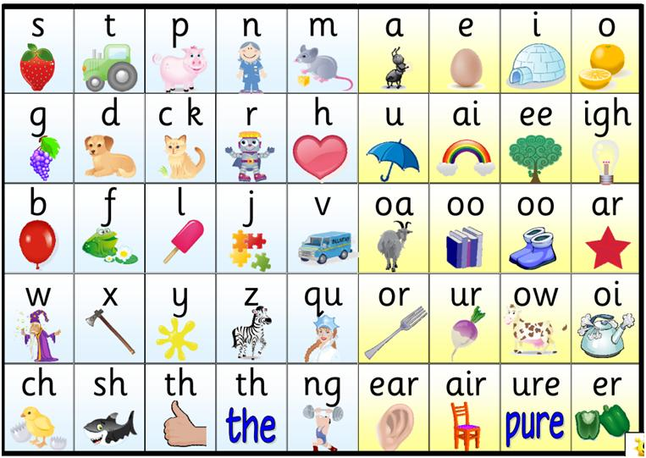
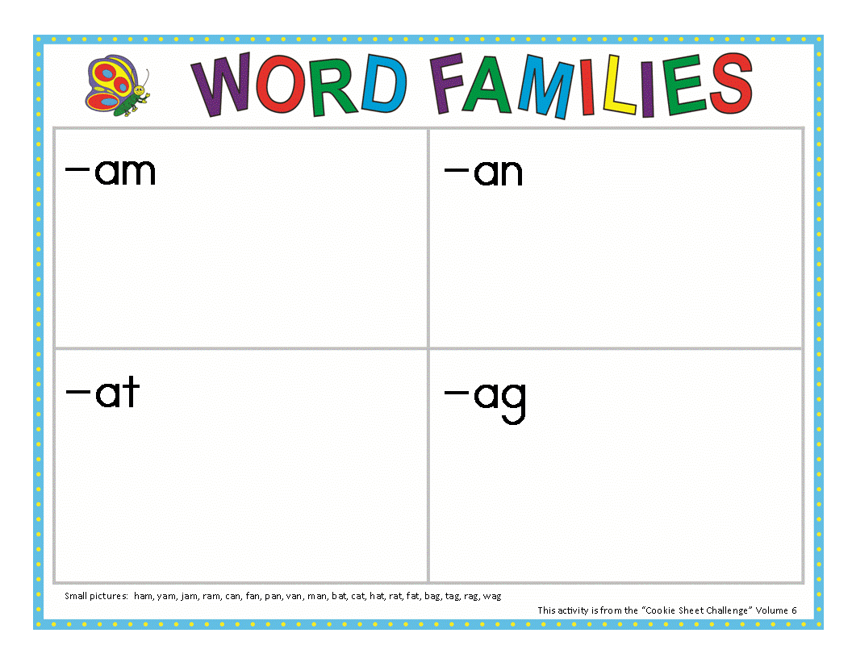
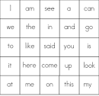
Phonics
The Alphabetic Principle: the idea that letters and letter patterns represent the sounds of spoken language.
Notes:
A method of teaching people to read by correlating sounds with letters or groups of letters in an alphabetic writing system. Phonology is hearing; Phonics is about sound and writing.

Slide 11
Phonics Activities
A. Word family reunion: The “am” Family Reunion
B. What’s the missing vowel?
p__t; 2. h__e 3. t__p 4. g__t; 5. p__e
C. What sound does this letter make?
M C F A G

Slide 12
Vocabulary
Defined: The knowledge of words and word meanings.
Word families is a base word plus its common inflections.
4,000 word families make up over 90 % of the words occurring in intermediate grade texts (Hiebert, 2005).
5586 Most | Frequent Words
Zone 1 | 30 families
Zone 2 | 500 families
Zone 3 | 1000 families
Zone 4 | 2000 families
Notes:
Vocabulary defined:
The knowledge of words and word meanings.
Vocabulary is the foundation for communication and learning
Language and thought are synonymous
Vocabulary size is strongly linked to reading comprehension and overall academic success

Slide 13
Vocabulary Research
Vocabulary is central to the comprehension of text (Davis, 1942; Thorndike, 1973).
The vocabularies of students when they enter school vary substantially (Hart & Risley, 1995).
The number of words in English is huge (Leech, Rayson, & Wilson, 2001).
The amount of time in schools is limited (Fisher, Berliner, Filby, Marliave, Cahen, & Dishaw,1980).
Notes:
Here is some research information on the importance of vocabulary and reading text. The last bullet makes clear that there is only so much time in school devoted to reading, so it has to also take place somewhere other than school.

Slide 14
Vocabulary Activity
1. Colors
List 5 things that are: red; white; yellow; green and black.
2. What’s the word synonym:
Abandon? Charm? Hinder? Part? Tire?
3.Expand your vocabulary
Alacrity? Erudite? Inveterate? Plethora? Zenith?
Notes:
A synonym is a word with the same or a similar meaning as another word.
Abandon: disregard, recklessness, abdicate; leave, betray;
Charm: beauty, agreeableness, spell, appeal, lure
Hinder: prevent, set back, jam, block, interfere
Part: fragment, bit, segment, measure, subdivision
Tire: weary, sap, run down, bore, ring (wheel)
Expand your vocabulary:
Zenith = (n.) the highest point, culminating point
Plethora = (n.) an abundance, excess
Inveterate = (adj.) stubbornly established by habit
Erudite = (adj.) learned
Alacrity = (n.) eagerness, speed

Slide 15
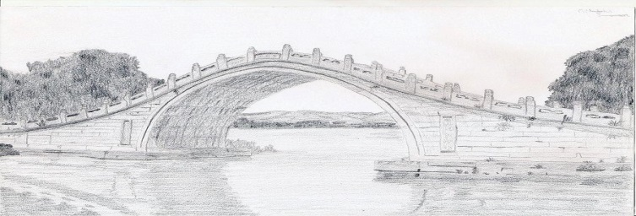
Fluency
The ability to read a text with speed, accuracy, and proper expression.
word
recognition comprehension
fluency
Fluent readers are able to focus their attention on comprehension.
Notes:
Use slide
Fluent readers are able to focus on comprehension, the same way a driver can navigate a car.

Slide 16
Fluency Activity
Andrés no se siente bien. Estuvo en una fiesta anoche y llegó a casa a las 3 am. Tiene dolor de cabeza y siente náusea. Bebió mucho y comió demasiados camarones. Él se levanta de la cama y se da cuenta que no tiene puesto el pantalón. Mira alrededor pero no lo puede encontrar. Va al baño y busca sus pastas. No las puede encontrar. Él escucha voces. Sale del dormitorio, baja por las escaleras y entra a la cocina. Hay gente hablando y riéndose en la cocina. Él se pregunta quién más volvió a casa con él anoche. Luego se da cuenta de algo. Él no tiene escaleras en su apartamento. ¡Está en la casa de otra persona!
Notes:
How fluently can you read this? What’s the problem? You may know some words, but not enough to read it fluently. You don’t know the language. Because of your lack of fluency. You focus all your energy of trying to decode the words. Now let’s try this: go to next slide.
Note: someone in the class may be able to read it fluently.

Slide 17
Activity: Fluency
Andrés is not feeling well. He was at a party last night and got home at 3 am. He has a headache and feels nauseous. He had too much to drink and ate too much shrimp. He gets out of bed and realizes that he is not wearing any pants. He looks around but cannot find them. He goes into the bathroom and looks around for his pills. He cannot find them. He hears voices. He walks out of the bedroom, goes down the stairs and into the kitchen. There are people talking and laughing in the kitchen. He wonders who else came back home with him last night. Then he realizes something. He doesn’t have stairs in his apartment. He is in someone else’s home!
Notes:
Now try this! Let participants read. What’s the difference? You can read fluently because you know the words (and language). When students aren’t fluid readers. It’s like reading a foreign language, where you may know some words but not enough to make sense of what you reading.

Slide 18
Reading Comprehension is:
Adequately decoding what they read
(2) making connections between what they read and what they already know. (Reasoning)
(3) “thinking “ deeply about what they have read.
the process of constructing meaning from written texts.
Notes:
Reading comprehension is the process of constructing meaning from written text. A reader who can comprehend what they are reading can do 1, 2 and 3.

Slide 19
Activity: Reading Comprehension
Parallel harmony is if you have 2 or more notes playing at the same time and the notes change up or down in the same interval (distance apart), this is parallel harmony. In other words, “the parallel movement of two or more (melodic) lines that preserve a consistent interval.”
So if you are playing F and C (which are 7 semi-tones apart) and you then play E and B (also 7 semi-tones apart) that is parallel harmony. If the intervals are not always the same, it’s not parallel harmony, or “parallel motion.” One of the reasons parallel harmony can be odd to look at (on music paper) is that even though 2 notes may look to be moving perfectly parallel, the uses of sharps, flats and naturals can make for different harmonies.
Editor’s Note: this article assumes basic knowledge in music fundamentals such as chord building and chord progressions.
Notes:
Ask participants: How do we define reading comprehension: Reading Comprehension is the process of constructing meaning from written texts.
Have participants read the slide.
Ask: What is it about? Parallel harmony What is parallel harmony? Even though you can read this fluently, why can’t you understand? Answer: Lack of prior knowledge or domain knowledge. What is the domain?
Music harmony.

Slide 20
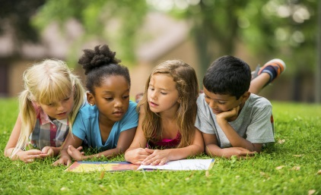
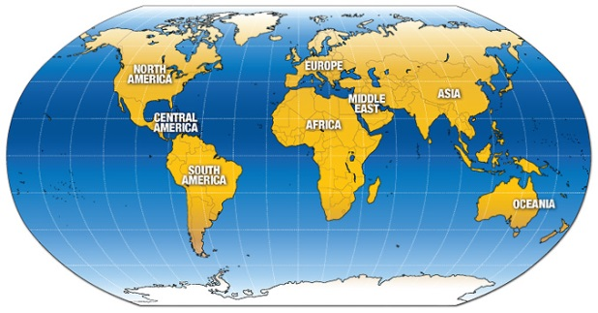
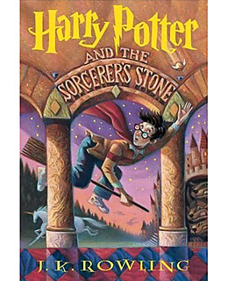
Prior Knowledge: Making Connections
Text to self
Text to world
Text to text
(Ellin Oliver Keene and Susan Zimmerman in Mosaic of Thought (1997).
Notes:
When we read we use our prior knowledge about the text—based on our experience.
We use our prior knowledge about the world to help us with the text
We use other text—book, magazine, article, etc. that we have read to help us understand the text that we are reading.

Slide 21
K-W-L
Know | Want (to learn) | Learned
Notes:
How many of you are familiar with K-W-L graphic organizer?
It allows us to write what we know related to the text, then what we want to learn, and finally what we did learn.

Slide 22
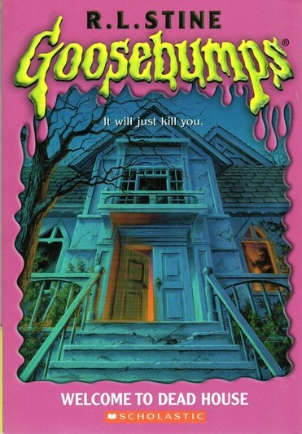
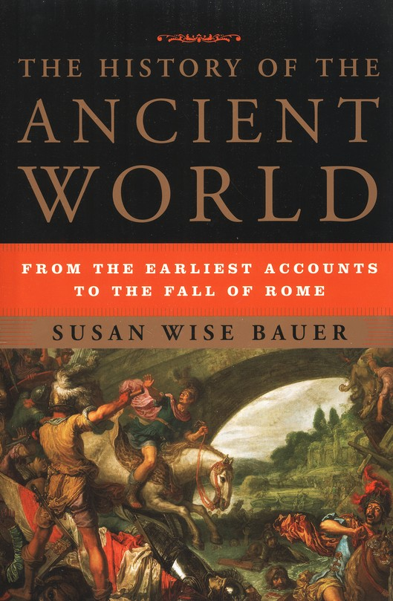
What is text Structure?
How information is organized in a passage.
Notes:
Ask question: What is text structure? Tap arrow for answer.
There are two different kinds of texts? What are they? Narrative and Expository. Which one is which? Goosebumps is narrative. Ancient World is expository.

Slide 23
The Research
“Students who are taught to identify the structure of expository and narrative text have been found to have better comprehension than students who have not received such instruction (Taylor, 1992).
Knowledge of text organization or structure is an important factor for text comprehension (Aebersold & Field, 1997; Fletcher, 2006; Grabe, 1991, 2004, 2008; Hall, Sabey, & McClellan, 2005; Horiba, 2000; Kendeou & van den Broek, 2007; Meyer, 2003; Meyer & Poon, 2001; Snyder, 2010).
Across the years of school, their awareness of text structures must increase as they progressively shift from reading a story line or casual text to reading for information (Lorch & Lorch, 1996).
Notes:
The research tells how knowledge of text structure helps a student’s reading comprehension. Let participant’s read slide. Go to next slide

Slide 24
The Research
Carrell (1985) argued that instruction on text structure indeed has a positive effect on the students' recall protocols.
Meyer (1985) stated that knowledge of the rhetorical relationship of the ideas-main idea, major ideas, and supporting details-helps readers with their comprehension of the expository texts.
It has long been known that the ability to recognize text structure enhances the student's ability to comprehend and recall the information read (Armbruster, Anderson, & Ostertag,1989).
Notes:
Let participant’s continue to read.

Slide 25


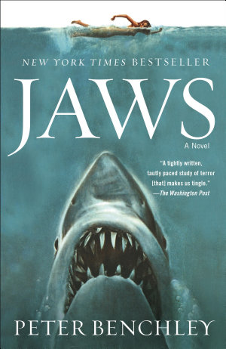



Narrative vs. Expository Text Structure Differences
Narrative text tells a story (true or fiction)
The author can be creative and tell a story in a way he or she likes
Expository text informs and/or explains
The author must follow some strict rules.
Notes:
What are the difference’s between narrative and expository text?
After a few responses: Hit return key for narrative answer, then hit return key again for expository text.

Slide 26


Five Elements of Narrative Structure
Plot
Theme
Character
Five Elements of Narrative Structure
Point
of
View
Setting
Notes:
Here are the five elements of narrative structure in picture form. Go to next slide.

Slide 27
The Five Elements of Narrative Texts
Theme: An overall meaning, lesson or idea from the story.
Plot: The arrangement of incidents or events in a story.
Character(s):People, animals or other entities in the text.
Setting: The place, time, surroundings, and context in which a story takes place.
Point of View: The vantage point from which a story is told.
Notes:
Use slide

Slide 28
Types of Narrative Text
A. Fable: a short story, typically with animals as characters, conveying a moral.
B. Myths: stories that are believed by some people, but the stories can not be true. It was told in an ancient culture to explain a practice, belief, or natural occurrence
C. Legend: a traditional story sometimes popularly regarded as historical but unauthenticated.
D. Fairy Tales: a children's story about magical and imaginary beings and lands.
Notes:
Here are some the the different types of narrative texts that we and our students are familiar with.

Slide 29
Types of Narrative Text (2)
E. Science Fiction: Story based on imagined future scientific or technological advances and major social or environmental changes, frequently portraying space or time travel and life on other planets.
F. Short Stories: a story with a fully developed theme but significantly shorter and less elaborate than a novel.
G. Parables: a simple story used to illustrate a moral or spiritual lesson (Parable differs from fables.)
H. Novels: A fictitious prose narrative of book length, typically representing character and action with some degree of realism.
I. Horror Story: Fiction which is intended to, or has the capacity to frighten, scare, disgust by inducing feelings of horror and terror.
Notes:
Here are more types of narrative texts.

Slide 30
Activity: Elements of Narrative Text Structure
“A key to comprehending narrative is a sense of plot, theme, characters, and events, and how they relate.
Activity: Read “The Defendant Speaks”
What is the plot?
Who are the characters?
What is the event?
What is the setting?
Whose point of view?
What is the theme?
Notes:
Pass out “The Defendant Speaks. Let participant’s read, the answer questions:
What is the plot: The wolf is telling his side of the story.
Who are the characters? The wolf,
What is the event? The wolf is testifying on his own behalf at his trial.
What is the setting? A Courtroom
Whose point of view? The wolf’s
What is the theme?

Slide 31
What is Expository Text
Written text that:
is used to explain, describe, or inform.
has unfamiliar content.
has different types of structures.
has frequent lack of coherence.
and
Does not assume prior knowledge!
Notes:
Ask participants: What is expository text. Get some answers, then hit return key, then hit it again for “and does not assume prior knowledge.

Slide 32
Expository Text Structures
1. Sequential: Describes items or events in order or tells the steps to follow to do something or make something.
2. Compare/contrast: Shows how two or more things are alike and/or how they are different.
3. Description: Describes a topic, idea, person, place, or thing by its features, characteristics or examples.
4. Cause/effect: Why something happened – effect is what happened (shows a relationship between the two).
5. Problem/solution: States a problem (and sometimes says why there is a problem) then gives one or more possible solutions.
Notes:
Here are the different types of expository texts. Push return key and they will come in one at a time.
Sequential is about sequence, steps or order.
Compare and contrast is about comparisons
Description tells about something or someone.
Cause and effect is why something happened and the result(s)
Problem and solution states a problem and gives solution, although sometimes a solution is not given.

Slide 33
Different types of Expository Text
Activity: Identify 15 types of expository text
Almanacs/reference books Atlases
Insurance forms Recipes
Bus schedules Airline Tickets
Text books Brochures
Newspapers/magazines Directions
Manuals Syllabi
Catalogues Dictionaries
Menus
Notes:
Ask participants to make a list 15 types of expository text. They can do it as a group.

Slide 34
Description Text Structure Example
My most valuable possession is an old, slightly warped blond guitar--the first instrument I taught myself how to play. It's nothing fancy, just a Madeira folk guitar, all scuffed and scratched and finger-printed. At the top is a bramble of copper-wound strings, each one hooked through the eye of a silver tuning key. The strings are stretched down a long, slim neck, its frets tarnished, the wood worn by years of fingers pressing chords and picking notes.
The body of the Madeira is shaped like an enormous yellow pear, one that was slightly damaged in shipping. The blond wood has been chipped and gouged to gray, particularly where the pick guard fell off years ago. No, it's not a beautiful instrument, but it still lets me make music, and for that I will always treasure it. (Jeremy Burden)
Notes:
What is the author describing? A Madeira folk guitar
What parts of the guitar is he describing? Color, condition, strings, shape, etc. and how he feels about the guitar.

Slide 35
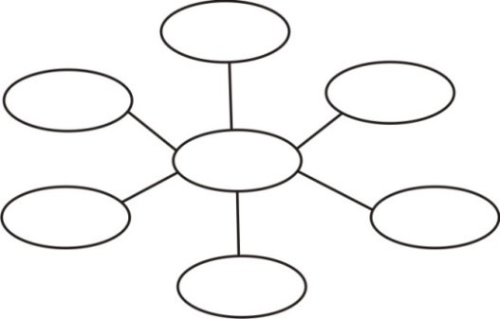
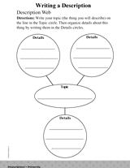
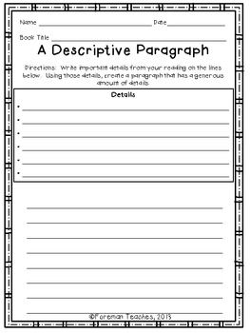
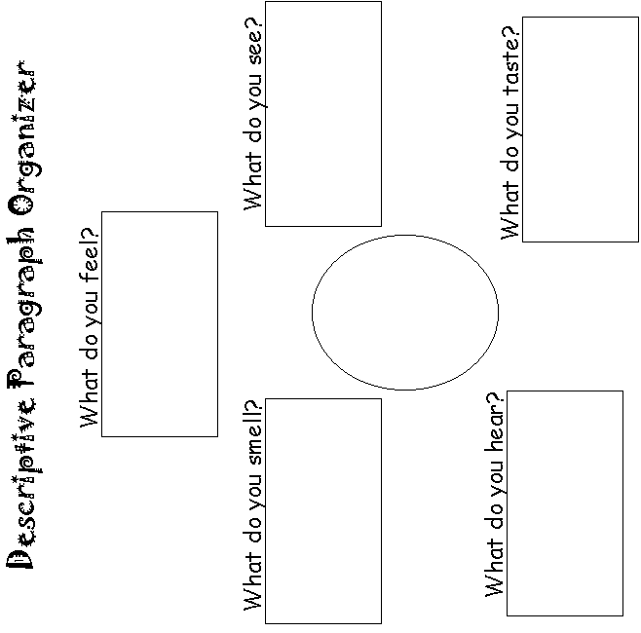
Description Signal words and graphic organizers
• To illustrate
• For instance
• In addition
• And
• Again
• Moreover
• Also
• Too
• Furthermore
• Another
• First of all
Notes:
Here are some signal words for descriptive writing and graphic organizers.
Go back to

Slide 36
Sequential Text Example
A Yummy Sandwich
You will find that the steps for making a peanut butter and jelly sandwich are as easy as pie. To get started, gather the ingredients and equipment. You need to find bread, peanut butter, jelly, and a knife. Next, you should peanut butter the bread. To do this, put two slices of bread on a clean part of the counter, and carefully spread peanut butter on one side of each slice using the knife. Make sure the peanut butter goes all the way to the edge of the bread and is evenly spread. Take care not to tear the bread. For the third step, you need to put peanut butter evenly across one slice and to the edge of the bread. Make the peanut butter about 3/8 of an inch thick. Fourth, spread the jelly on the other slice of bread. You can make the jelly as thick as the peanut butter. Be sure the whole slice is covered with the jelly. When you have finished spreading the jelly, you’re ready for the fifth step, putting the sandwich together. Take one of the slices of bread, and put it on top of the other slice, making the peanut butter and jelly touch each other. Finally, cut the sandwich in half with the knife and put both halves on a plate to serve it. In sum, if you follow these six steps carefully, the result will be a very delicious sandwich.
Notes:
This is self-explanatory. The sequence for making a yummy peanut butter sandwich.

Slide 37
What is the difference between chronological sequential and sequential text?
Chronological order = A chronological pattern of organization that arranges information according to a progression of time, either forward or backward.
Example: Making a timeline of World War 2.
Sequential order = A sequential pattern of organization is similar to a chronological pattern, but arranges information according to a step-by-step sequence that describes a particular process.
Example: How to make a peanut butter sandwich.
Notes:
Here are the differences between sequence and chronology. Our slide on making a peanut butter sandwich was a step by step sequence. Chronological is sequence and order based on time.

Slide 38
Chronological Sequence Text Example
My family and I went to the Kennedy Space Center in Florida. The first thing we did when we got there was to take a tour of a space shuttle that once flew into space. During our tour, an astronaut showed us her spacesuit. I even got to try on the space boots. Next, we tasted the food astronauts eat while they are in space. It was really different from other foods that I had eaten but it tasted pretty good. Finally, we got in a special booth that showed us what it is like to be weightless! It was an amazing day.
Notes:
The words first, during, next and finally tell in what order the events happened. Therefore the text is structured sequentially. But it is the last sentence that let’s you know it’s chronological.

Slide 39
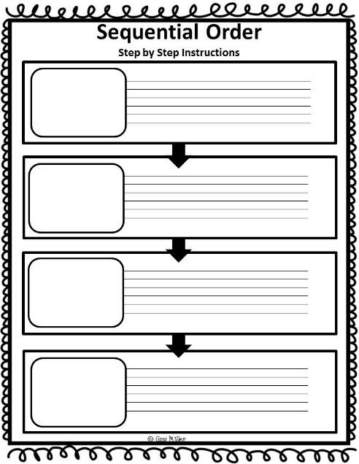
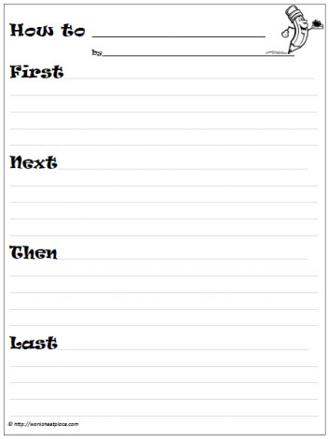
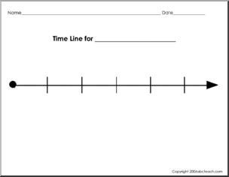
Sequencing signal words and graphic organizers
At the same time Following
Finally At last
In the end On (date)
At (time) Directions
First, second, third Next
Then, After
Before, Prior to
Not long after While,
Meanwhile Simultaneously
Notes:
Here are signal words and graphic organizers for sequential texts.

Slide 40
Problem /Solution Text Structure Example
Astronauts face many problems in space caused by weightlessness. One of these problems is floating around the cabin. To solve this problem, astronauts wear shoes that are coated with a special adhesive. This adhesive sticks to the floor of the cabin. Serving food is another problem. It won't stay put on the table! Experts solved this problem by putting food and drinks in pouches and tubes. It only needs to be mixed with water. Weightlessness also causes problems when an astronaut tries to work. The simple task of turning a wrench or a doorknob can be difficult. Since there is no gravity to keep him down, when he exerts a force in one direction, the opposite force may flip him over completely. To solve this problem, he must be very careful about how much force he uses to do these simple tasks. Here on earth, life is much simpler, thanks to gravity.
Notes:
The first sentence tells us what kind of text structure this is.
What’s the problem? Weightlessness What are the solutions/ Special shoes, food and drinks in special pouches, being careful about how much force that you use.

Slide 41
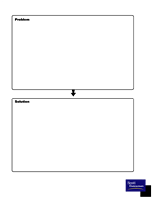
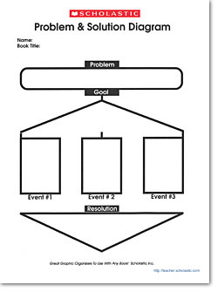
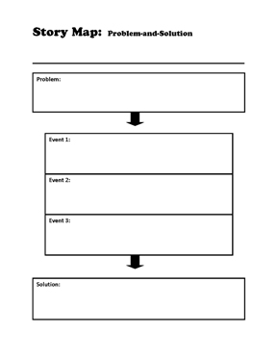
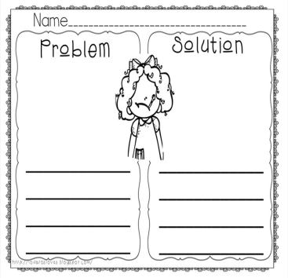
Problem / Solution Signal Words and
Graphic Organizers
problem is
• dilemma is
• if/then
• because
• so that
• question/answer
• puzzle is solved
cause and effect
words
Notes:
Here are some signal words and graphic organizers for problem and solution text structures.

Slide 42
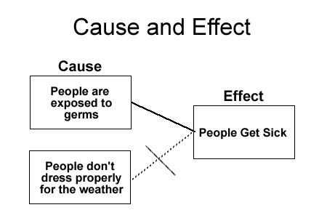
Cause and Effect
Reason(s) why something happened or the effects of something that happened.
Effect Effect
Cause
Effect Effect
School
is
cancelled
Hazardous
Roads
snowstorm
Kid can
go
sledding
People can
build snowmen
Notes:
Example: Many people think that they can get sick by going into cold weather improperly dressed; however, illnesses are not caused by temperature- they are caused by germs. So while shivering outside in the cold probably won’t strengthen your immune system, you’re more likely to contract an illness indoors because you will have a greater exposure to germs.
In the above example, the paragraph explains how germs cause illnesses. The germs are the cause in the paragraph and the illness is the effect.
Another Example: Students are not allowed to chew gum in my class. While some students think that I am just being mean, there are many good reasons for this rule. First, some irresponsible students make messes with their gum. They may leave it on the bottoms of desks, drop it on the floor, or put it on other people’s property. Another reason why I don’t allow students to chew gum is because it is a distraction. When they are allowed to chew gum, students are more worried about having it, popping it, chewing it, and snapping it then they are in listening, writing, reading, and learning. This is why I don’t allow students to chew gum in my class.

Slide 43
Types of cause and effect
First explains the why or how of something happening and what resulted from it.
Second (causes), in which there are many causes but only one effect.
Third (effects) in which there is only one cause, but there are many effects.
Notes:
Use slide

Slide 44
Cause and Effect Example
On September 11, 1992, Hurricane Iniki struck the Hawaiian Islands. It was the most powerful hurricane to hit the Hawaiian Islands. As a result, Hurricane Iniki caused 1.8 billion dollars in damages and six people died. The island of Kaua‘i suffered the most damage. More than 1,400 homes were destroyed and thousands more were damaged. The heavy winds and rains caused many farmers to lose their crops. For weeks, residents of Kaua‘I did not have electricity.
Notes:
What is the cause: Hurricane Iniki
What is the effects? 1.8 billion in damages/six people dead
Kaua’I Island suffered most damage
1400 homes destroyed—many more damaged
Farmers lost crops
Weeks of no electricity

Slide 45
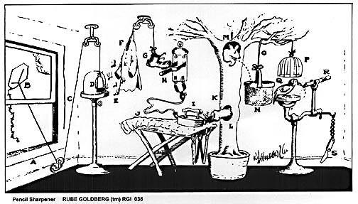
Many causes, one effect
(Causes leading to the effect of a sharpened pencil)
Open window (A) and fly kite (B). String (C) lifts small door (D) allowing moths (E) to escape and eat red flannel shirt (F). As weight of shirt becomes less, shoe (G) steps on switch (H) which heats electric iron (I) and burns hole in pants (J). Smoke (K) enters hole in tree (L), smoking out opossum (M) which jumps into basket (N), pulling rope (O) and lifting cage (P), allowing woodpecker (Q) to chew wood from pencil (R), exposing lead. Emergency knife (S) is always handy in case opossum or the woodpecker gets sick and can't work.
Notes:
The Linking of Events
Pulitzer prize-winning cartoonist Rube Goldberg was most famous for his ability to link one event to another — in outrageous fashion. This series of causes leads to the effect of a sharpened pencil.

Slide 46
One cause, many effects
As Tim was driving home last night, a light appeared on his dashboard that he didn’t notice. The reason for the light was that the pressure in his right rear tire was low. Tim’s mind was on the his favorite meal that his wife was preparing. When his delicious dinner was over Tim studied for tomorrow’s physics test.
When Tim went to his car the nest morning, he discovered that he had a flat tire. He called his brother for a ride to school. But by the time he arrived, and Tim got to school, through rush hour traffic, the class was over. Because he missed the class, he failed the test. Because he failed the test his class grade dropped one letter grade from B to C. All of this happened because he didn’t notice the warning light on his dashboard.
Notes:
What is the cause here? Flat tire. What are the effects? 1. Missed class, 2. Failed test, Letter grade dropped from b to c.

Slide 47
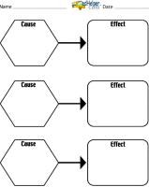
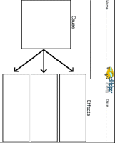
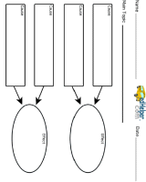
Cause and Effect Signal Words and Graphic Organizers
Cause
Effect
Because
The reason for
on account of
Bring about
Give rise to
Created by
Lead to Due to
Since
As a result
Outcome
Finally
Consequently
Therefore
For this reason
Hence
Effect
Then
So
Notes:
Here are cause and effect signal words and graphic organizers.

Slide 48
Compare and Contrast Text Example
“If you study baboons and chimpanzees you will see similarities and differences. Both can be found on African savannahs (grasslands), where they spend most of their time on the ground, but sleep in trees…chimps and baboons need their group for protection whereas the chimp can defend itself…Baboons eat only plants; chimpanzees eat meat as well as plants.”
(Alley & Dokan, 1979, p73)
Notes:
This text structure is about comparisons:
What is being compared? Baboons and chimpanzees. What’s similar? What’s different?

Slide 49
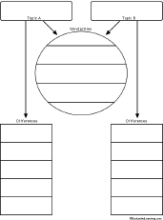
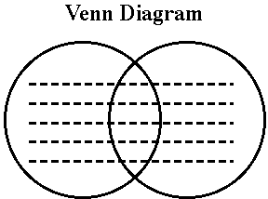
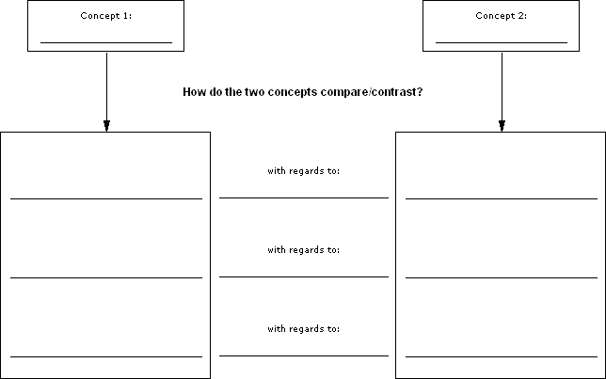
Compare and Contrast
Signal words and phrases that show similarities
similarly | like | still | likewise
in the same way | in comparison | at the same time | in the same manner
Signal words and phrases that show contrasts
however | on the other hand | but | nevertheless | while
rather | on the contrary | yet | more (than) Comparative forms (er) | in contrast
Notes:
Here are compare and contrast signal words and graphic organizers.

Slide 50
Question and Answer Text Structure
Why are birthday cakes different? Well, sometimes they are store bought and sometimes they are homemade. That usually depends on whether the person responsible for the cake has time to bake a cake. Another big difference is the type of cake it is. Some people like chocolate cake and some like vanilla. I have even heard of marble cakes which mix chocolate and vanilla. Finally, the frosting can be many different flavors with or without decorations. This also depends on whether the person with the birthday likes chocolate, vanilla, buttercream, or chocolate chip icing. So, there are many types of cakes to suit many different likes and dislikes.
YUM!
Notes:
Question is posed and then followed by answers.

Slide 51
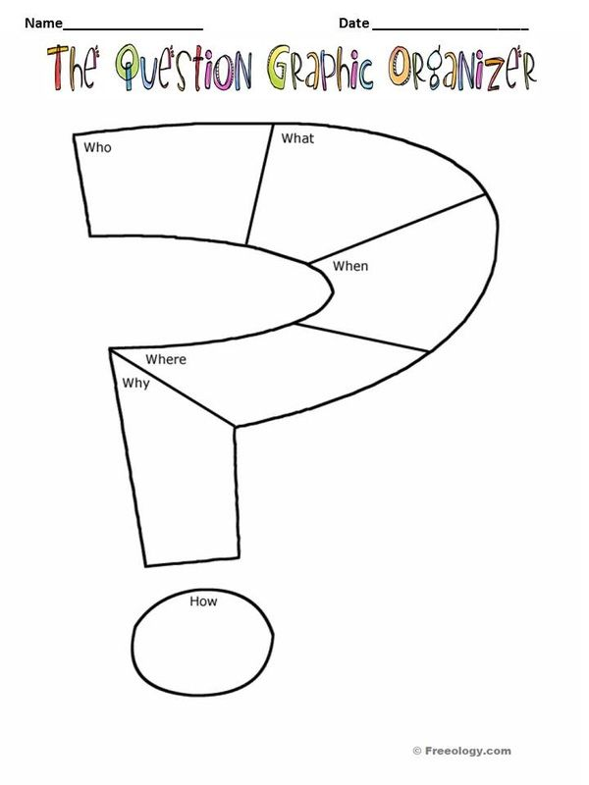
Question and Answer text structure signal words and graphic organizers
•how
• one may conclude
• when
• why
• how many
• the best estimate
• where
• it could be that
• what
• who

Slide 52
Vocabulary in Text
Lightening is an electrical discharge. As a thunderstorm develops, the cloud becomes charged with electricity. Scientist are still not clear on what causes this to happen. But they do know that as much as 100 million volts build up in the lower part of a thunderhead, and the temperature of a single bolt of lightening reaches, 50, 000 degrees F. within a few millionth of a second. That’s almost five times greater than the temperature at the sun’s surface (Simon, 1989).
Notes:
Vocabulary plays a fundamental role in the reading process, and contributes greatly to a reader's comprehension. A reader cannot understand a text without knowing what most of the words mean. Students learn the meanings of most words indirectly, through everyday experiences with oral and written language. Other words are learned through carefully designed instruction.
Most kids know something about lightening and have seen it numerous time. They also know about the relationship between lightening and thunder. But how many kids would know the words that are bolded in the paragraph? (Electrical discharge, volt, thunderhead and bolt). So, depending on how much prior knowledge students have, they may not have the easiest time trying to understand the paragraph. However, sometimes pictures can help. Go to next slide

Slide 53
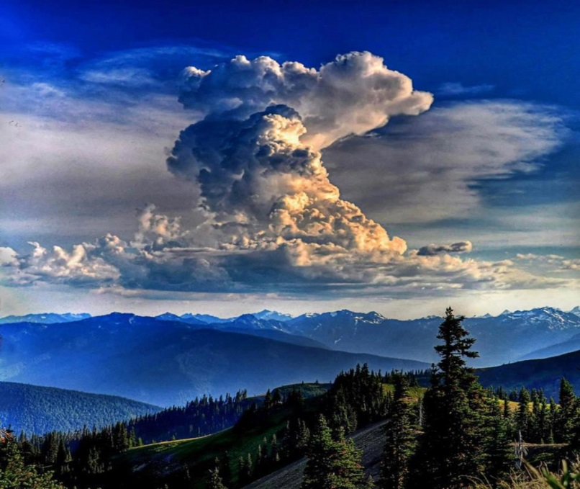
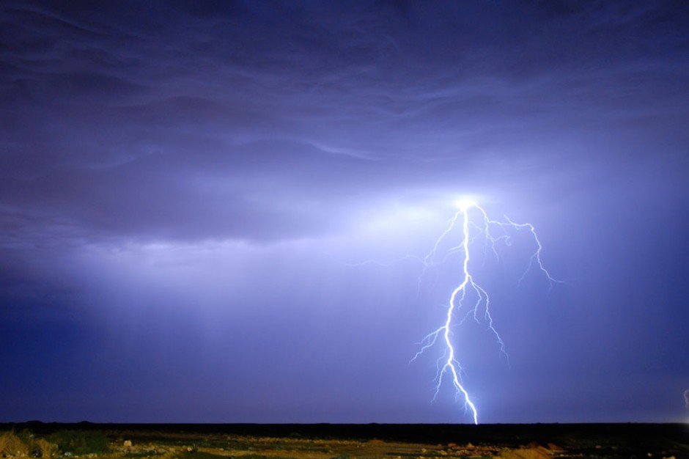
Pictures & illustrations: Text Helpers
Lightening is an electrical discharge. As a thunderstorm develops, the cloud becomes charged with electricity. Scientist are still not clear on what causes this to happen. But they do know that as much as 100 million volts build up in the lower part of a thunderhead, and the temperature of a single bolt of lightening reaches, 50, 000 degrees F. within a few millionth of a second. That’s almost five times greater than the temperature at the sun’s surface (Simon, 1989).
Notes:
The pictures immediately change the situation. It is, as they say, worth a thousand words. You can see the lightening bolt, which is familiar to most kids, and the thunderhead cloud in the other picture. All kids know what the sun is and that it is very hot. The addition of the pictures helps the student to comprehend the text.

Slide 54
Activity
Compare
And Contrast
Cause and Effect
Identifying Expository Text Structures
Question and Answer
Sequence
Problem
And
Solution
Description

Slide 55
What text structure is this?
How would you cross rivers where there are no bridges? Large flat boats called scows take the wagons across the Mississippi River… The covered wagon had blocks of wood placed in front and in back of its wheels so that it wouldn’t roll off the scow…(Levine, 1986)
Notes:
Answer: Question and Answer. It is obvious considering the first sentence is a question. What is the signal word? Answer: How.
What other type of text structure might this be? Answer: Problem and Solution What

Slide 56
What text structure is this?
One problem the early pioneers had was that they needed help to find their way from the Eastern cities to the West. So, the pioneers hired trail guides to help them find their way. Trail guides were people who had made the trip before and knew their way. Usually they had been fur traders and trappers out West for many years. When they came back to the East, they had special knowledge that was helpful to the pioneers” (Levine, 1986, p. 16)
Notes:
Answer: Problem and Solution. What’s the problem: Early pioneers needed help finding their way from Eastern cities to the west. What was the solution? They hired trail guides. What is the signal word? Answer: problem.

Slide 57
What is the text structure ?
Before the eruption, Mt. St. Helens was like a giant pressure cooker. The rock inside it held superheated water. The water stayed liquid because it was under great pressure , sealed in the mountain. When the mountain was torn open, the pressure was suddenly relieved. The super heated water flashed to steam. Expanding violently, it shattered rock inside the mountain and exploded out of the opening, traveling at speeds of up to 200 miles per hour. ….
The result was what one geologist called a ‘stone wind.’ It was a wind of steam and rocks traveling at high speed. The rocks gave the blast its great force. Before it, trees snapped and fell. The stumps looked as if they had been sandblasted
                (Lauber, 1986, pp.9-10)
Notes:
Answer: Cause and Effect. What is the cause? When the mountain was torn open. What was the effect (s)? Answer: Water flashed to steam; shattered rock inside the mountain; stone wind = a wind of steam and rocks traveling at high speed. Trees snapped and fell and stumps looked sandblasted. What are signal words? Answer: When

Slide 58
What is the text structure?
“ A popular proposal (for the safe disposal of nuclear waste) involves the “four barrier” approach. The first step of this approach is to embed the waste in a the non-radio active material….The ceramic material can hold waste securely within it, so that they cannot easily leak out. The waste containing ceramic material is then sealed into a ceramic or metal container. Next, an absorbent mineral filling is packed around the container. Finally, everything is securely buried underground in area that is free from the danger of earthquakes or some other natural disaster…..
      (Brockway, Gardner, & Howe, 1985, pp. 257-58.
Notes:
Answer: Sequential Graph the story with graphic organizer
What are the signal words? First Step; Next; and finally. Does the “ four barrier” approach give us a clue? Yes. Why? Because it implies steps or sequence which is what we see.

Slide 59
What text structure is this?
“If you study baboons and chimpanzees you will see similarities and differences. Both can be found on African savannahs (grasslands), where they spend most of their time on the ground, but sleep in trees…chimps and baboons need their group for protection whereas the chimp can defend itself…Baboons eat only plants; chimpanzees eat meat as well as plants.”
(Alley & Dokan, 1979, p73)
Notes:
Answer: Compare and Contrast What are the signal words? Similarities; differences; both

Slide 60
What the text structure?
The castle was laid out in a series of smaller yet stronger defensive rings, one inside the other. The space in the center of the castle was called the inner ward. It was enclosed by a high wall called an inner curtain. The area around the outside of the of the inner curtain was called the outer ward, and it was enclosed by a lower wall called an outer curtain. Rounded towers were located along both walls, making it possible for soldiers to observe the entire perimeter of the structure (MacCauley, 1977, p11).
Notes:
Answer: Description What are the signal words?

Slide 61
Different structures within text
Hailstones begin to form when the tiny particles of dust and ice collide with cold water droplets that freeze them. The powerful winds of a thunderstorm toss these ice pellets up and down, and they grow larger as they come into contact with more water droplets. When the chunks of ice grow too heavy for the winds to carry them aloft, they plunge to earth as hailstones”
Hailstones sometimes cause great damage. Grasses and small plants are beaten into the ground by the speed and impact of stones. Crops are broken and destroyed. Hailstones can knock down and even kill small animals such as chickens, rabbits, and squirrels, and they have injured animals as large as cows and horses. Hailstones also damage roofs and windows, as well as cars and farm machinery left outdoors” (Simon, 1989, n.p.)
Notes:
What different structures are within this text?

Slide 62
Different structures within text
Hailstones begin to form when the tiny particles of dust and ice collide with cold water droplets that freeze them. The powerful winds of a thunderstorm toss these ice pellets up and down, and they grow larger as they come into contact with more water droplets. (cause & effect) When the chunks of ice grow too heavy for the winds to carry them aloft, they plunge to earth as hailstones” (cause & effect)(sequence).
Hailstones sometimes cause great damage. Grasses and small plants are beaten into the ground by the speed and impact of stones. Crops are broken and destroyed. Hailstones can knock down and even kill small animals such as chickens, rabbits, and squirrels, and they have injured animals as large as cows and horses. Hailstones also damage roofs and windows, as well as cars and farm machinery left outdoors” (Simon, 1989, n.p.) (descriptive)

Slide 63
Different Structures within Text
One problem the early pioneers had was that they needed help to find their way from the Eastern cities to the West. So, the pioneers hired trail guides to help them find their way.
Trail guides were people who had made the trip before and knew their way. Usually they had been fur traders and trappers out West for many years. When they came back to the East, they had special knowledge that was helpful to the pioneers”
(Levine, 1986, p. 16)
Notes:
What different text structures are in this this text?

Slide 64
What different Text Structures are in this text?
One problem the early pioneers had was that they needed help to find their way from the Eastern cities to the West. So, the pioneers hired trail guides to help them find their way. (Problem and Solution)
Trail guides were people who had made the trip before and knew their way. Usually they had been fur traders and trappers out West for many years. When they came back to the East, they had special knowledge that was helpful to the pioneers” (Levine, 1986, p. 16). (Description)
Notes:
Answer: 1. Problem and Solution 2. Description What is being described? Trail guides

Slide 65
Activity
Sequence
Problem
And
Solution
          Read Text
Identify Text Structures and Signal Words
              Graph Text
Question and Answer
Description
Cause and Effect
Compare
And Contrast

Slide 66
Activity: Identify text structure and graph story
It was my tenth birthday and I had waited all day for my birthday cake. First my dad brought the amazing cake out to the dining room table. Then, he lit the colorful candles. I made a wish, but that is my secret. After that, I took a big breath and blew out the candles. Mom said I could cut the cake so I cut a nice big piece for myself. This was going to be a cake to remember!
Notes:
What is the text structure? Answer: Sequence Use graphic organizer to graph text
1. First, my dad brought cake
2. Then, he lit candles
3. I made a wish
4. After that, I blew out candles
5. I cut myself a big piece of cake
What are signal words: First; Then; After that

Slide 67
Activity: Identify text structure and graph story
I had a terrible experience the last time I tried to bake a birthday cake. I put the cake mix into the bowl and went to the refrigerator to get the eggs. That’s when I discovered that I didn’t have enough eggs so I had to make a quick run to the grocery store. When I finally got home it was almost dinner time. I cracked the first egg but it missed the bowl and spilled all over the counter and even dripped onto the floor. So I had to stop and clean up the mess. I added the rest of the eggs and mixed the batter. I had a pan all ready sitting on the counter.
Now I thought what else can go wrong? Well, I shouldn’t have asked that question because the next thing I knew my cat, Bumbles, came running into the room and I tripped over her as I was carrying the cake batter over to pour it into the pan. Some of the batter poured out onto the floor and onto my shoes! What a mess! Finally I poured the rest of the batter into the pan and put the cake in the oven. I ended up with a very small cake, which was slightly burned because I forgot to set the timer. What a disaster!
Notes:
What text structure is this? Answer: Cause and Effect. Use graphic organizer to graph text
Cause = 1. Not enough eggs
Effect 1. make a quick run to the store
Cause 2. It missed the bowl
Effect/Cause = Spilled all over the counter and even dripped onto the floor
Effect 3: Stop and clean up the mess
Cause 3. I tripped over her (cat, Bumbles)
Effect 3: Batter poured out onto the floor and onto my shoes!
Effect 4: Slightly burnt
Cause 4: I forgot to set the timer
What are signal words?: That’s when;

Slide 68
Activity: Identify text structure and graph story
Why are birthday cakes different? Well, sometimes they are store bought and sometimes they are homemade. That usually depends on whether the person responsible for the cake has time to bake a cake. Another big difference is the type of cake it is. Some people like chocolate cake and some like vanilla. I have even heard of marble cakes which mix chocolate and vanilla. Finally, the frosting can be many different flavors with or without decorations. This also depends on whether the person with the birthday likes chocolate, vanilla, buttercream, or chocolate chip icing. So, there are many types of cakes to suit many different likes and dislikes. YUM!
Notes:
What is the text structure? Use the graphic organizer to graph story.
What was the question?: Why are birthday cakes different?
What was the answer?: To address the many different likes and dislikes.
What are signal words? : Why

Slide 69
Activity: Identify text structure and graph story
There are some things that happen that are so special that you always remember them. On my tenth birthday there was a terrible blizzard. We were snowed in with almost two feet of snow! Since we could not even get out of the driveway there was no chance for my mom to go to the store. I saw my mom and dad talking quietly in the morning. They seemed upset. I was worried that I would not get a birthday cake or presents. When it was almost lunch time I was just sitting all alone in my room feeling sorry for myself. Suddenly, mom and dad walked in my room with a fantastic birthday cake decorated with chocolate sprinkles. Dad was carrying an armload of wrapped presents. I could hardly believe it! Mom said, “Sorry Matt, we don’t have any candles.” Now I know why they were worried, but suddenly I didn’t mind at all that we were snowed in. That was a birthday I will always remember.
Notes:
What is the text structure? Answer: Problem and solution Graph story using graphic organizer
What is the problem? Matt was worried that he wouldn’t get a birthday cake or present
What was solution (It is inferred): Parent went the day before to get cake and presents in anticipation of the storm
You could also say that the storm was the cause of the situation, but that would be for the parents. But it’s really not the blizzard because the blizzard is not solved.

Slide 70
Activity: Identify text structure and graph story
One thing about having a twin sister is that you never really have a birthday that is all your own. On our last birthday my parents said my sister and I should have different birthday cakes. That sounded like a good idea! My sister’s cake was chocolate with pink frosting but mine was marble with vanilla frosting. Even our candles were different although we both had nine candles. Mine were blue trick candles that kept lighting back up when I blew them out. My sister’s red candles were really tall and skinny so she let them burn for a long time. Along the sides of my cake there were tiny M&Ms marching all around the cake. My sister had rainbow sprinkles on her cake, not on the sides, but on the top. It sure was fun to have our own cakes!
Notes:
What is the text structure? Answer: compare and contrast Graph using graphic organizer
What are the signal words?: different; both;

Slide 71
Activity: Identify text structure and graph story
It was the best birthday cake ever! It was three layers high and covered with soft white icing swirling like drifting snow. Chocolate sprinkles and miniature marshmallows dotted the cake. There were three tall colorful candles, each with a cheerful flame. My excitement increased as I blew out the candles. When I cut into the cake, I could see the fluffy icing between the layers of chocolate and vanilla cake. The room smelled like a bakery. This was going to be a cake to remember!
Notes:
What is the text structure? Description Graph story using graphic organizer
The descriptive and sensory language is:
Best birthday cake
Three layers high
Soft white icing
Swirling
Drifting snow
Sprinkles and miniature (Marshmallows)
Tall colorful (candles)
Cheerful (flame)
Excitement
Blew out (the flame)
Fluffy (icing)
Chocolate and vanilla (cake)
Bakery
Cake to remember
What are signal words? See words listed above

Slide 72
Coherence
Defined: Where all the information “fits together” and makes sense as a unified whole.
Local: The formation in adjoining sentences “fit’s together” in a way the reader can comprehend
Global: The point or “gist” of a longer text segment.
Notes:
The meaning of the word "coherence" is holding together
Coherence in a paragraph is the technique of making words, phrases, and sentences move smoothly and logically from one to the other. In other words, the ideas are so interwoven and "glued" together that the reader will be able to see the consistent relationship between them.

Slide 73
A coherent paragraph
It is commonly recognized that dogs have an extreme antagonism toward cats. This enmity between these two species can be traced back to the time of the early Egyptian dynasties. Archaeologists in recent years have discovered Egyptian texts in which there are detailed accounts of canines brutally mauling felines.
Today this type of cruelty between these two domestic pets can be witnessed in regions as close as your own neighborhood. For example, when dogs are walked by their masters (and they happen to catch sight of a stray cat), they will pull with all their strength on their leash until the master is forced to yield; the typical result is that a feline is chased up a tree. The hatred between dogs and cats has lasted for many centuries, so it is unlikely that this conflict will ever end.
Notes:
This paragraph is effective for the following reasons:
The paragraph shows unity. All the sentences effectively relate back to the topic sentence at the beginning of the paragraph.
The paragraph shows coherence. There is a flow of thoughts and ideas among the sentences in this paragraph. There are good transitions employed in the paragraph. The writer also presents her sub-topics in an orderly fashion that the reader can follow easily.
The paragraph is developed. The writer gives herself enough space to develop the topic. She gives us at least two reasons to accept her argument and incorporates some examples in order to give those reasons more validity.

Slide 74
Local incoherent/Coherent Text Example
Local Incoherent Text
For me, the worst thing about waiting tables is the uniform. All the waitresses had to wear this ugly brown striped jumper. The shirts were polyester. Sometimes someone you know comes in. Now I have a job in an office.
Local Coherent Text
For me, the worst thing about waiting tables was the uniform. At the last place I worked, all the waitresses had to wear an ugly brown striped jumper. Underneath it we had to wear an even uglier polyester shirt. Sometimes someone I knew would come in and I'd feel embarrassed by my outfit. Now I have a job in an office, where I can wear my own clothes.
Notes:
The local incoherent text is disjointed and disconnected.
You see the improvement in the second example:
It flows much better and logically.

Slide 75
Global Incoherent Text
“Cells help organisms grow. A puppy does not grow just because its cells get bigger. Instead, muscle cells produce more cells to make longer and stronger muscles. Also. Skin cells produce more skin to make the skin larger. The number of cells becomes larger as the puppy grows older. The number of cells stops getting larger once the puppy becomes an adult dog.”
Notes:
Remember: Global Coherence is the point or “gist” of a longer text segment.
You get dizzy trying to determine how cells make an organism grow. An organism grows by cells making more cells regardless of the type of cell. You can’t get the gist or sense of this text.

Slide 76
Local and Global incoherence
It’s dryness that makes a desert. There are many deserts around the world. Some deserts, like the sandy Sahara, seem quite lifeless. Others, like the Sonoran Desert, have so many plants they are called “green deserts.” But they all have one thing in common. If you could catch rain as it falls on any desert for a year, you would not fill a coffee can. Deserts are places where rainfall is less than ten inches a year.” (Cobb, 1989)
Notes:
This is a local and global problem.
What’s the local problem? (local coherence) The sentences are disjointed:
Topic sentence is what makes a desert, which is dryness. The next sentence is the number of deserts in the world. The next one is about the seemingly lifeless Sahara. The next one is about the Sonoran desert with plants which implies water. The next is their commonality. The next one is about rainfall, and finally the last one connects to the topic sentence.
The global coherence is disjointed because the big topic is what makes a desert, dryness, but the text seems to be about different types of deserts.

Slide 77
Global Coherence
The Flooded City
Venice is a very special city in Italy. What makes it special? Venice is almost completely surrounded by water! Venice does have streets and roads like other cities. But Venice also has special waterways called canals. People use boats to move along these canals. The people of Venice have always loved their city. Many people visit Venice to see the beautiful bridges and old buildings. There are hundreds of old houses, famous churches, and lovely fountains.
But the city of Venice is facing a problem. The tides are rising. Each day, there are two high tides. Each day, the water rises and covers streets and roads. The water comes up to the windows of buildings. The problem is even worse when there are storms. Storms make tides even higher. The city of Venice could be completely flooded!
Scientists have worked to find a solution. They planned a set of 78 steel gates in the water outside of Venice. These gates will be able to open and close. When the water is calm, the gates will be open. But when there are storms, the gates will rise and protect the city. Will the gates work? No one really knows. But the people of Venice hope that these gates will save their city from the high tides.
(Emily Kissner, 2009)
Notes:
This is an example of how global coherence should work. The topic is rising tides that are threatening the city of Venice. Even through the topic is in the second paragraph, the idea and logic flows naturally, so that there is no confusion about what the text is about. The local coherence—connecting sentences– is there also.

Slide 78

Notes:
Any questions?

Slide 79

Notes:
Thanks for coming!

