Slide 1
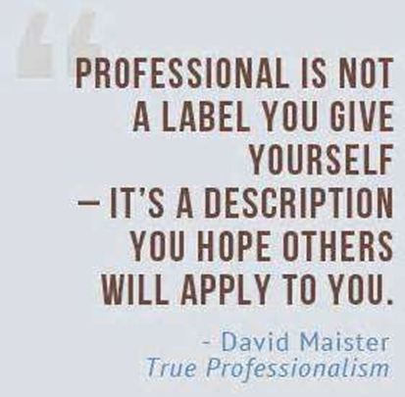
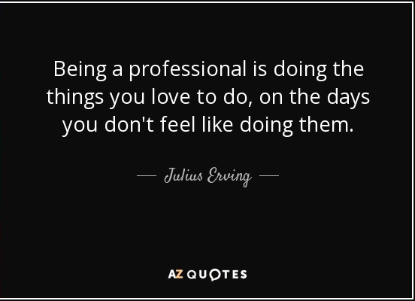
The 3C’s of Professionalism
Notes:
Professionalism and professional are two words we hear a let about in our schools. As we know, professionalism is part of our job evaluations. Some people say that professionalism is hard to measure, but you know it when you see it. So let’s delve into professionalism what professionalism is all about.

Slide 2
Who is a Professional?
A professional is a member of a profession or any person who earns their living from a specified professional (educating) activity.
2. What does the term professional mean? See # 1
3. What does para mean? A prefix with many meanings, including: alongside of, beside, near
4. Are paraprofessionals professionals? See # 1

Slide 3
Being a Professional
Being a professional is an equal opportunity aspiration and is not an exclusive domain based on education or pedigree. Yet, it’s important to note that being a professional is not defined by what the person does (technical competence) but rather how the individual goes about doing what they do.
A paraprofessional doesn’t view his or her profession as just a job, but rather sees it as a calling that is all about caring for children. The ability to make personal connections with students is an identifiable trait of a successful educator (Pajak 2001).
Notes:
How we go about our job is professionalism. Professionalism is acting like a professional.

Slide 4
Characteristics of a Professional
Honest
Competent
Courteous
Reliable
Considerate
Cooperative
Committed
Collaborative

Slide 5
How Do You Define Professionalism?
“‘Professionalism’ is commonly understood as an individual’s adherence to a set of standards, code of conduct or collection of qualities that characterize accepted practice within a particular area of activity.” _{Universities UK et al. 2004}
The skill, good judgment, and polite behavior that is expected from a person who is trained to do a job well.
Professionalism is defined by our inner character, the behavior we exhibit, and the image we project.
Professionalism demonstrate a commitment to carrying out professional responsibilities and an adherence to ethical principles.
Professionalism is the way a person conducts himself or herself in the workplace.
Notes:
Professionalism is acting like a professional.

Slide 6
What is unprofessionalism?
1. Contrary to the accepted code of conduct of a
profession
2. At variance with professional standards or
ethics
3. List 10 things that you consider to be unprofessional for paraprofessionals?
Notes:
Unprofessional behavior is inappropriate behavior
Have three groups of participants read their lists.

Slide 7
Unprofessionalism
Habitual lateness
Excessive absence
Gossiping
Inappropriate dress
Violating confidentiality
Bad attitude
Insubordination
Insults
Profanity
Intimidation/ Bullying
Harassment
Inappropriate communication
Inappropriate relation-ships with student(s)
Being disorganized
Inappropriate physical touching or contact.
Notes:
This list is not exhaustive.
Let’s look at the three Cs of Professionalism next slide

Slide 8
Your Professionalism is Judged By:
Conduct
Communication
Competence
Notes:
This is how you are judged as a professional—by your professionalism or behavior and conduct in the workplace.
Unwritten rules: how you adhere to these unwritten rules: You don’t take other people’s food from the fridge in the staff lounge.
Code of Conduct: How you follow the code of conduct
Culture: How much you follow the school’s culture, which is different from school to school
Expectation and standards: How well you meet the expectations and standards set by the school culture, code of conduct, etc.
One’s personal values: your personal values and ethics and standards that you set for yourself in doing your job
Communication: You communicate appropriately in different situation and don’t gossip.
Image: This is how you portray your self in the work environment: Professional or unprofessional.
Competence: How well you do your job.
Demeanor: You have a pleasant and approachable persona
Appearance: you have the right dress for the right work environment; You are groomed and practice good hygiene
Behavior: your behavior is appropriate and marks you as a professional or unprofessional
Attitude: you have a positive attitude and a problem solving attitude, not a bad unproductive attitude.

Slide 9
Conduct
Respectful
Collaborative/Team work
Punctual
Attitude
Reliable
Regular Attendance
Professional Appearance
Responsible
Notes:
Personal responsibility is the level of commitment you are willing to make in setting and achieving your goals. In other words, personal responsibility means being responsible for your actions, words and, ultimately, your performance at work.

Slide 10
Ethics
Moral principles that govern a person's behavior or the conducting of an activity.
Personal ethics: refers to the moral principles that a person identifies with in respect to people and situations that they deal with in everyday life.
Professional ethics: refers to the moral principles that a person must adhere to in respect of their interactions and dealings in their professional life.
Notes:
Morals are relating to, dealing with, or capable of making the distinction between right or wrong conduct.
principles
standards
beliefs with respect to right or wrong behavior
Professional ethics are the standards of behavior in the workplace.

Slide 11
Making Ethical Choices
Is the action you have arrived at one that lives up to your sense of moral integrity?
(Could I do this and look at myself in the mirror?)
Would it be an action chosen by someone you consider a moral model? (Could I feel good about telling mother/father/minister/significant other I took this action?)
Would you be comfortable if the action or its results were made public?
(What if this became headline news?)
Notes:
As professionals we have to make choices in the workplace.
Sometimes they are hard choices. These are some things
to consider when having to make ethical choices at work.

Slide 12
5 Factors That Demonstrate a Strong Work Ethic
Integrity
Sense of Responsibility
Emphasis on Quality
Discipline
Sense of Teamwork
Notes:
Everyone’s work ethic is different, but here are five factors of a strong work ethic that undermine a person’s professionalism
5 Factors That Demonstrate a Strong Work Ethic
Integrity –(the quality of being honest and having strong moral principles) An employee with integrity fosters trusting relationships with everyone. Coworkers value the employee's ability to give honest feedback. Supervisors rely on the employee's high moral standards, trusting him not create problems.
Sense of Responsibility – Feels personally responsible for job performance always putting in their best effort.
Emphasis on Quality – cares about the quality of their work, not just churning out the bare minimum
Discipline – completes tasks/assignments, stays focused on goals and objectives.
Sense of Teamwork – respect peers and contributes to classroom/school goals.

Slide 13
Communication
Speak Confidently
Speak Politely
Speak Concisely
Smile
Listen Actively
Write grammatically correct
Notes:
Professional communication: Speak confidently = Speak up for yourself keeping your needs and feelings in mind as well as the person that you are talking with.
Speak politely = Speak courteously and politely
Speak concisely = keep the conversation relevant to the topic.
Smile = puts an instant facelift to your voice and tone. Not like a Cheshire Cat
Listen Actively: Use active listening technique to ensure that you understand the person that you are communicating with and they understand you.

Slide 14
Communication is like throwing a ball, once it leaves your hand, you have no control. Once they catch it, then they have control of it. They will interpret the message based on their knowledge and experience. This is where you have the risk of misunderstanding and miscommunication.

Slide 15
Competence
having the necessary ability, knowledge, or skill to do something successfully.
The ability to do your job efficiently and capably
Training Helps you to be competent and stay competent.
Professional Development Ongoing training that provides both refresher sessions and new topics and developments as they occur in special and general education.
Notes:
You must have the skill or expertise to do what the job requires. Competence is obviously a key component of professionalism. You have to know what you and how to do it well. A novice paraprofessional is not as competent as a veteran paraprofessional who has been working for 10 or 15 years. If we need surgery, we want the most experienced surgeon even though the novice surgeon is qualified.

Slide 16
Massachusetts Policies for Instructional
Paraprofessionals in Title I Programs
IV. Ongoing Paraprofessional Training
Once paraprofessionals can demonstrate the skills and knowledge required by the NCLB statute, they should be encouraged to continue to participate in professional development opportunities that address the learning guidelines and promote their continued professional growth. Districts are required to offer these opportunities through the district professional development plan, as outlined in Chapter 71, Section 38Q. Districts and charter schools are encouraged to make use of federal funding available through Title
IA, Title IIA and D, Title III and Title V to help support local professional development programs.

Slide 17
· Instructional paraprofessionals are respected team members responsible for assisting in the delivery of instruction and other student-related activities. As valued members of the faculty, they are essential partners in the work of Title I programs.
· Given their responsibilities, instructional paraprofessionals must be skilled in reading, writing and mathematics, and familiar with instructional practices that ensure and support the achievement of all students.
· To enhance the continuity and quality of services for students,
paraprofessionals must be encouraged and supported in their efforts to
participate in ongoing professional development programs.
· Programs for instructional paraprofessionals are best when they are
comprehensive, acknowledge the diverse roles paraprofessionals play in
schools and provide pathways to further education and teacher licensure, if desired.
Massachusetts Department of Education July 2003

Slide 18
Code of Conduct
A set of conventional principles and expectations that are considered binding on any person who is a member of a particular group
Notes:
We have a code of conduct for our students that establishes acceptable and appropriate behavior. A professional code of conduct does the same thing for professionals. It establishes the standard of behavior and

Slide 19
Code of Conduct
If you wrote a Paraprofessional Code of Conduct what would you include
A code of conduct for para-educators should examine specific responsibilities of the para-educator, as well as the relationships that must be maintained with students and parents, teachers and your school/district.

Slide 20
If the first initial of your last name begins with:
A-G: Write down 3 “codes” you think would fall under the category of “Accepting Responsibilities” in your Code of Conduct
H-M: Write down 3 “codes” you think would fall under the category of “Relationship with Students and Parents” in your Code of Conduct
N-S: Write down 3 “codes” you think would fall under the category of “Relationship with Your Supervisor” in your Code of Conduct
T-Z: Write down 3 “codes” you think would fall under the category of “Relationship with Your School” in your Code of Conduct

Slide 21
Accepting Responsibilities
Engage only in instructional and non-instructional activities for which you are qualified or trained.
Refer concerns expressed by parents, students or others to your supervisor.
Recognize that the supervisor has the ultimate responsibility for instruction and management and follow the prescribed directions.
Help to see the best interests of individual students are met.
Do not communicate progress or concerns about students to parents.
Recognize that the supervisor has the ultimate responsibility for the instruction and behavior management of children and follow the directions prescribed by him/her.

Slide 22
Relationships with Students and Parents
Discuss a child's progress, limitations and/or educational program only with the supervisor in an appropriate setting.
Express differences of opinion with your supervisor only when students are not present.
Discuss school problems and confidential matters only with appropriate personnel.
Respect the dignity, privacy and individuality of all students, parents and staff members.
Be a positive role model.
Do not engage in discriminatory practices based on a student's handicap, race, sex, cultural background or religion.
Use behavior management strategies that are consistent with standards established by the local school district and supervisor

Slide 23
Relationship with your Supervisor
Establish communication and a positive relationship with your supervisor.
Advocate for quality relevant Professional Development Training with your supervisor to enhance student learning and develop your professional competency.
Follow the behavior management approach established by your supervisor
Express differences of opinions when students are not present
Discuss concerns directly with your supervisor. Do not undermine your supervisor by gossiping and side talking
Do not discuss supervisor problems with students, other staff or parents.
If issues cannot be resolved, contact your building representative for further guidance

Slide 24
Relationship with the School
Engage in behavior management strategies that are consistent with standards established by the local school district.
Accept responsibility for improving your skills.
Become familiar with and follow school policies and procedures.
Represent the school and its programs in a positive manner.
When problems cannot be resolved utilize the grievance procedures outlined by the local school district.
You should refrain from:
airing school problems and confidential matters, including personalities, outside of school circles;
discussing administrative, interdepartmental and interschool problems in the presence of pupils; and
gossiping about problems with those who cannot assist in the solution.

