Slide 1

Strategies for Student Success
Words Can Nurture or Hurt

Slide 2
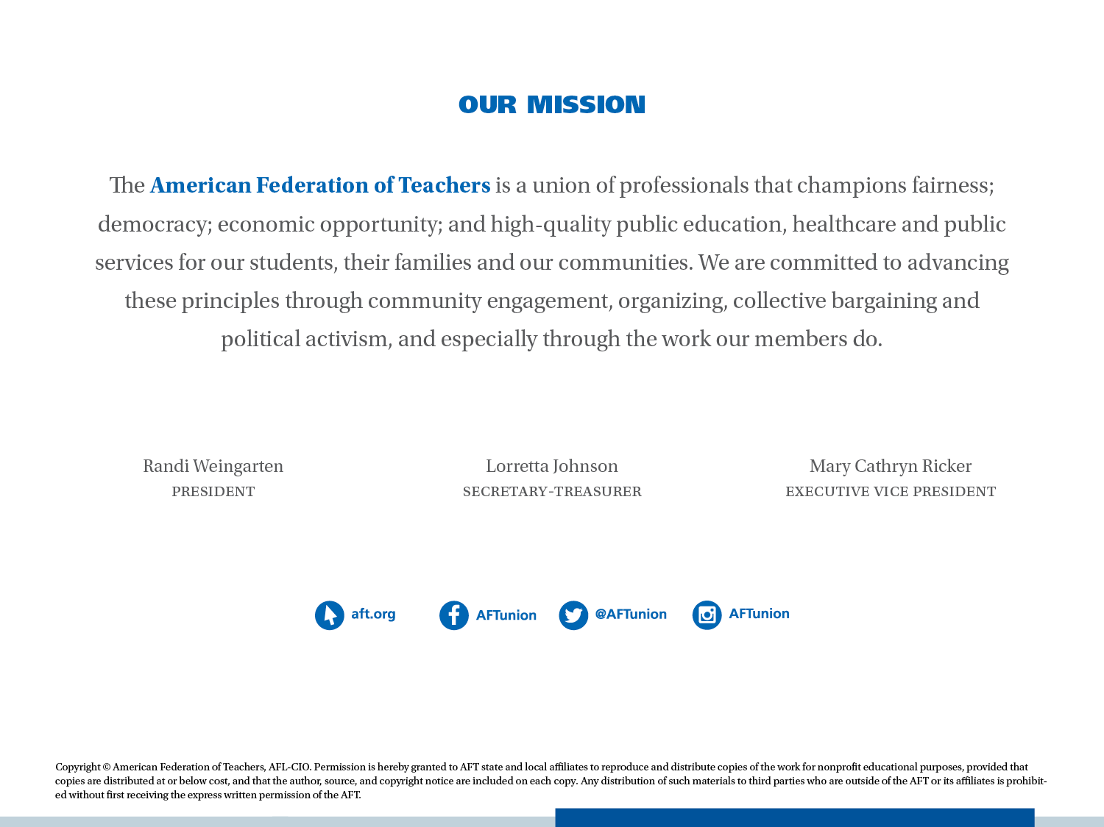

Slide 3

Objectives
By the end of the session, participants will
be able to:
  Assess whether your words hurt or nurture;
  Motivate children without affecting their self-esteem; and
  Better gauge when and when not to give feedback.

Slide 4

Researchers
See p. 1

Slide 5
Activity One
Effective Praise
Directions: Read the lists on p. 3 and circle the action(s) that represents effective praise.
What do you think is the purpose of feedback?

Slide 6

Reading #2
Temperature Check

Slide 7
Activity Two
Praising Bazaar
Directions:
Read your assigned scenario.
Assess the quality of the praise.
(Place the scenario in the context of the age group with whom you work.)

Slide 8
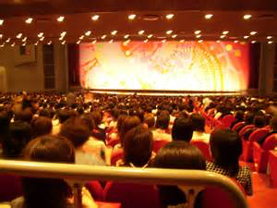
Activity Three
Age-Appropriate Interactions
Directions:
With your tablemates, develop a skit that shows how you would persuade the child to complete the task or demonstrate your reaction to the incident.

Slide 9
Activity Four
Key Feedback Considerations
Directions:
Read the passage, Elements of Effective Feedback, take notes and be able to explain with examples the following:
  Contingency
  Specificity
  Credibility
  Ability-focused
  Effort-focused
  Product- or action-directed
  Person-directed

Slide 10
Activity Five
Situational Studies
Directions:
Read your selected situation and
Give feedback to the individual(s) in your
  situation.
Record your response.
You have 5 minutes to complete your assigned
  study.

Slide 11

Activity Six (a)
Stand Up!
Directions:
Stand if you think this feedback is effective.
Write I near the statements you did not think were effective.
Be prepared to explain how the educator could have been more effective.

Slide 12

Activity Six (b)
A Word on Pitfalls
Directions:
Record notes from the lecture and share your notes with your shoulder partner.

Slide 13

Feedback Pitfalls

Slide 14

Social comparisons as well as predictable forms of feedback have an inverse relationship on student motivation. Feedback should be timely but unexpected.
(Henderlong, 2002)

Slide 15
The Malleable view sees levels of ability as dependent on effort. One who holds this view is in control of the outcomes. Failure can be addressed by their efforts.
The Fixed view perceives the situation as unchangeable. Nothing they do will change the existing outcome.

Slide 16

Feedback Pitfall Wrap-Up
Never use praise to control behavior.
(Deci, Koestner & Rizan, 1999)
Avoid feedback that will be interpreted
as an assessment of ability.
(Brophy, 1981)
Students make strong connections
between ability level of intelligence
and self-concept (older students
especially). (Muller,1998; Dweck, 1998)
How students react to your praise is dependent on whether they view their ability level as fixed or malleable. (Dweck and Legget,1988)

Slide 17

Activity Seven
Breakthrough
Directions:
Watch the video clip and respond to
the following questions.
What was the message of the educator to the parents?
How did she quell their apparent apprehension of where the visit would go?
Have you had an experience where you found it difficult to talk to a parent or student? What happened?

Slide 18
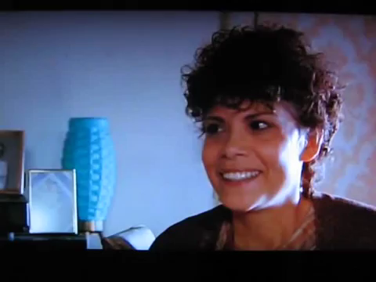

Slide 19

Activity Eight
A Conversation
Directions:
Outline a report you would give to a parent to whom you were offering feedback on their child’s progress. The child in question has been and still is difficult. Be creative.

Slide 20
Activity Nine
Words
Directions:
Think of a time when you had to give your opinion to a colleague.
What did you say and now that you have this information, did you handle the situation appropriately? (The situation could focus on a hairstyle, clothing, a trip or how to handle a particular child.)

Slide 21
Closure: My Thoughts
Directions:
Complete the following stem:
  Now I know that when I say…
  children hear ……
Give us examples of things you
will change because of the
information you have learned.

